Slide 1


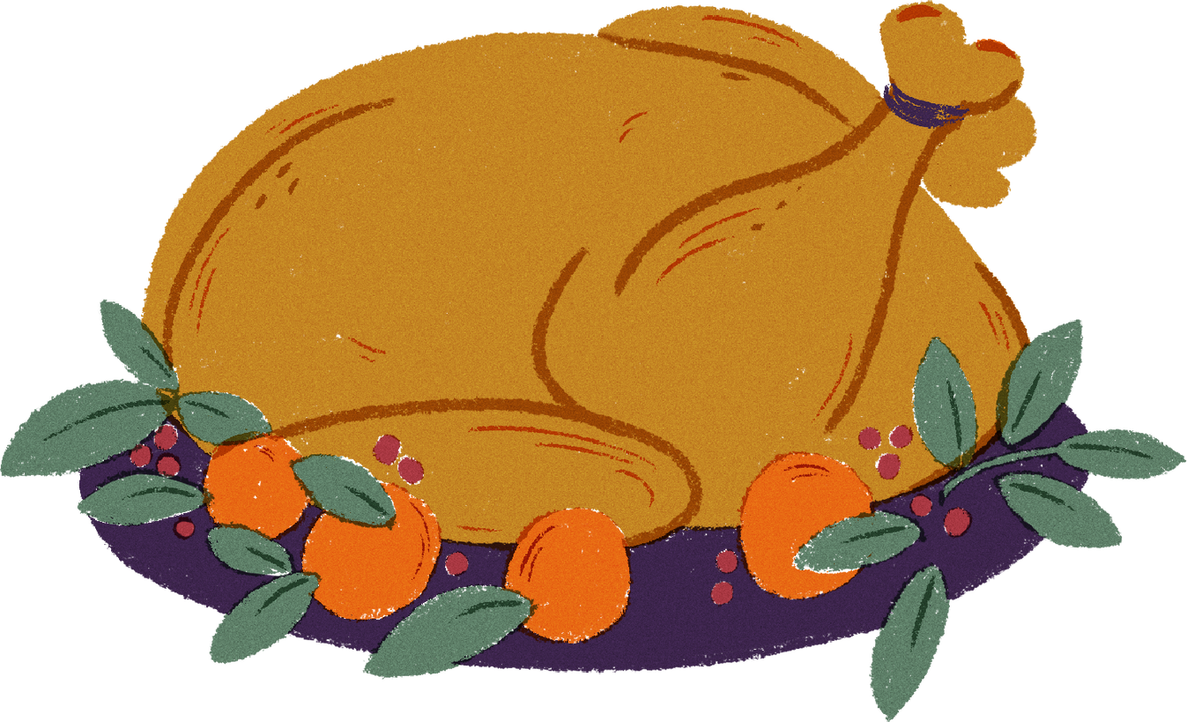
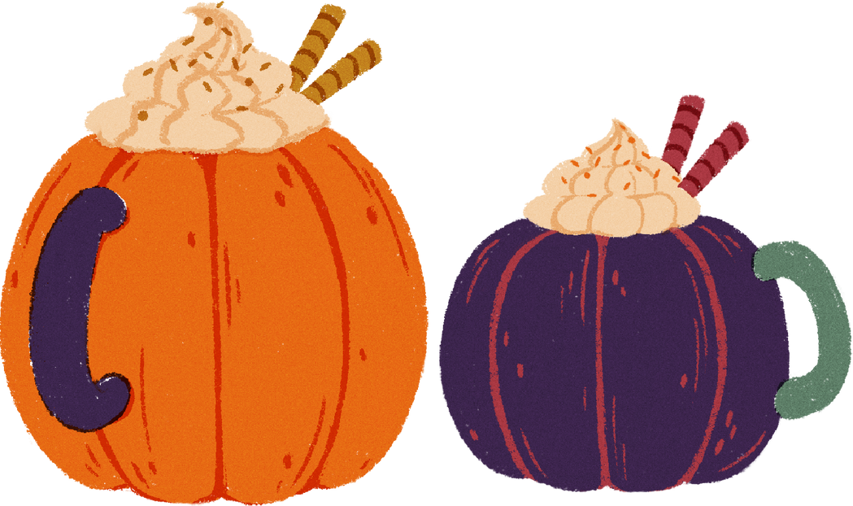
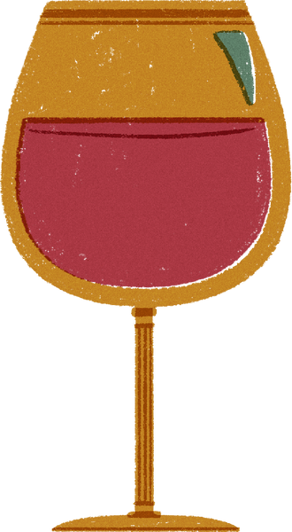
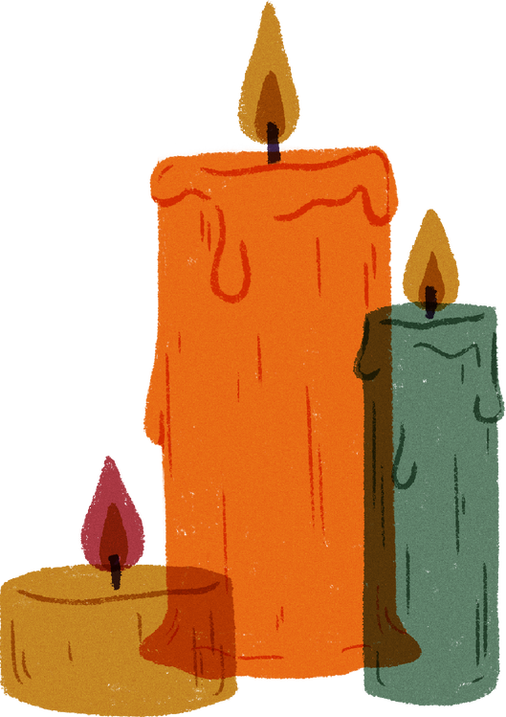
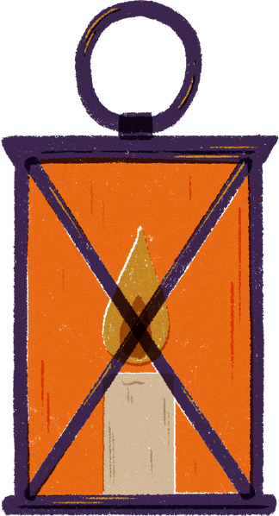
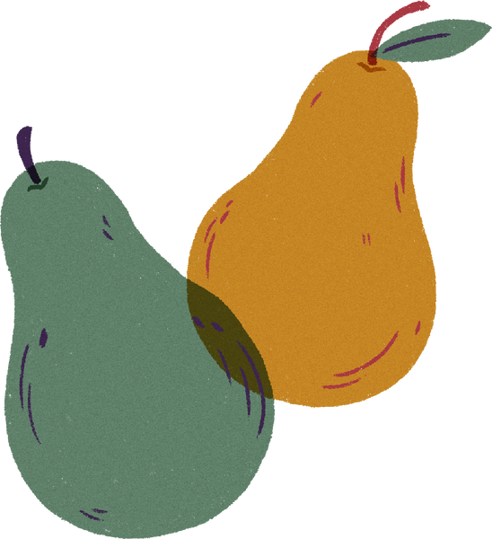
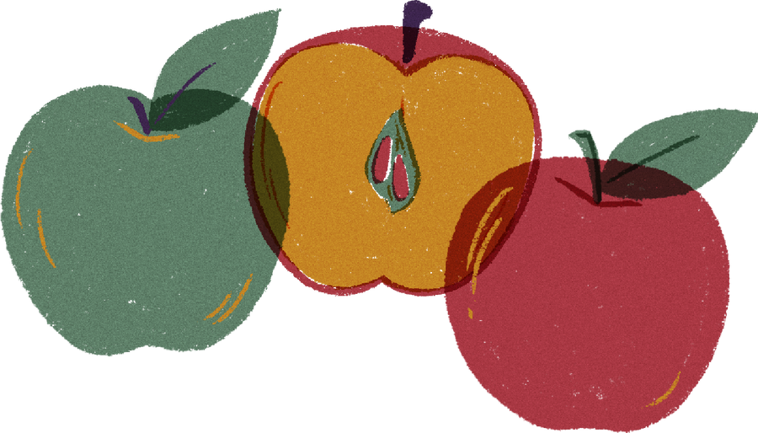
THANKSGIVING
MARKETING

Slide 2
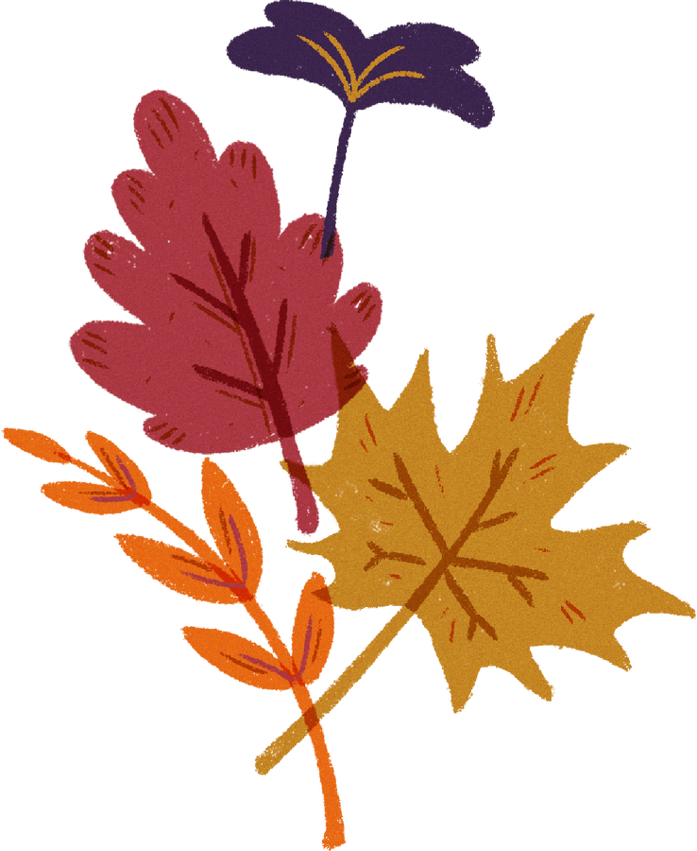
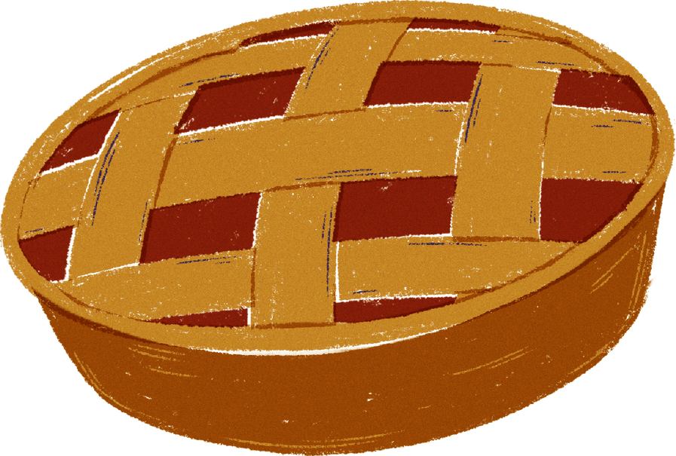
Thanksgiving Brands
  A Houston Chronicle story suggests that much of what we celebrate on Thanksgiving is the direct result of marketing.
  Over time, some brands have become synonymous with Thanksgiving feasts, with consumers filling supermarket shopping carts with these products every year.
  In this presentation, we will identify the most popular Turkey Day brands based on category, according to market research from IRi, a consumer data and analytics firm.

Slide 3
Thanksgiving Brands
  Before reviewing the presentation, ask yourself what brands played a role in your Thanksgiving Day meals? There are far more than you probably considered!
  Which brands do you think are big sellers over the Thanksgiving holiday?
  Try to create a list of at least five popular Thanksgiving related food brands, then see if you were able to identify some of the most popular brands by category (like turkey or butter).

Slide 4
Most Popular Turkey Brand

Slide 5
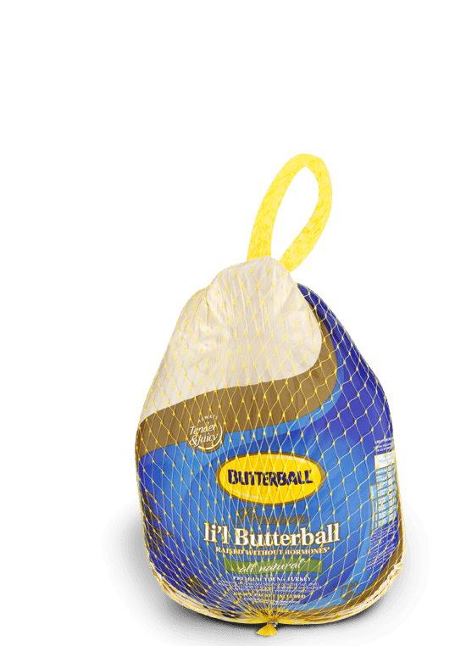
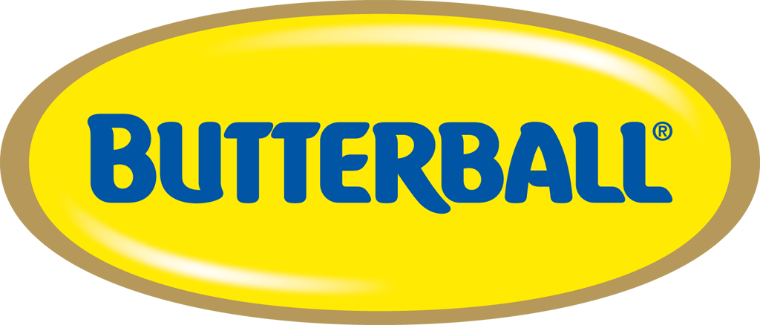
Most Popular Turkey Brand

Slide 6
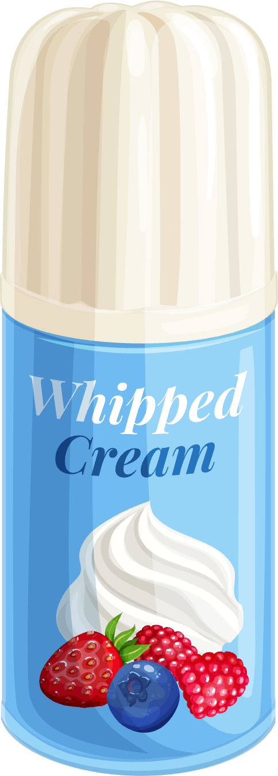
Most Popular Whipped Cream Brand

Slide 7
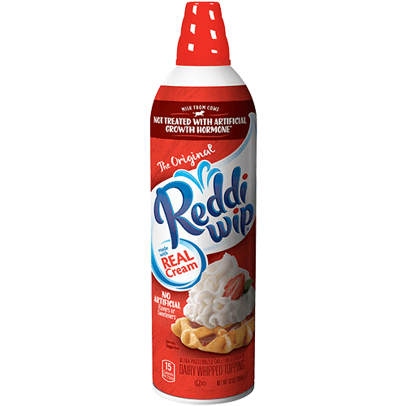

Most Popular
Whipped Cream Brand

Slide 8
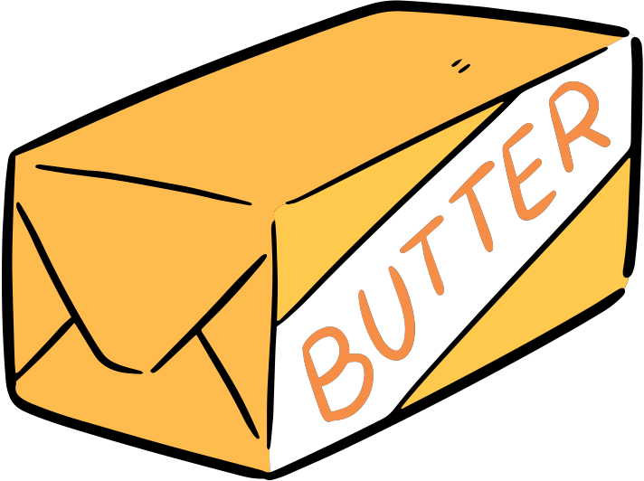
Most Popular Butter Brand

Slide 9
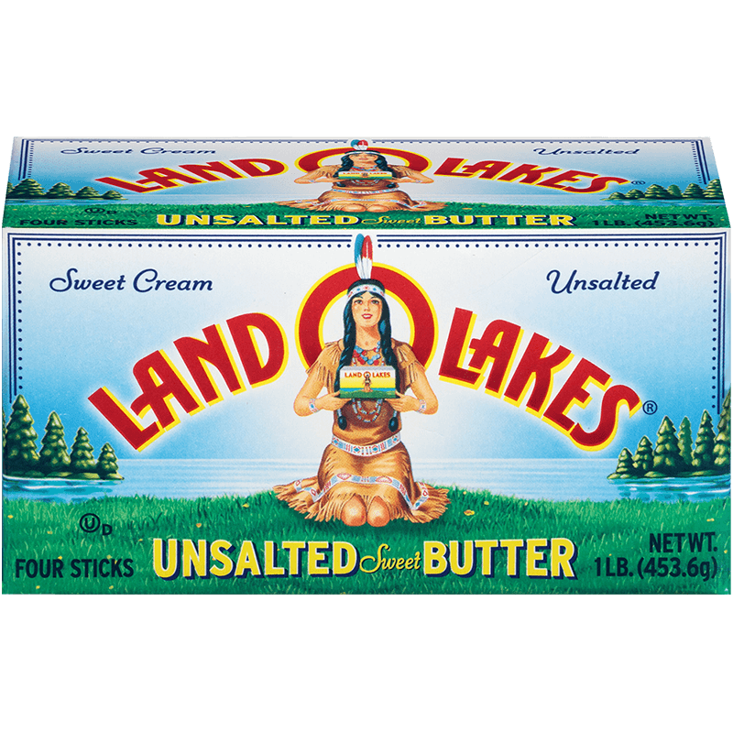
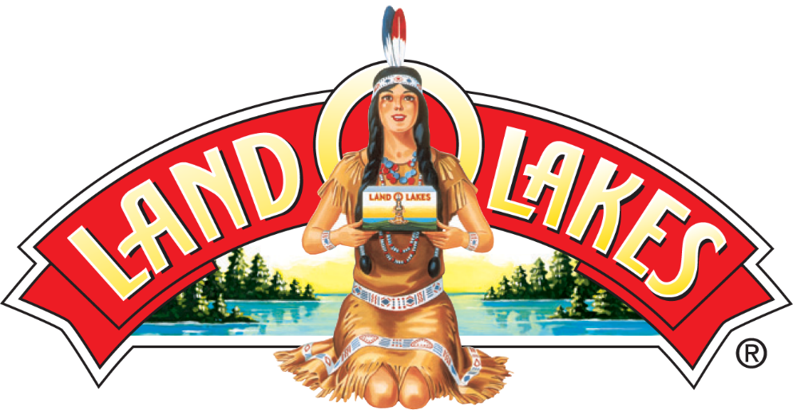
Most Popular
Butter Brand

Slide 10
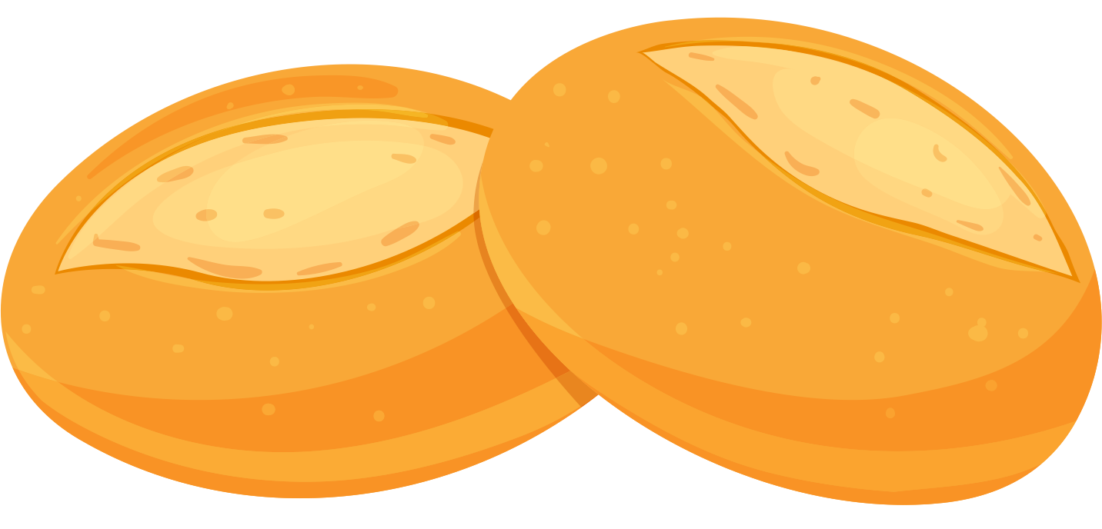
Most Popular
Rolls Brand

Slide 11
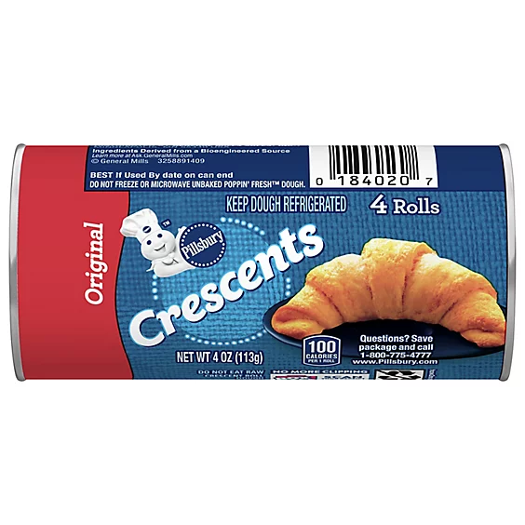
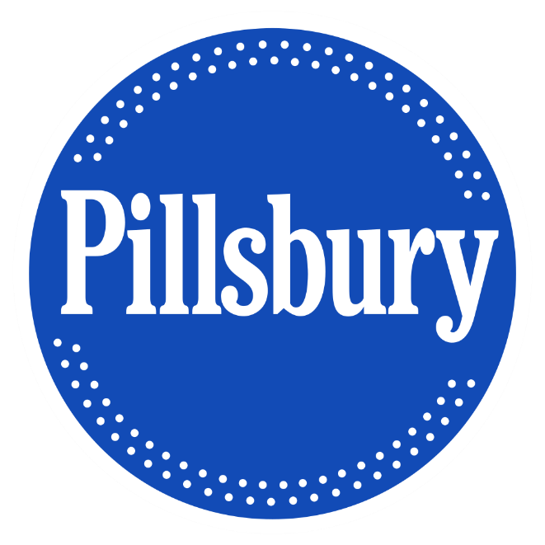
Most Popular
Rolls Brand

Slide 12
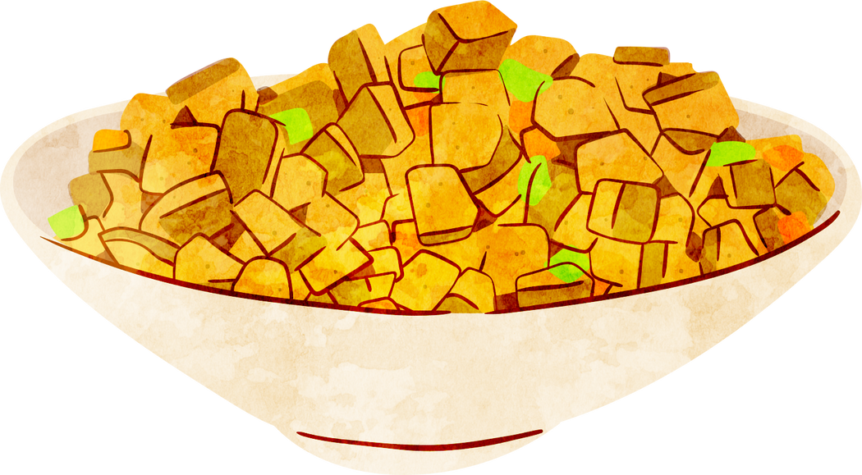
Most Popular Stuffing Brand

Slide 13
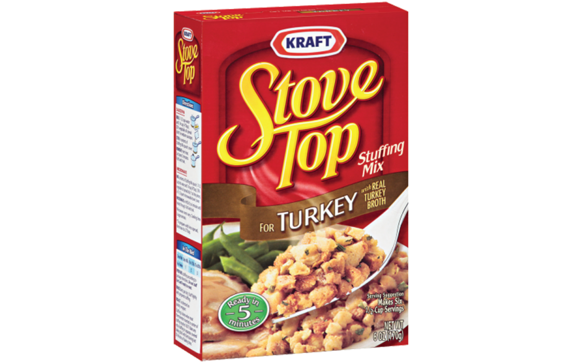
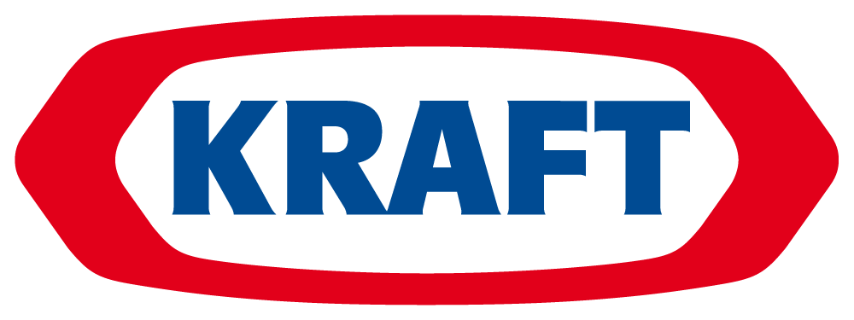
Most Popular
Stuffing Brand

Slide 14
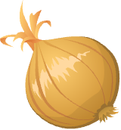
Most Popular Toppings

Slide 15
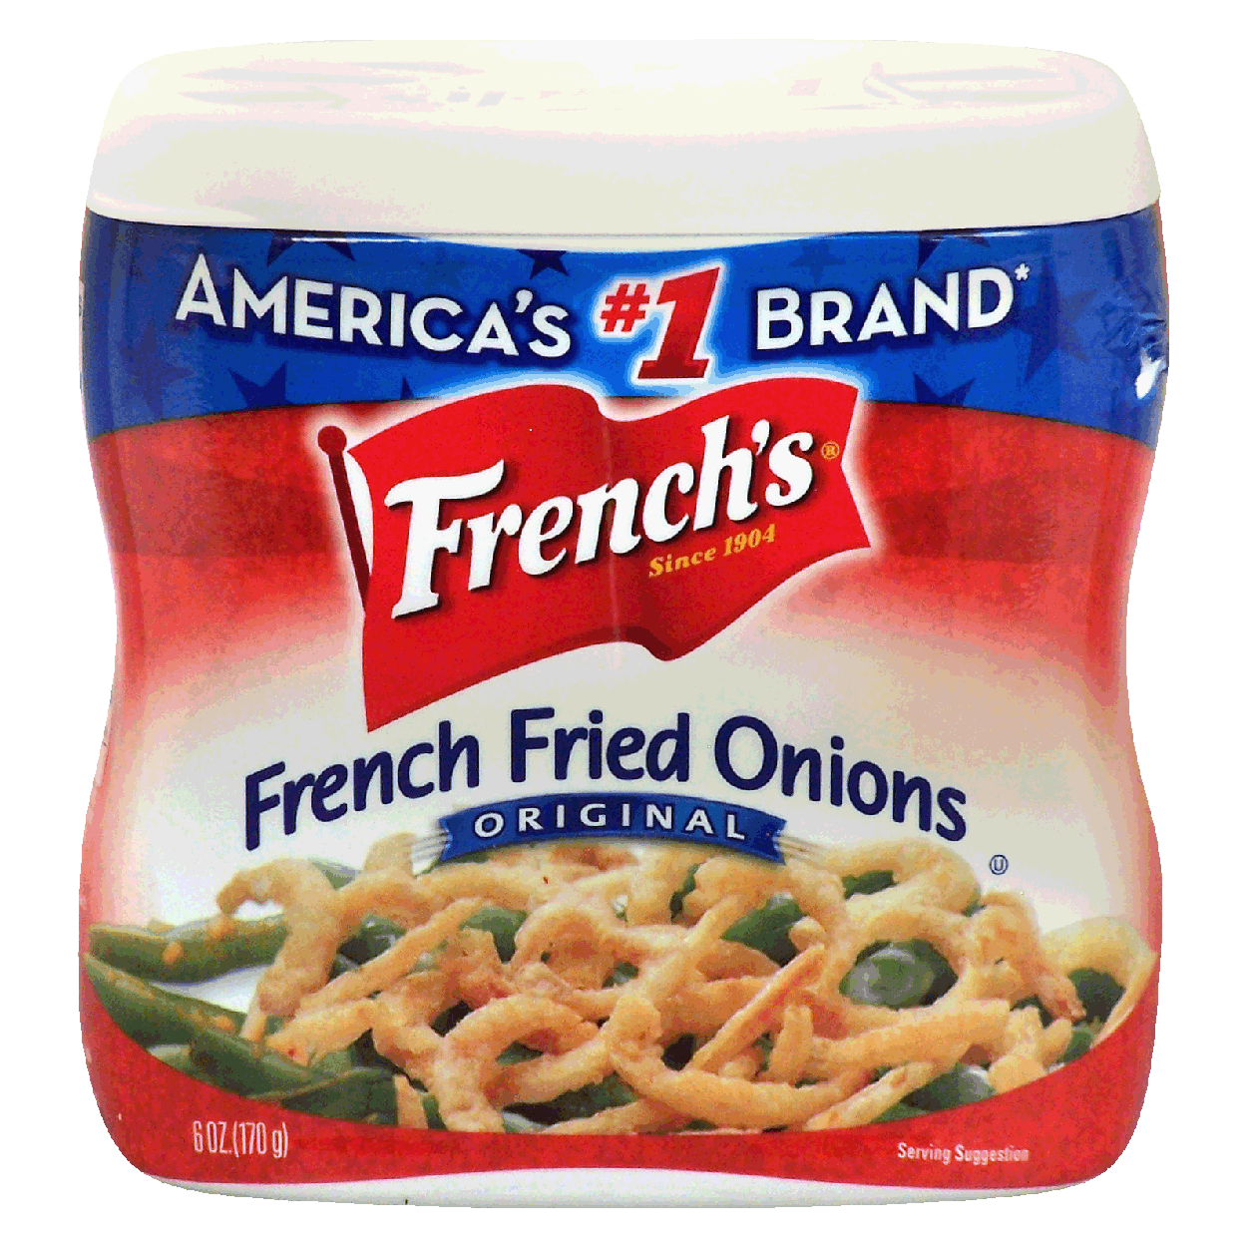
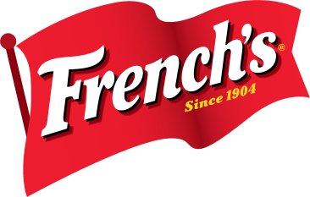
Most Popular
Turkey Day Toppings

Slide 16

Most Popular Pumpkin Brand

Slide 17
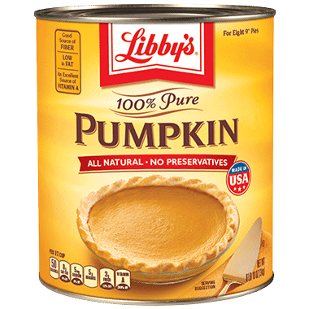
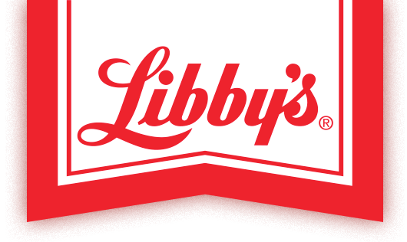
Most Popular
Pumpkin Brand

Slide 18

Most Popular Cranberry Product

Slide 19
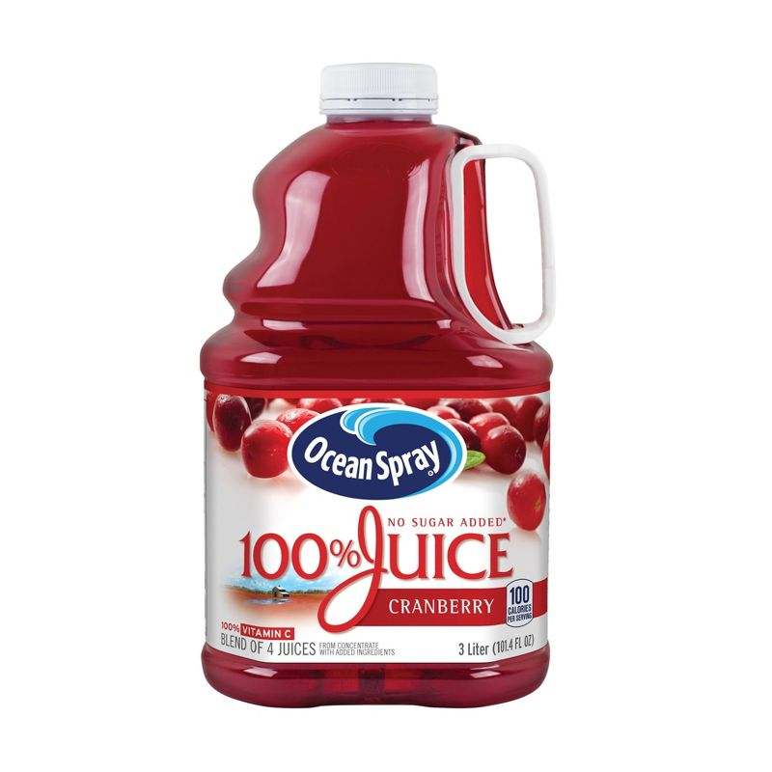
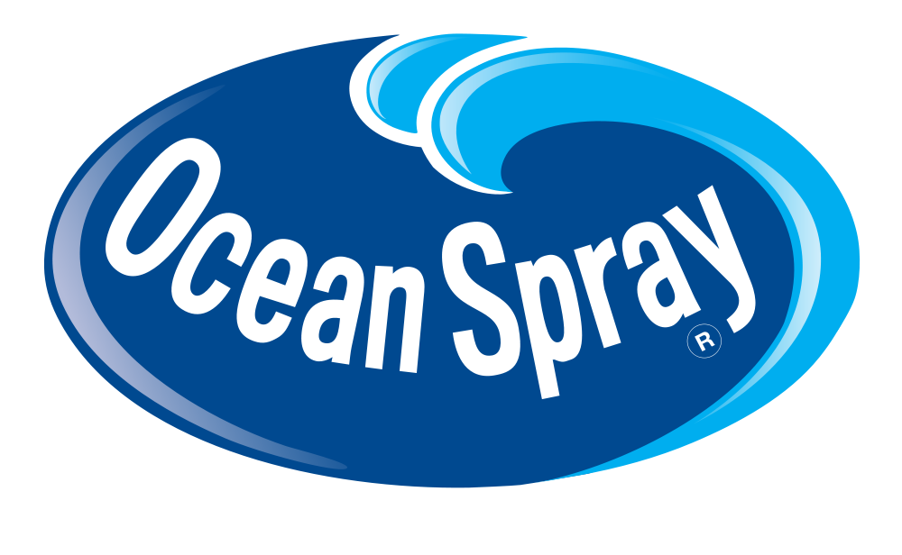
Most Popular
Cranberry Product

Slide 20
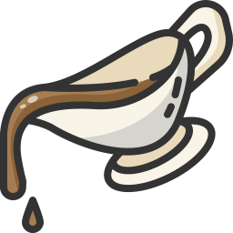
Most Popular
Gravy Brand

Slide 21
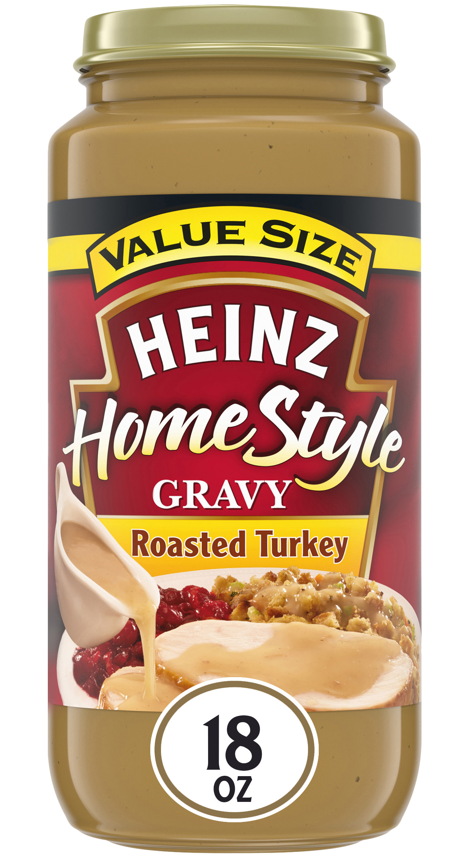

Most Popular
Gravy Brand

Slide 22
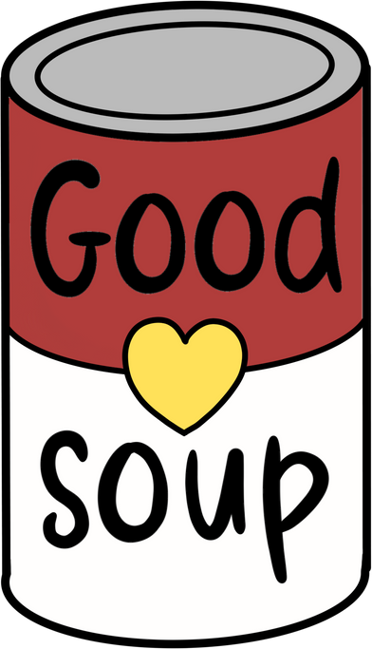
Most Popular
Soup Brand

Slide 23
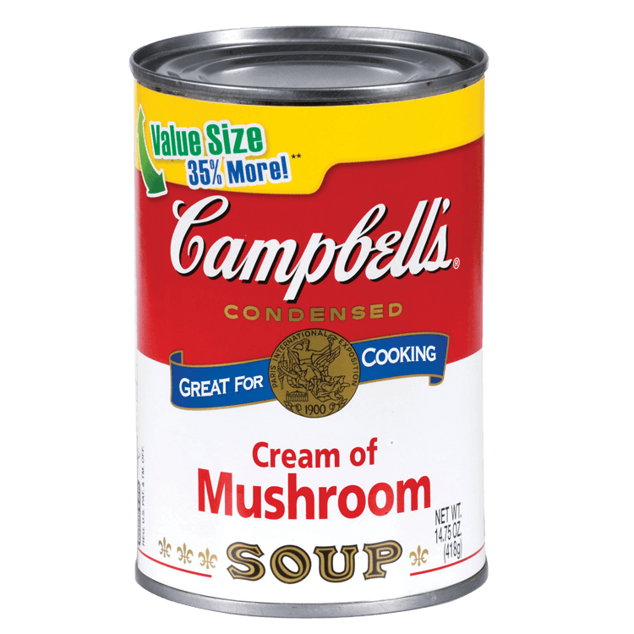
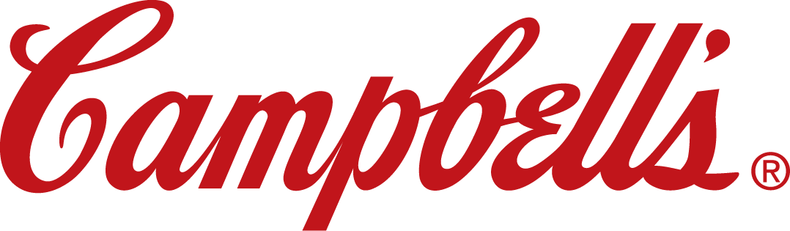
Most Popular
Soup Brand

Slide 24

Discussion
  How many of the most popular Thanksgiving brands were you able to identify?
  What are some other brands that might be popular Thanksgiving staples?
  What is positioning?
  How do you think positioning has played a role in the brands identified in this presentation as the most popular Thanksgiving brands?
  How might businesses and brands study consumer behavior and trends to shape the strategies they use to market their products leading up to Thanksgiving?
  Choose one of the brands reviewed in this presentation. What type of promotion and marketing would you engage in to boost sales over the holiday?

