Slide 1
GoesPublic

Slide 2
WATCH NOW: How Birkenstock Became a Cult Classic

Slide 3
PART ONE
A HISTORY OF ENTREPRENEURSHIP & INNOVATION
Entrepreneurs offer a product or service that meet consumer wants or needs not currently being met in the marketplace.
Entrepreneurs solve an existing consumer problem through invention (creating a new product or service) or innovation (improving an existing product or service).
Entrepreneurship and innovation are the genesis of the Birkenstock sandal and are foundational to the company’s success.
Birkenstock has stayed true to their core innovation and product: a comfortable, ergonomic shoe.

Slide 4
1774 HUMBLE ORIGINS
Johann Birkenstock is listed as “subject and cobbler” in the records of a small church in Germany. This is the first record of the Birkenstock family as shoemakers.
In 18th century Germany, the average person owns one pair of shoes and would take their shoes to a cobbler for repair.
1873 INNOVATION
In 1873 Johann’s grandson Konrad Birkenstock invents the three-dimensional last (a form in the shape of a foot, with a curved sole, arch and heel, around which shoes could be built).
Through this innovation, Konrad Birkenstock seeks to improve foot health and comfort.
Prior to 1873, most shoes are made with flat soles and have no differentiation between the right and left foot.
LEFT: 3-Dimensional Shoe Last (BIRKENSTOCK)
RIGHT: Konrad Birkenstock in 1924 (BIRKENSTOCK)

Slide 5
INNOVATION RESISTANCE
Initially, shoemakers are resistant to the innovative three-dimensional last. Even though they know that the innovation could improve the quality of their product, implementing its use would result in a greater workload and cost.
Despite this resistance, the three-dimensional last eventually becomes the basis for all modern footwear.
3-Dimensional Shoe Last (BIRKENSTOCK)

Slide 6
1896
Konrad Birkenstock sells all his possessions to open a shoemaker's workshop in Frankfurt.
1896 INNOVATION
Konrad Birkenstock designs contoured insoles and footbeds to be used by shoemakers in the production of custom footwear.
(Complete Birkenstock)
1899-1914 EVANGELIZING
Konrad Birkenstock gives lectures to master cobblers, guilds, and tradespeople, explaining his custom-made footwear design and sells licenses allowing others to produce his innovative footbed shoe design.
Custom footbeds enable cobblers to give their shoes a better fit.
BIRKENSTOCK footbed boxes
(BIRKENSTOCK, 2023)

Slide 7
1902-1909 INVENTION
1902 Konrad Birkenstock invents the first flexible insole. The flexible insole allows a shoe to roll from heel to toe as the insole flexed, better replicating a human’s natural foot motion while walking.
In 1909 Konrad Birkenstock files patents for the flexible insole along with the contoured footbed.
A patent is a legal registration that protects an invention from being copied.
BIRKENSTOCK flexible insole, 1910s
(BIRKENSTOCK, 2023)
1910
Due to financial difficulties Konrad Birkenstock is forced to sell his patent for the flexible insole and move operations out of Frankfurt.
1910
PASSION OVER PROFITS
Konrad Birkenstock’s drive to innovate causes him to neglect product sales.
Billboard for the BIRKENSTOCK footbed, 1920s (BIRKENSTOCK, 2023)

Slide 8
1920s TURNING POINT
In 1925, Konrad Birkenstock registers the "Footbed" trademark.
Demand for contoured footbeds and flexible insoles skyrocket just after the First World War.
Konrad Birkenstock, along with his son Carl open a new factory in Friedberg, Germany while Konrad travels throughout Germany, Austria and Switzerland lecturing shoe manufacturers on the merits of his footbed. He even licenses other cobblers to produce footbeds using his technique.
Attendees at a Birkenstock training course, 1935
(BIRKENSTOCK, 2023)
Even though much of Europe struggles financially during the years following WWI, Birkenstock footbeds sell extremely well.
Purchasing new insoles is a cost-effective way to prolong the life of a pair of shoes.
Advertisement for the BIRKENSTOCK footbed, 1920s (BIRKENSTOCK, 2023)

Slide 9
1936 THE IDEAL SHOE
In 1936, Konrad Birkenstock patents the “Ideal Shoe” which features the signature Birkenstock footbed, fused to a flexible insole and two leather straps.
The design would become the precursor to the Original BIRKENSTOCK Footbed Sandal which would be released in 1963.
1950
Konrad Birkenstock passes away and never sees his Ideal Shoe design come to market as factory-produced footwear.
BIRKENSTOCK’S “blue” footbed, 1930s
(BIRKENSTOCK, 2023)
1947 THE CARL BIRKENSTOCK SYSTEM
Konrad’s son, Carl Birkenstock, effectively positions the BIRKENSTOCK brand as “healthy footwear” with the publication of “Podiatry – The Carl Birkenstock System.”
With 14,000 copies printed, “Podiatry – The Carl Birkenstock System“ becomes the best-selling textbook on podiatry of the time.
“The Carl Birkenstock System”
(BIRKENSTOCK, 2023)

Slide 10
1963 READY TO WEAR
In 1963, Carl Birkenstock’s son, Karl, launches the Original BIRKENSTOCK Footbed Sandal as the company’s first ready to wear, mass-produced footwear.
Even though sales are slow, Karl Birkenstock continues to innovate with footwear designs through out the 1960s, maintaining the same footbed design while changing the shoe’s upper.
Marketed as the worlds first fitness sandal, the Original BIRKENSTOCK Footbed Sandal (renamed Madrid in 1979), features a single strap over the toes and a deep, flexible footbed, like those found on Birkenstock sandals today.
ORIGINAL BIRKENSTOCK FOOTBED SANDAL (BIRKENSTOCK, 2022)
1966 BIRKENSTOCK COMES TO THE THE USA
In 1966, Margot Fraser, a Berlin-born, American dressmaker, visits a German spa where she discovers the Original BIRKENSTOCK Footbed Sandal as an antidote to her chronic foot pain. Inspired by the shoe’s health benefits, she decides to import BIRKENSTOCK sandals to the USA.
1971 EXCLUSIVE US IMPORT RIGHTS
In 1971, Margot Fraser negotiates exclusive US import rights, and incorporates her trading company called Birkenstock Footprint Sandals, Inc. in California.
Margot Fraser in front of a Birkenstock van
(Complete Birkenstock)

Slide 11
1973 ARIZONA SANDAL
BIRKENSTOCK’s now-iconic Arizona sandal is introduced in 1973, and the US Birkenstock Import business takes off.
The sandals are popular amongst the counterculture due to their unconventional appearance and aligned values (health, comfort).
Over the next 30 years the US import business grows into a multi-million-dollar operation.
Margot Fraser is credited with kickstarting the global success of Birkenstock.
1980s SALES BOOM
With an increase in the number of styles and a resurgence in the popularity of 1960s ‘Hippie’ culture, Birkenstock sales boom.
1985
Birkenstock offers over 40 style and color combinations.
BIRKENSTOCK catalog, 1980s
(BIRKENSTOCK)

Slide 12
1988
CONTINUED INNOVATION
BIRKENSTOCK begins to use environmentally friendly adhesives in the production of their footwear, setting a new standard for environmental awareness worldwide.
(Complete Birkenstock)
1990 EXPANSION
BIRKENSTOCK expands and modernizes its production facilities. Through this modernization, BIRKENSTOCK reduces their energy consumption by over 90%.
1996
BIRKENSTOCK now offers almost 300 style and color combinations. The footwear is worn by millions of people throughout the United States.
(Complete Birkenstock)

Slide 13
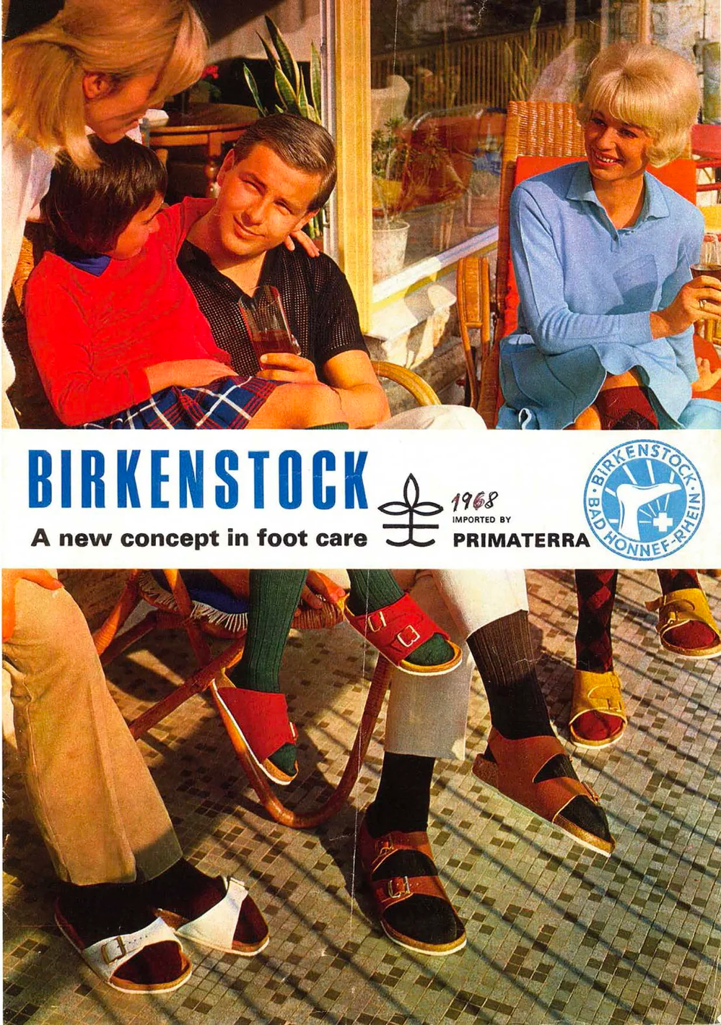
PART TWO
MARKETING: FROM THE COUNTERCULTURE TO POP CULTURE
With its business firmly rooted in podiatry, and a core philosophy of “function over form,” BIRKENSTOCK has always marketed its shoes as a health-conscious footwear choice.
However, over the years, BIRKENSTOCK has transitioned from being the footwear of choice for the counterculture, to entering the mainstream, and even foraying into the realm of high fashion.

Slide 14
POSITIONING
With the growth of BIRKENSTOCK as a global footwear powerhouse, the company continues to position their product as health and comfort footwear. Even as the company grows, and with the introduction of new styles, the shoe‘s flexible, contoured footbed remains essentially unchanged.
Positioning is how businesses create consumer perception and fix their brand in the minds of consumers.
(Heddels)

Slide 15
US MARKET
A ROUGH START
Initially, Margot Fraser struggles to get her imported BIRKENSTOCK sandals placed in shoe stores, and instead, finds a home for her shoes in California health food stores. This placement reinforces the brand’s alignment with health benefits.
1967 SUMMER OF LOVE
Over 100,000 young people descend on San Francisco’s Haight-Ashbury neighborhood during the Summer of Love. BIRKENSTOCK is positioned in the right place at the right time and their sandals become the shoe of choice of young people in the counterculture.
Fantasy Fair and Magic Mountain Music Festival, June 1967
(realsanfranciscotours.com)
1972
ENTERING THE SHOE MARKET
In 1972 Margot Fraser is finally able to get her BIRKENSTOCK sandals into shoe stores. This transition is made possible by the popularity of the shoe amongst Baby Boomers, who are beginning to have greater buying power and market influence.
“It was this perfect moment. The culture was ready for such modern, convention-breaking shoes.”
Andrea Schneider-Braunberger
Curator, BIRKENSTOCK Historical Archive

Slide 16
ONGOING
MARKETING STRATEGY
As BIRKENSTOCK gains popularity with new, young audiences, BIRKENSTOCK continues to promote their shoes to everyone – housewives, students, doctors, chefs, and anyone who can benefit from wearing a comfortable shoe.
Vintage BIRKENSTOCK advertisement
(via Ann Harbor District Library)
1970s BIRKENSTOCK advertisements
(BIRKENSTOCK)

Slide 17
WOMEN DRIVE BIRKENSTOCK’S SUCCESS
Although BIRKENSTOCK markets their sandals as unisex, Margot Fraser’s focus on the female market paid off exponentially.
“She paid attention to women—and it paid off. They were her first customers. They were also her best customers.”
Wall Street Journal
BIRKENSTOCK credits “the breakthrough of modern feminism,” and rejection of fashion norms, as a key driver of its business.
Vintage Birkenstock Advertisement
(BIRKENSTOCK)
72%
Percentage of Birkenstock customers that are female in 2022.
Margot Fraser
(BIRKENSTOCK)
Vintage Birkenstock Advertisement
(Ann Arbor Library)

Slide 18
1990 BIRKENSTOCK
ENTERS HIGH FASHION
The July 1990 issue of The Face magazine features a then unknown model named Kate Moss in a photo spread entitled “The Third Summer of Love.“
This spread is one of the first appearances of BIRKENSTOCK footwear in a fashion magazine.
“There was a new democratic freedom to express yourself, be different and also be true to yourself. The images became iconic, a personification of a youthquake, the so-called 3rd Summer of Love.“
Melanie Ward
Stylist
Kate Moss wearing BIRKENSTOCK sandals in a photo spread: “Third Summer of Love”
Photographer: Corinne Day
The Face, July 1990

Slide 19
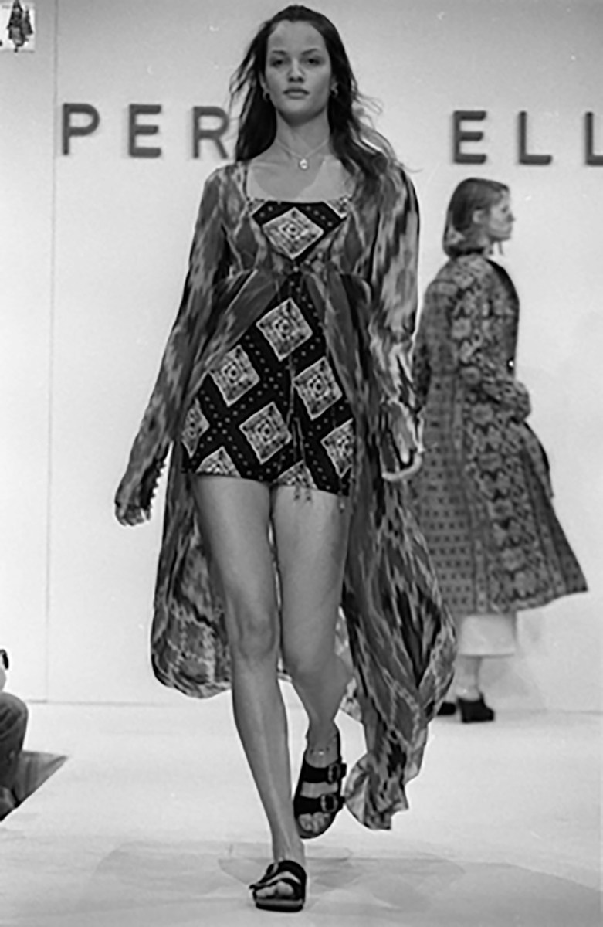
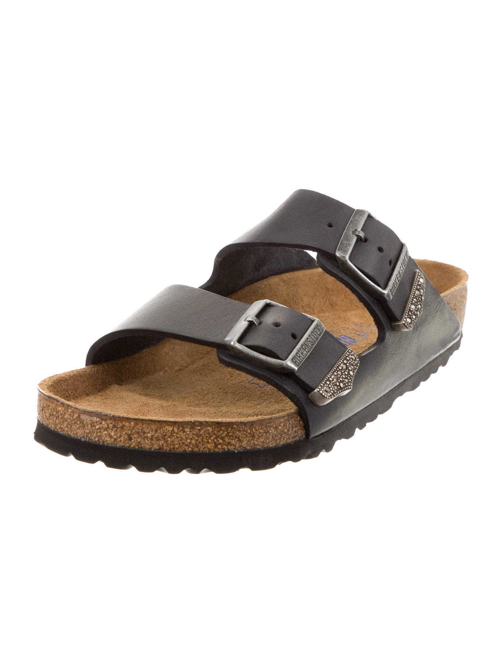
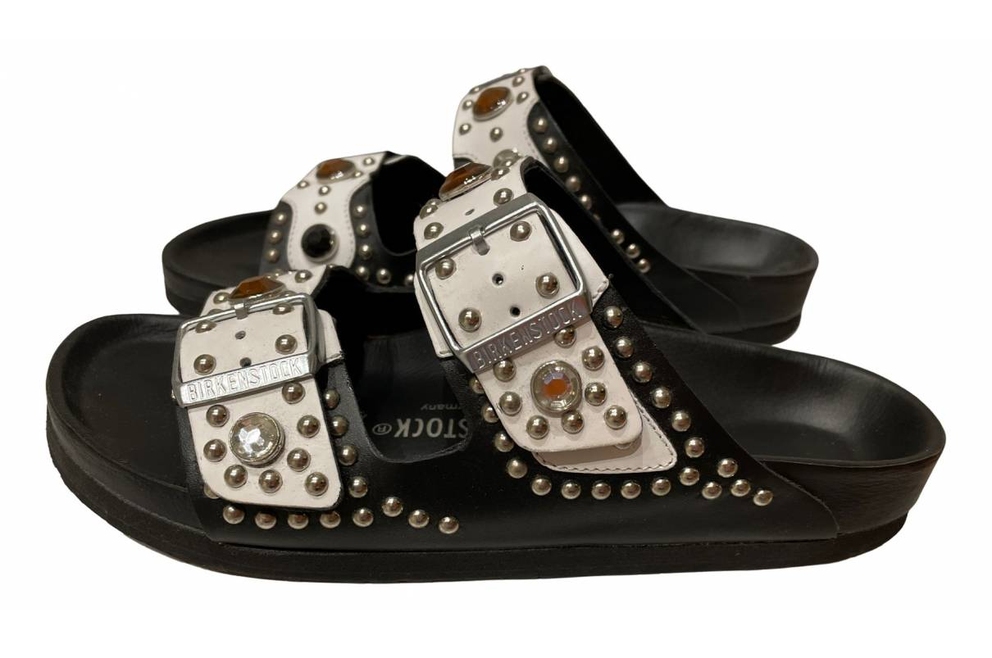
1993
MARC JACOBS
Fashion designer Mark Jacobs features BIRKENSTOCK sandals as a part of his Spring 1993 “Grunge” collection for Perry Ellis.
The show revives the popularity of BIRKENSTOCK sandals and begins a trend of high fashion collaboration that continues to this day.
2018 Marc Jacobs releases re-issued designs from the notorious show, featuring a new collaboration with BIRKENSTOCK.
1993-2018
BIRKENSTOCK DESIGNER COLLABORATIONS
BIRKENSTOCK begins collaborating with fashion designers and luxury goods brands to create limited edition, collectible footwear.
MARC JACOBS for PERRY ELLIS Spring ’93 Fashion Show (FAIRCHILD FASHION ARCHIVES)
MARC JACOBS X BIRKENSTOCK 2018 Redux Grunge Collection (LYST)
2008 HEIDI KLUM x BIRKENSTOCK
(HEIDI KLUM)
2008 BAPE x BIRKENSTOCK
(BAPE)
2010
Futura Laboratories x BIRKENSTOCK
(Futura Laboratories)
2014
Concepts x BIRKENSTOCK
(Concepts)
2018
Rick Owens x BIRKENSTOCK Burning Man
(Rick Owens)

Slide 20
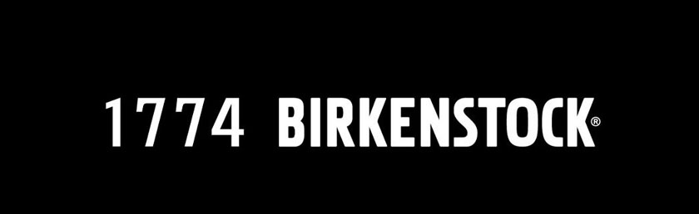
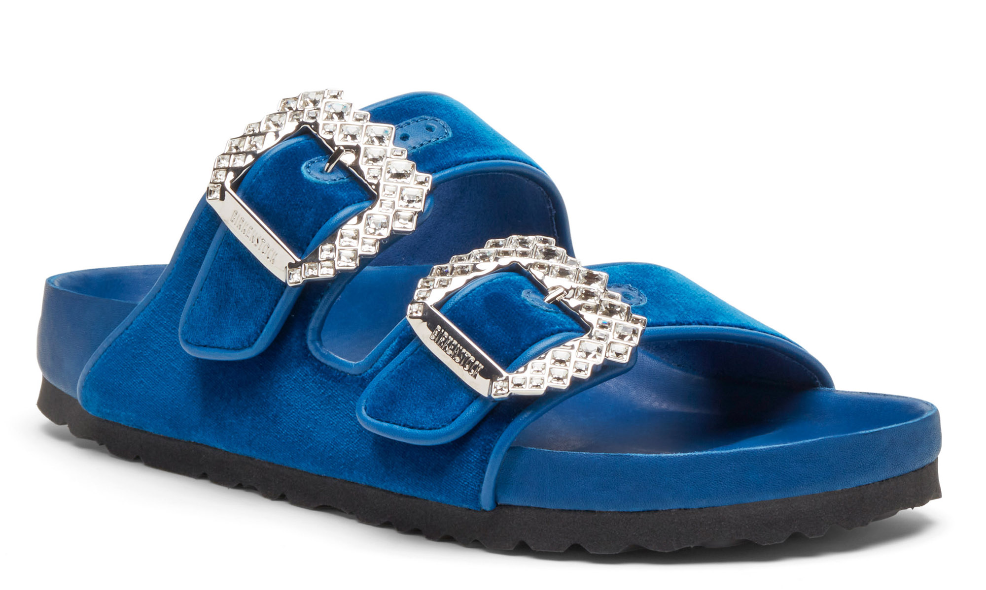
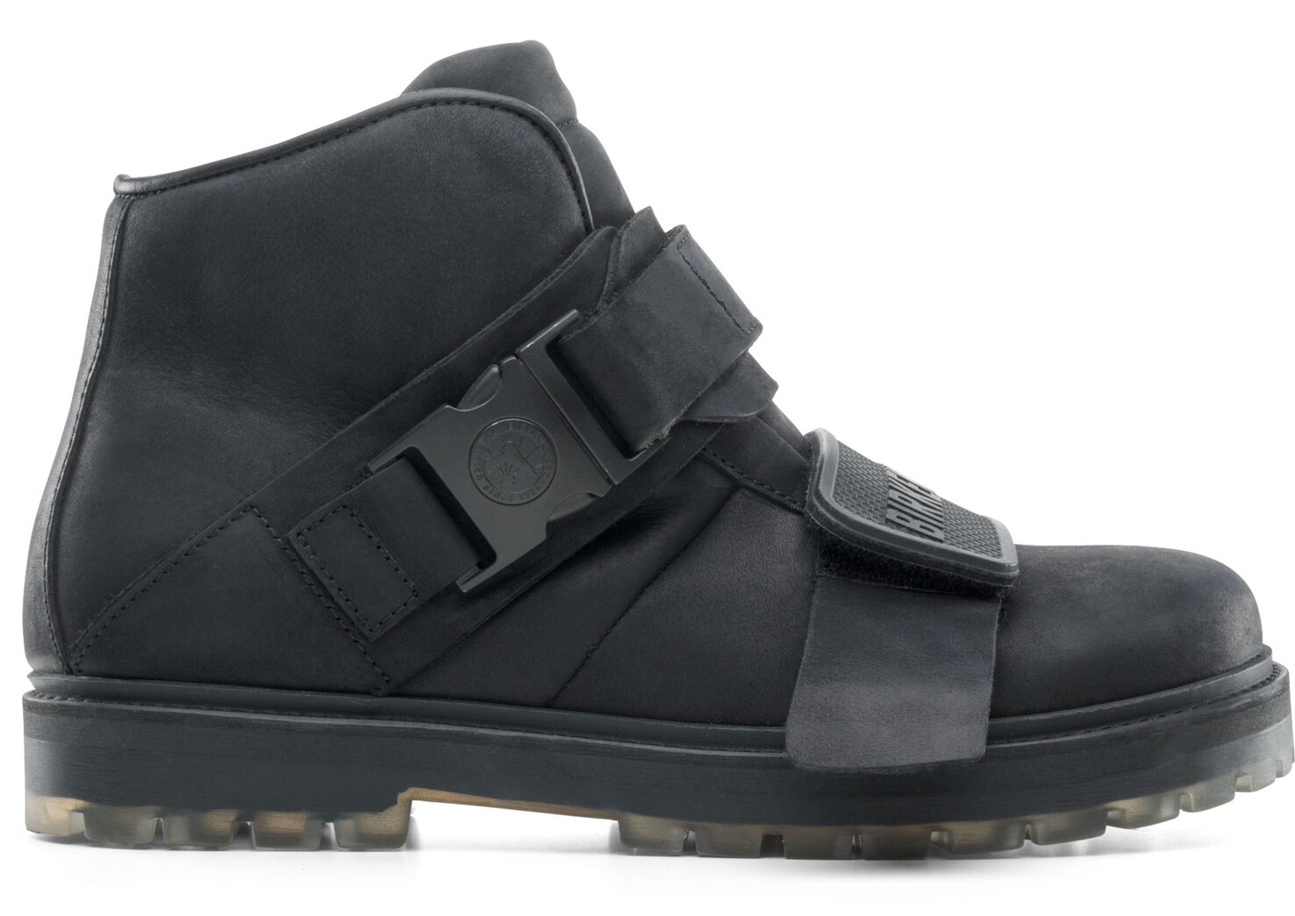
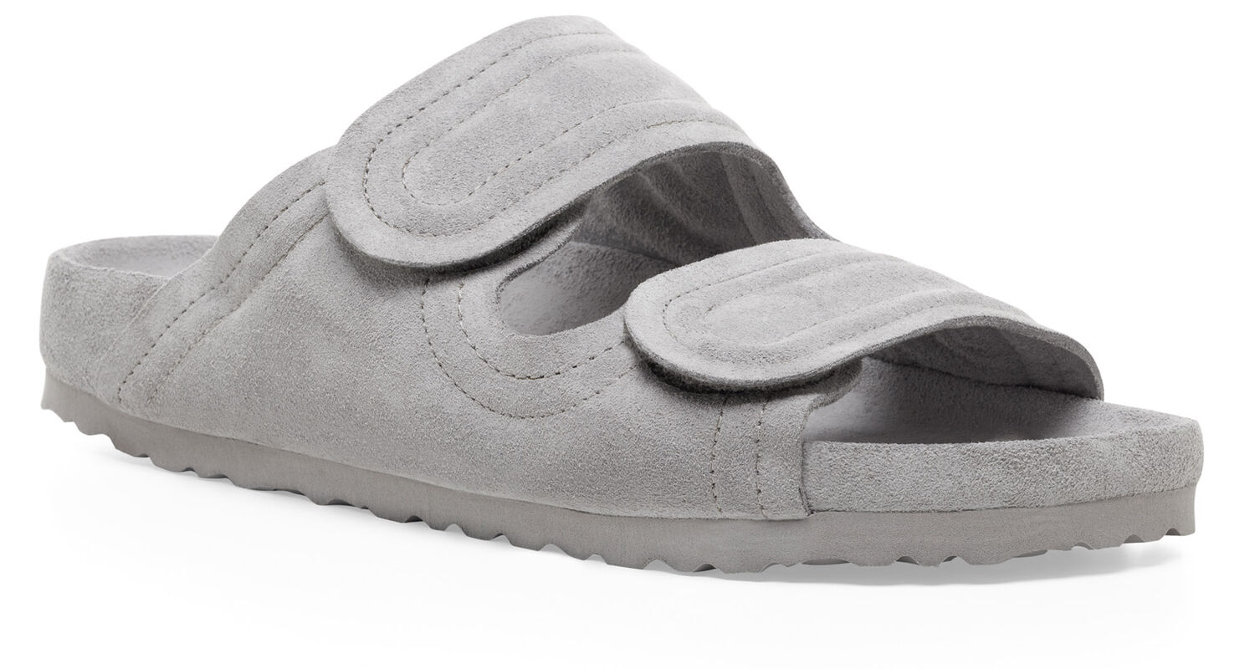
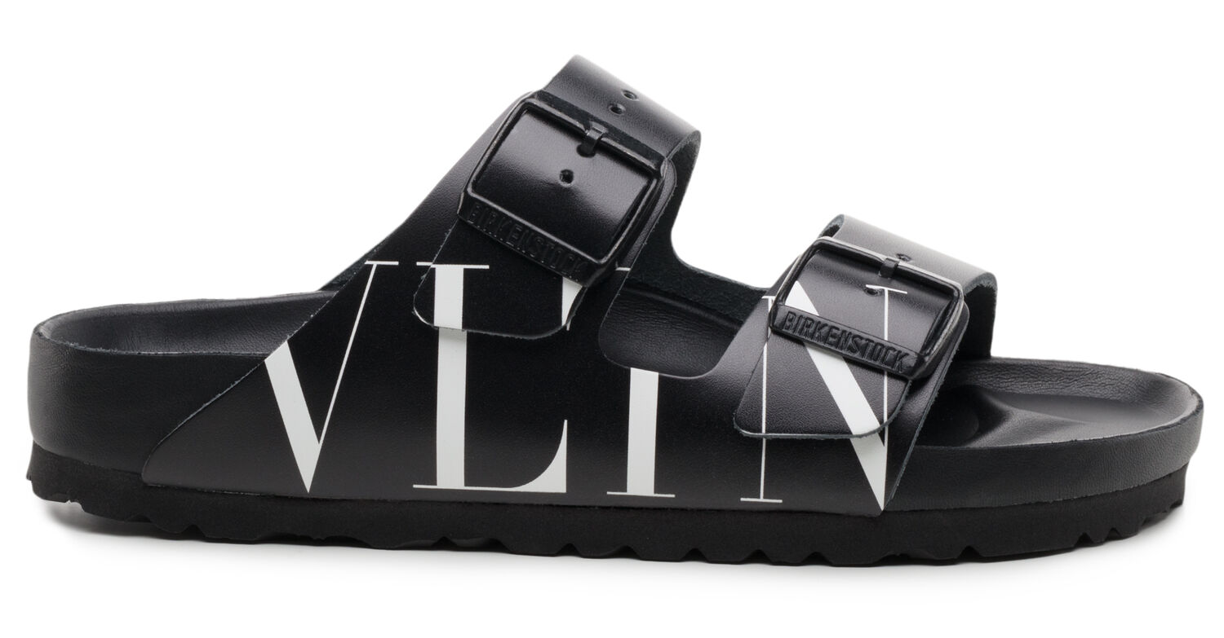
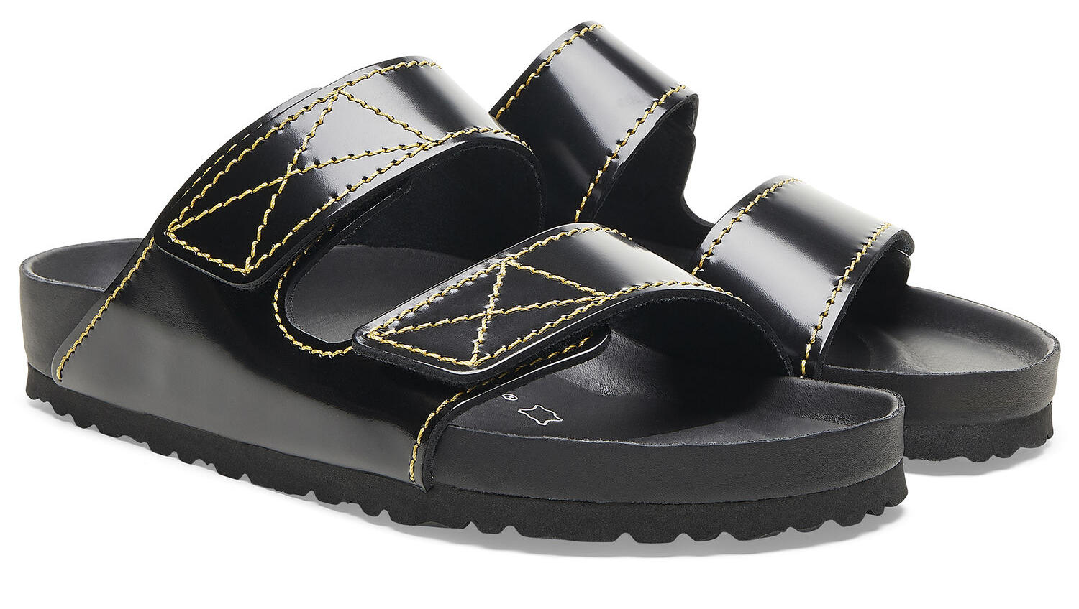
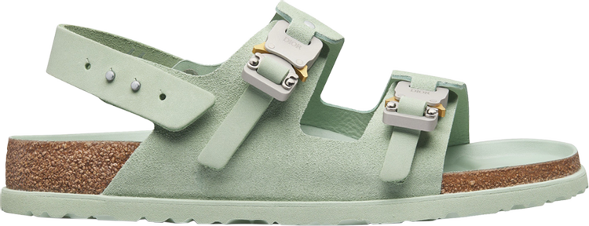
2019
1774 BIRKENSTOCK CREATIVE STUDIO
The company launches 1774 BIRKENSTOCK, a creative studio that features limited edition footwear collaborations between designers, artists and architects.
Between January 2019 and October 2023, 1774 BIRKENSTOCK releases over TWENTY designer collaborations.
Aug 2020 Stüssy x BIRKENSTOCK
Mar 2022 Manolo Blahnik x BIRKENSTOCK
Jan 2019 Rick Owens x BIRKENSTOCK
Mar 2019 032C x BIRKENSTOCK
Apr 2021 Toogood x BIRKENSTOCK
Jan 2023 Fear of God x BIRKENSTOCK
Feb 2019 Valentino x BIRKENSTOCK
Sep 2019 Proenza Schouler x BIRKENSTOCK
Jan 2022 Dior x BIRKENSTOCK
Sep 2023 Tekla x BIRKENSTOCK
On the creation of the 1774 BIRKENSTOCK creative studio:
“I was afraid we would wake up in our own museum, surrounded by traditional pieces that had no relevance to today. Which is why it is important to build bridges to other people’s creativity and energy — to offer them a white canvas and the paint and say: ‘Go!’’’
Oliver Reichert
CEO, BIRKENSTOCK
2020
COMFORT IS KING
During the pandemic consumer interest shifts toward comfort clothing and footwear. British Vogue names Birkenstock as its “Sandal of the Year”
225%
Increase in Internet searches for BIRKENSTOCK from 2019 - 2020, thanks in part to the superfan Kendall Jenner posting about the shoes on TikTok, according to global fashion shopping app LYST.

Slide 21
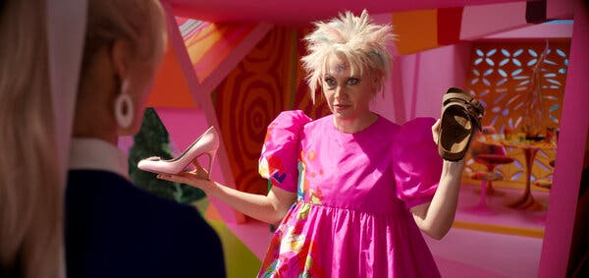
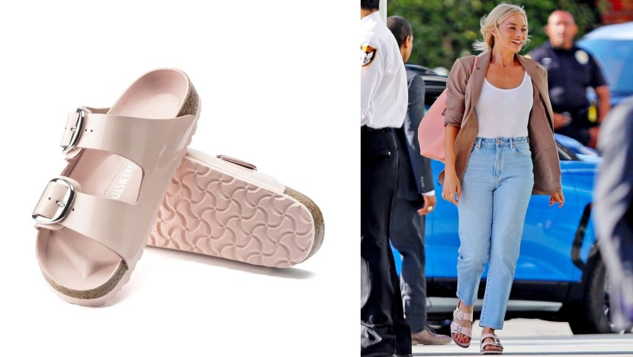
BIRKENSTOCK IN POP CULTURE: “BARBIE”
The 2023 blockbuster movie “Barbie” features TWO surprise BIRKENSTOCK cameos. While the sandal’s inclusion was purposeful, BIRKENSTOCK did not pay for product placement.
“The inclusion of BIRKENSTOCK in the plot of ‘Barbie’ – the most successful film of 2023 worldwide with box office sales of over 1.381 billion dollars – underlines what BIRKENSTOCK has always stood for – authenticity and natural walking.”
BIRKENSTOCK GROUP
BIRKENSTOCK Cameo #1
BIRKENSTOCK Cameo #2
Warner Bros.
(BIRKENSTOCK, Clickphotos)
Barbie (Margot Robbie), in a moment of existential crisis, has woken up with flat feet. She is left with a choice: either to continue wearing heels that are now unbearable to wear or opt for the comfortable and sensible choice: Birkenstock sandals.
In this scene Weird Barbie (Kate McKinnon) asks, ”pink stiletto heels or brown flat sandals?” while holding up a Birkenstock Arizona sandal.
CLICK HERE TO WATCH THE SCENE
In another scene, Barbie sports a pair of BIRKENSTOCK Arizona Big Buckle Natural Leather Patent sandals, a pink, fashion forward version of the traditional Arizona style.
346%
Increase in US Google searches for “Birkenstock sandals for women” the week after “Barbie” premieres.
Following Barbie’s release, the pink Arizona sandals featured in the movie, immediately sell out.

Slide 22
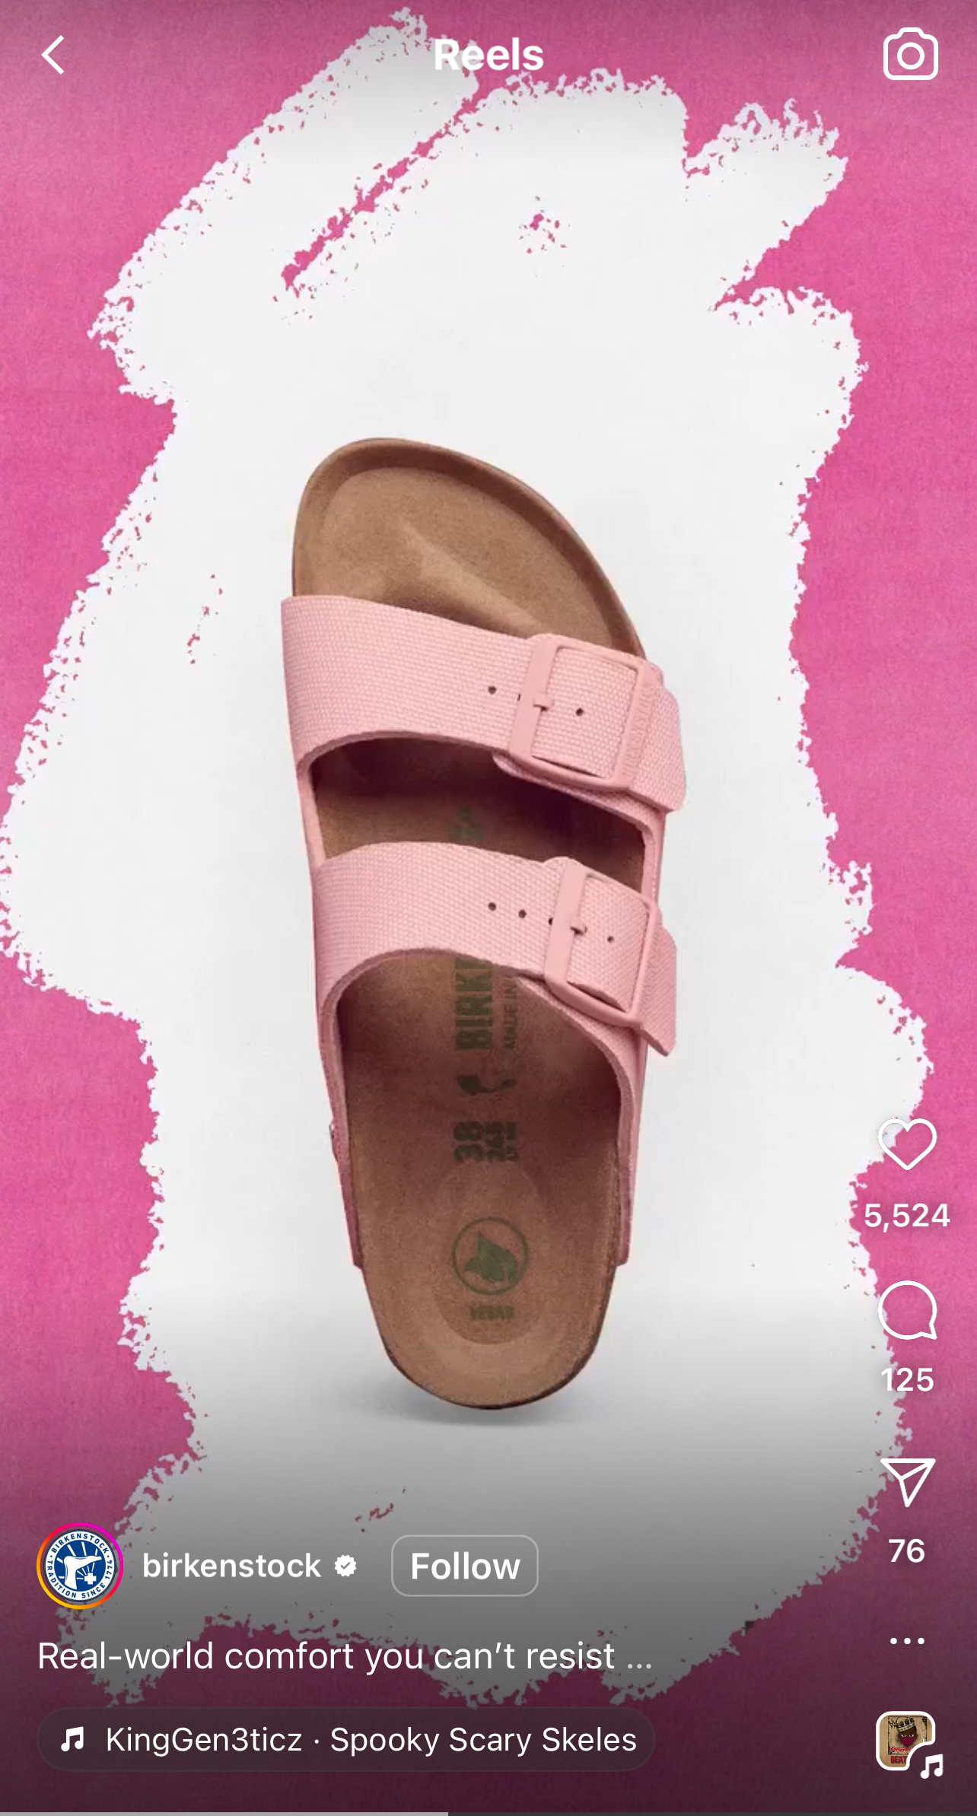
BIRKENSTOCK x BARBIE
THE COLLABORATION THAT WASN’T
Out of the many products featured in “Barbie,” BIRKENSTOCK does not have a formal product collaboration with Mattel or Barbie.
Even though BIRKENSTOCK’s product placement in “Barbie” is unpaid, this doesn’t stop BIRKENSTOCK from capitalizing on their brand’s surge in popularity due to the success of the movie.
EARNED ADVERTISING
Earned advertising is unpaid publicity generated for a business or brand. In the case of “Barbie” BIRKENSTOCK’s earned advertising resulted from the unpaid feature of their sandals, that created public awareness and conversation around their product.
LEVERAGING EARNED ADVERTISING
During the weeks following the “Barbie” release, BIRKENSTOCK runs a social campaign that features several of its pink shoes with the tagline, “Real-world comfort you can’t resist” — a call-out to the shoe’s role in the movie.

Slide 23
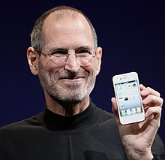
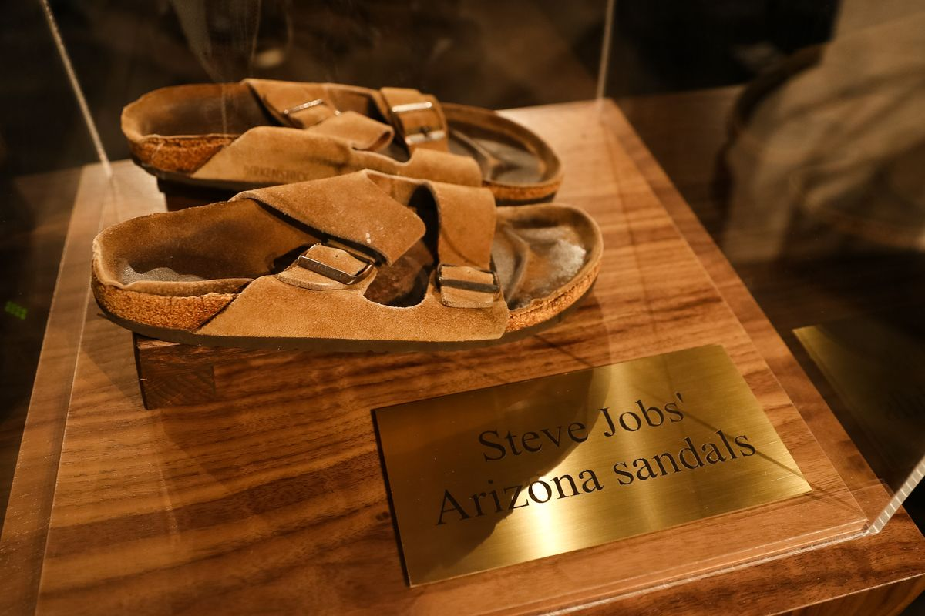
BIRKENSTOCK IN POP CULTURE
$218,750
Price paid at auction for a pair of BIRKENSTOCK Arizona sandals worn by Steve Jobs in the early days of Apple in November 2022, at Julien's Auctions in New York City.
According to Julien’s, it is the highest price ever paid for a pair of sandals at auction.
(Neil Rasmus / BFA.com)

Slide 24
2022 "UGLY FOR A REASON” CAMPAIGN
In July 2022, BIRKENSTOCK launches its first global paid content campaign on NYTimes.com. The ad campaign – a three-part video documentary – returns to the company’s roots by raising awareness on the role footwear has in maintaining foot health. The campaign follows in the tradition of the Konrad Birkenstock’s educational lectures that communicate the company’s core values.
CLICK HERE TO VIEW THE CAMPAIGN
"Foot health is at the heart of everything we do at BIRKENSTOCK. With our campaign, we want to stage the human foot - and address the role of proper footwear for our health.”
Oliver Reichert
CEO, BIRKENSTOCK Group
(T Brand, 2022)

Slide 25
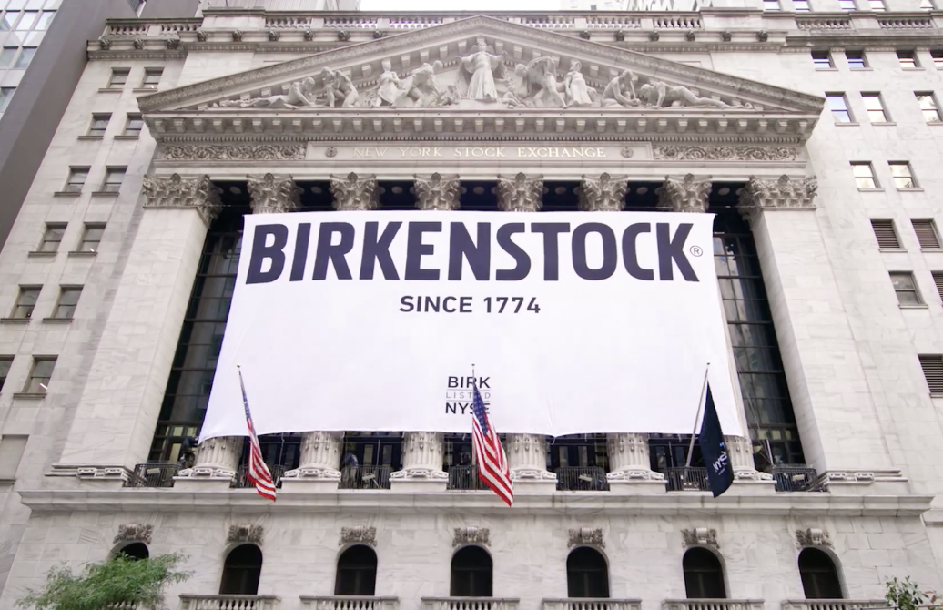
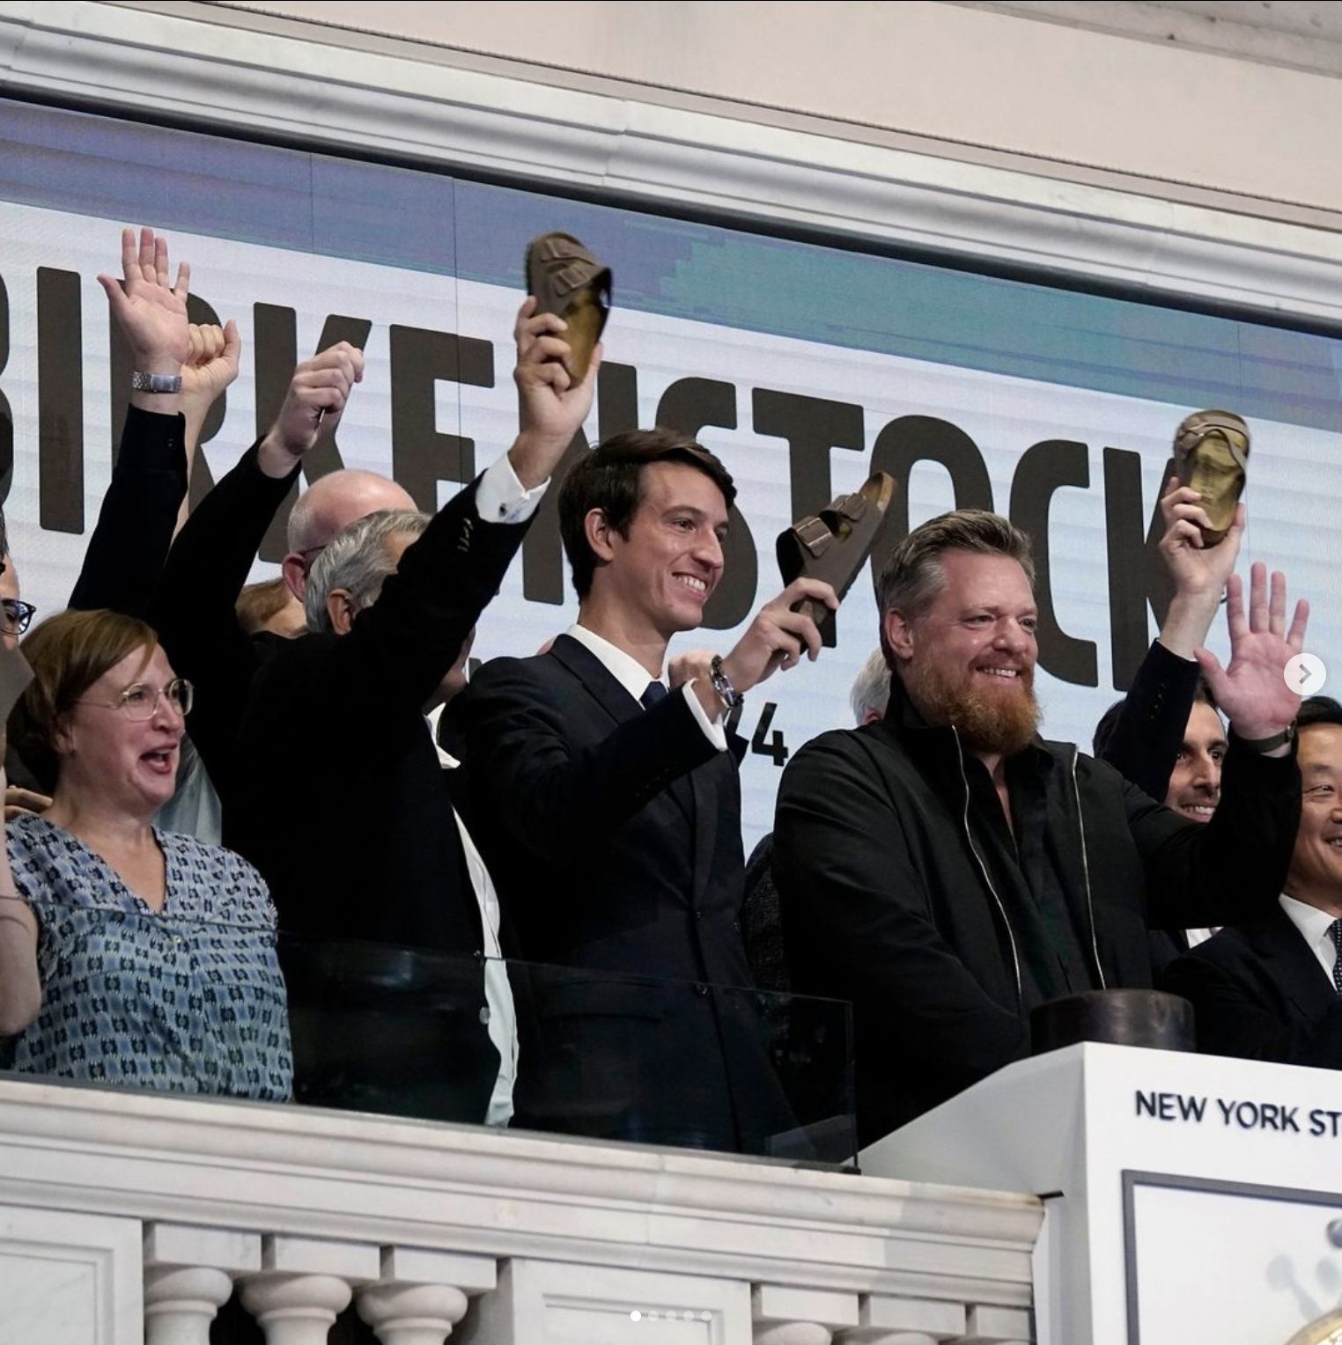
PART THREE
THE ROAD TO GOING PUBLIC
In October 2023, after almost 250 years of being a privately owned company, BIRKENSTOCK makes a massive business move by taking their company public.
The process required years of calculated business decisions and strategic growth.
What does being a public company mean for BIRKENSTOCK going forward?
(NYSE)

Slide 26
STOCK MARKET TERMINOLOGY
SHARES vs. STOCK
Shareholders refers to anyone who has ownership “shares” or stock in a company.
Stock refers to fractional ownership of equity in a company.
A security is a catch-all term referring to financial instruments used by a company that can be traded between parties. Stocks are a type of security.
A stock exchange is a market in which securities are bought and sold. The two main stock exchanges in the US are the New York Stock Exchange (NYSE) and the NASDAQ.
A stock symbol (ticker symbol) is a unique series of characters assigned to a specific security, used for trading purposes.
PUBLICLY TRADED vs. PRIVATELY HELD
Publicly traded, or being a public company means that the company has stock shares that are available for public purchase through a stock exchange such as the New York Stock Exchange (NYSE) or NASDAQ.
Privately held means that a company’s shares are not available for public purchase, and are owned entirely by one or more founders, employees, private investors, and/or families.
WHAT DOES IT MEAN TO “GO PUBLIC”?
Going public is when a privately held company begins to offer stock shares to the public through a process called an Initial Public Offering (IPO), after which the company’s shares are publicly traded on a stock exchange.
BIRKENSTOCK (NYSE: BIRK)
Birkenstock’s Stock Symbol: BIRK Stock Exchange trading BIRK: New York Stock Exchange (NYSE)

Slide 27
BIRKENSTOCK: THE LAST 40 YEARS
1990-2000
2002
2002
2007
2009
Corporate Division
Karl Birkenstock divides his company into several sub-brands to appeal to different markets.
Employee Ownership
Margot Fraser transfers ownership of Birkenstock Distribution, USA to the company’s 60 employees, making the import company 100% employee owned.
Changing of the Guard
Karl Birkenstock passes control of BIRKENSTOCK on to his three sons: Alex, Christian and Stephan. The new executive team struggles to manage the sub-brands and each sibling has a different vision for the company’s future.
Consolidation
The Birkenstock family purchases Birkenstock Distribution, USA as a part of a larger consolidation effort to improve distribution and increase sales.
New GM
Oliver Reichert takes over as BIRKENSTOCK’s General Manager
2023
2021
2013
Initial Public Offering (IPO)
After years in the making, Birkenstock holds its IPO on the New York Stock Exchange on October 11, 2023.
(NYSE: BIRK)
Private Equity Buyout
Private equity firm, L. Catteron pays $4.7 billion for controlling stake in The Birkenstock Group. Brothers Christian and Alex retain a 40% stake in the company.
The Birkenstock Group uses the cash infusion and leverages the equity firm’s luxury and consumer brand global network to accelerate growth across markets.
Realignment
BIRKENSTOCK merges their loose structure of 38 companies into one cooperation—The Birkenstock Group and Oliver Reichert takes over as CEO.
This move ends a 240-year-old tradition of family involvement in business operations, although brothers Christian and Alex Birkenstock remain the majority shareholders. This realignment allows the company to expand and better navigate the competitive footwear market.
BUT HOW DOES THE IPO HAPPEN?

Slide 28
BIRKENSTOCK IPO: HOW DID IT HAPPEN?
IPO REQUIREMENTS
Companies must meet certain requirements to go public:
PRIVATE VALUATION
To go public, a company should have a private valuation of $1 billion or greater.
Private valuation: when an underwriter determines the value of a private company. Underwriter: a financial institution that specializes in analyzing the value of a company.
HOW DO UNDERWRITERS EVALUATE A COMPANY’S VALUE?
Comparable company analysis (CCA), involves comparing similar publicly-traded companies with the private company being evaluated. These comparisons include sales figures, assets, debts and projected growth.
MEET SEC REQUIREMENTS
The SEC (Securities and Exchange commission) is the US government agency in charge of enforcing securities trading regulations.

Slide 29
BIRKENSTOCK IPO: HOW DID IT HAPPEN?
REQUEST FOR PROPOSALS (RFP)
SELECT THE UNDERWRITER
CHOOSE THE IPO TEAM
SEC DOCUMENTATION
Underwriters submit proposals to the company that include the proposed valuation, the offering price (starting stock price), number of shares at time of issue, and IPO time frame.
The company selects an underwriter and signs an agreement.
The IPO team is made up of the underwriter, lawyers, certified public accountants (CPAs) and SEC experts.
File S-1 Registration statement – an official registration with the SEC for the IPO. Revisions can be made if necessary.
POST-IPO
SHARES ISSUED (IPO)
BOARD OF DIRECORS & PROCESSES
MARKETING THE IPO
If there are post-IPO provisions in place, these guidelines will be followed. A common pos—IPO provision is called a quiet period, where certain investors cannot sell their shares.
The company issues its shares on the chosen IPO date, and the shares are sold through the stock exchange.
The money earned transfers to the company as cash and is recorded as ”stockholders' equity” on the company’s balance sheet.
Formation of a board of directors and determining quarterly financial reporting processes.
The underwriter and the company market the IPO proposal estimate demand for the stock and determine a final offering price.

Slide 30
PROS & CONS OF GOING PUBLIC
PRO:
Increased capital (money) to pay off debts and/or fund business growth.
CONS:
Business decisions can be harder to implement because ownership isn’t centralized.
Publicly held companies are subject to management restrictions and government regulatory constraints.

Slide 31
BIRKENSTOCK GLOBAL REVENUE AND GROWTH 2015-2023
REVENUE
YEAR-OVER-YEAR GROWTH
$1.4B
35%
$1.2B
30%
$1B
25%
$800M
20%
$600M
15%
$400M
10%
$200M
5%
$0M
0%
2015
2016
2017
2018
2019
2020
2021
2022
2023*
*First 9 months of fiscal year 2023, ending September 30, compared to same period of 2022. Figures converted at a rate of $1.00 = €0.95
Source: Statista.

Slide 32
“Consumers buy our products for a thousand wrong reasons, but they all come back ... Through the strong reputation and universal appeal of our brand — enabling extensive word-of-mouth exposure and outsized earned media value — we have efficiently built a growing global fanbase of millions of consumers that uniquely transcends geography, gender, age and income.”
Oliver Reichert
CEO, BIRKENSTOCK Group

Slide 33
BIRKENSTOCK IPO: KEY DATA
32.3 million
TOTAL Number of Shares Sold at IPO
10.8 million shares
from The Birkenstock Group
21.5 million
shares from L Catteron Private Equity
$9.3 billion
Pre-IPO Valuation
$46
Per-Share Price at IPO
$1.48 billion
TOTAL Amount Raised at IPO (32.3 M x $46)

Slide 34
STOCK STUMBLE
Birkenstock Holding PLC (BIRK) had an initial stumble on it’s first day of trading, closing at $40.20, down 12.61%.
The stock price has been volatile during the first two weeks of trading.

Slide 35
FACTORS AFFECTING
THE BIRKENSTOCK IPO
Following an underwhelming market debut, analysts cite several factors that may have affected the success of the IPO:
POOR TIMING
During the week of the BIRKENSTOCK IPO several events unfold that may have caused stock buyers to shy away from this investment:
Potential US government shutdown
Public holidays in Germany and the US
Delayed stock listings in
Accelerating conflict in the Middle East.
DISAPPOINTING EARNINGS REPORT
L Catteron, Birkenstock’s Private Equity backer, posts a disappointing earnings report just hours before the new stock was set to open trading in New York.
AN INFLATED MARKET CAP
Market capitalization, or market cap, is the total value of a company's outstanding stock shares of stock, which include publicly traded shares plus restricted shares held by company officers and insiders.
Birkenstock’s market cap is higher than publicly traded footwear brands Skechers, Crocs and Steve Madden. Each of these companies has a higher revenue than Birkenstock, and a lower market cap.

Slide 36
DISCUSSION QUESTIONS
What is entrepreneurship?
How might the history of BIRKENSTOCK represent an example of entrepreneurship?
What is innovation?
How did BIRKENSTOCK innovate in the footwear industry?
How has innovation played a key role in the success of BIRKENSTOCK?
How has the company evolved over time in terms of leadership and ownership?
What is positioning?
How has BIRKENSTOCK positioned its brand?
What is a demographic?
Based on what you learned in this presentation, who might represent BIRKENSTOCK’s primary demographic?
(BIRKENSTOCK)

Slide 37
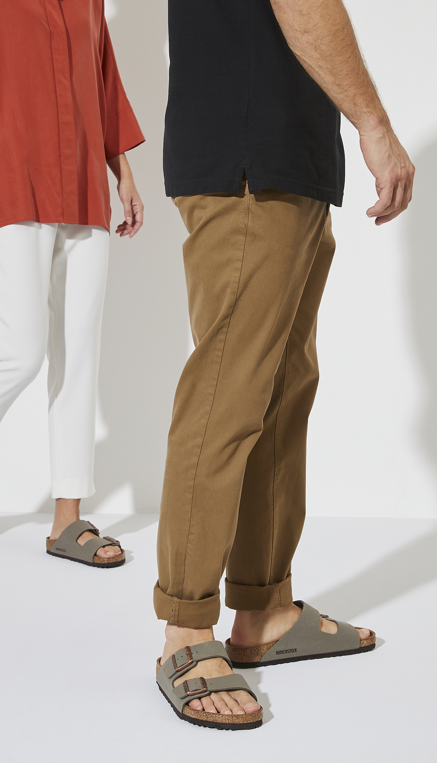
DISCUSSION QUESTIONS
What is stock?
Who are a company’s shareholders?
Why is stock important to a business?
What is the difference between public stock and private stock?
Where are public stocks bought and sold?
What is a stock symbol?
What is an IPO? What does that have to do with “going public”?
What are the requirements a company must fulfill before going public?
What are the advantages to going public?
What are the disadvantages?
Why do you think BIRKENSTOCK went public?
According to this presentation, how did BIRKENSTOCK’s stock price perform initially?
(BIRKENSTOCK)

Slide 38
DISCUSSION QUESTIONS
What factors influenced BIRKENSTOCK’s early performance on the stock exchange?
What is an earnings report?
What is a market cap?
BIRKENSTOCK has less revenue than other footwear brands like Skechers and Cros, yet has a higher market cap. How is that possible?
Who is the SEC?
What role does the SEC play in business?
What is the
In your opinion, is BIRKENSTOCK a stock with long term investment potential? Why or why not?
(BIRKENSTOCK)

Slide 39
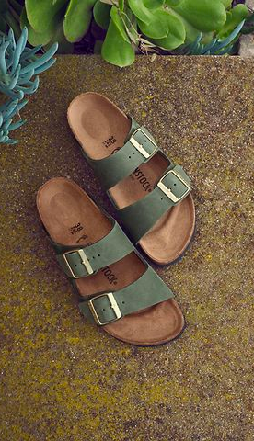
SOURCES
birkenstock.com/us/journal/heritage/
investopedia.com/ask/answers/what-does-going-public-mean/
heddels.com/2018/08/birkenstock-history-philosophy-iconic-products/
birkenstock-group.com/de/en/newsroom/konrad-birkenstock-celebrating-the-150th-anniversary-of-the-birth-of-the-inventor-of-the-footbed/
sec.gov/Archives/edgar/data/1977102/000119312523248061/d507917df1a.htm
happyfeet.com/blog/history-of-birkenstock/
forbes.com/sites/abinlot/2019/07/26/a-look-inside-birkenstock/?sh=683bb1d24ab8
businessinsider.com/the-history-growth-of-birkenstock-german-shoe-brand-2023-8
marketingdive.com/news/birkenstock-paid-global-campaign-ugly-sandals-purpose/626540/
prnewswire.com/news-releases/ugly-for-a-reason-birkenstock-launches-its-first-global-paid-content-campaign-on-nytimescom-301579539.html
cnn.com/style/article/birkenstocks-history-comfortable-shoes-sandals/index.html
wsj.com/business/retail/birkenstock-ipo-sandals-margot-fraser-254b5c80
wsj.com/story/a-visual-history-of-birkenstocks-rise-from-insoles-to-ipo-7487bc0d
theface.com/archive/kate-moss-summer-of-love
luxurytribune.com/en/birkenstock-just-cant-stop-collaborating
nytimes.com/2023/10/11/style/birkenstock-ipo.html
hypebeast.com/2023/10/best-birkenstock-collaborations
footwearnews.com/gallery/marc-jacobs-grunge-perry-ellis-photos-nyfw-spring-1993/perry-ellis-rtw-spring-1993-collection/
www.sofi.com/learn/content/shares-vs-stocks/
(BIRKENSTOCK)

Slide 40
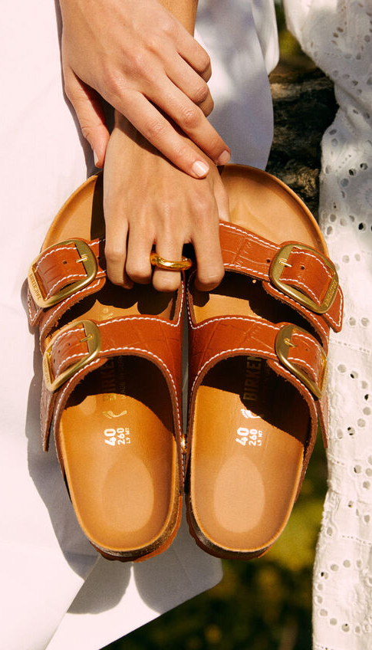
SOURCES
footwearnews.com/gallery/marc-jacobs-grunge-perry-ellis-photos-nyfw-spring-1993/perry-ellis-rtw-spring-1993-collection/
mega-onemega.com/marc-jacobs-reissues-1993-grunge-collection/
prnewswire.com/news-releases/ugly-for-a-reason-birkenstock-launches-its-first-global-paid-content-campaign-on-nytimescom-301579539.html
nytimes.com/paidpost/birkenstock/how-feet-made-us-human.html
statista.com/chart/30989/revenue-growth-of-birkenstock/
yahoo.com/lifestyle/birkenstock-riding-high-searches-soar-143114021.html
npr.org/2022/11/15/1136637908/steve-jobs-auction-sandals-birkenstocks-apple
en.wikipedia.org/wiki/Birkenstock#:~:text=After%20Karl%20Birkenstock%20retired%20from,competing%20product%20lines%20and%20subsidiaries.
birkenstock-group.com/de/en/about-us/tradition-since-1774/1963-today/
yahoo.com/lifestyle/birkenstocks-hold-surprising-meaning-barbie-183021901.html
hypebae.com/2023/8/barbie-film-causes-500-percent-search-rise-for-birkenstock
.barrons.com/articles/birkenstock-ipo-sandal-makeover-news-d593f98a
forbes.com/sites/laurendebter/2021/03/02/birkenstock-billionaires-unveiled-after-german-sandal-maker-agrees-to-sale/?sh=3602269c48d7
medium.com/@IsabelGoldin/birkenstocks-clever-marketing-boosted-by-barbie-s-success-91ebd5e9d7d3
townandcountrymag.com/leisure/arts-and-culture/a44764625/margot-robbie-barbie-final-scene-outfit-shop/
finance.yahoo.com/news/birkenstock-lackluster-debut-mistimed-shaky-050000432.html
bullishbears.com/birkenstock-ipobullishbears.com/birkenstock-ipo
investopedia.com/terms/s/shares.asp
investopedia.com/terms/i/ipo.asp
.lw.com/en/news/latham-watkins-advises-on-birkenstock-ipo
(BIRKENSTOCK)

