Slide 1
Starbucks
Pumpkin Spice Latte
20th Anniversary
Starbucks

Slide 2
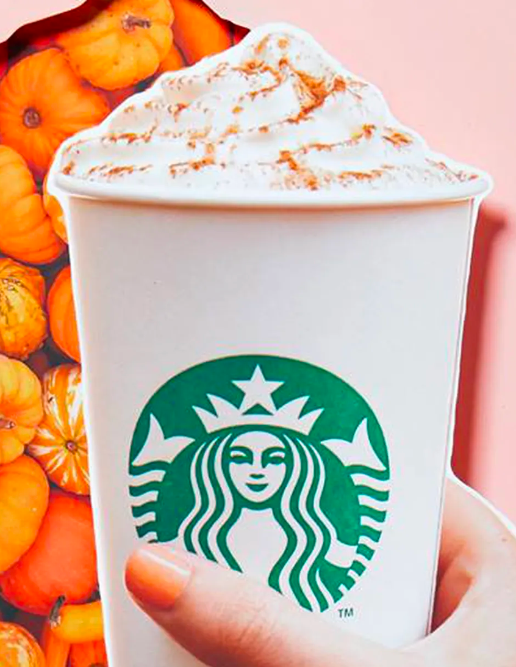
02
PSL History
Introduced in Fall 2003, the Pumpkin Spice Latte (nicknamed PSL), was Starbucks’ second seasonal drink offering after the brand launched the Peppermint Mocha for the holiday season in 2002.
“The Peppermint Mocha really seemed to resonate with our customers,” said Peter Dukes, former Starbucks Director of Market Strategy, who led the team that brought the PSL to life. “We saw an opportunity to do something for fall.”
Starbucks / Facebook

Slide 3
03
“We started with a huge brainstorm list and filled the wall with ideas. We probably had at least a hundred ideas up on the wall. And once we got those ideas, we started to whittle away at them and came down to a list of about 20 different flavors including chocolate and caramel – the most popular flavors to pair with coffee – and there was orange and cinnamon ... and there was pumpkin there as well.”
Peter Dukes
Former Director of Market Strategy
Starbucks

Slide 4
04
Market Research
The Starbucks marketing team brainstormed possibilities for a new fall beverage, then provided customers with a list.
They then asked two key questions in a written survey:
How likely would you be to purchase each drink on the list?
How unique do you think each flavor is?
Caramel and chocolate flavored drinks scored highly when it came to likeliness to buy, but customers didn’t find them unique. The proposed pumpkin latte scored high for uniqueness, but customers were unsure about the proposed pumpkin flavor.

Slide 5
05
Product Development
Spring 2003
The Starbucks product development team met in the “Liquid Lab,” a secure research and development space at Starbucks HQ in Seattle, to brainstorm flavor ideas for a fall themed drink.
Members of the team began to explore ideas by sampling a forkful of pumpkin pie followed by a sip of hot espresso – to help determine which flavor notes from the pie complemented the flavor of the coffee.

Slide 6
06
Refining the Recipe
1 cup steamed milk
1 oz brewed Starbucks® Espresso Roast
3 Tbsp Pumpkin Spice Syrup
0.5 cup whipped cream
1 pinch pumpkin pie spice (garnish)
Spring - Summer 2003
Over the next three months, the product development team worked on the drink’s recipe, refining it to become the drink customers know and love today: a traditional latte, handcrafted with espresso, pumpkin spice sauce, and steamed milk – topped off with whipped cream and a dash of pumpkin pie spice topping.

Slide 7
07
Naming the Product
“There was a desire to choose a really unique name, such as the fall harvest latte. We ultimately ended up landing on Pumpkin Spice Latte because the spices play a really important role in bringing out the flavors of pumpkin, while also highlighting the espresso in the cup.”
Peter Dukes
Former Director of Market Strategy
Starbucks
Starbucks

Slide 8
08
Test Market
Fall 2003
Starbucks released the Pumpkin Spice Latte as a test product in about 100 stores in Washington, D.C. and Vancouver, Canada.
“Within the first week of the market test, we knew we had a winner. I remember calling store managers on the phone to see how the new beverage was doing, and we could hear the excitement in their voices.”
Peter Dukes
Former Director of Market Strategy
Starbucks
Starbucks

Slide 9
09
Product Launch
Fall 2004
Starbucks rolled out the Pumpkin Spice Latte across the U.S. and Canada.
In the years following the drink’s initial release, Starbucks considered replacing the PSL with other seasonal drinks, the thought being that keeping their menu “fresh” would increase customer curiosity and sales.
Starbucks

Slide 10
10
Social Media Impact
2006
Social media platforms Facebook and Twitter exploded in popularity. As customers began sharing their love for PSL on social media with their family and friends, the drink’s popularity increased exponentially.
“With the arrival of social media, it just took off on a whole new level.”
Peter Dukes
Former Director of Market Strategy
Starbucks
Starbucks

Slide 11
11
Social Media Impact
Millions of social media posts featuring fans love of the Pumpkin Spice Latte placed the beverage firmly in the cultural zeitgeist within just a few years of the drink’s introduction.
In 2014 Starbucks established dedicated Instagram and Twitter (now X) accounts for the Pumpkin Spice Latte.
The media took note of the growing pumpkin spice phenomenon, with morning talk show hosts and late-night comedians making it a topic of discussion.
In 2012 there was even a temporary shortage of pumpkin spice ingredients that caused news outlets to declare a “Pumpkin Emergency.”
Starbucks / Instagram: @TheRealPSL
Starbucks

Slide 12
12
Seasonality & Nostalgia
A powerful seasonal marker, pumpkin is associated with fall holidays Halloween and Thanksgiving. When Starbucks established pumpkin as a Fall seasonal flavor, it enabled them to tap into a well of consumer nostalgia surrounding the Fall season.
The Pumpkin Spice Latte being a seasonal item, is an important marketing tool for Starbucks. The drink has an increased demand due to its limited availability.
CLICK HERE TO WATCH
Starbucks / Instagram
Starbucks

Slide 13
13
Consumer Engagement
2012
Following the success of the PSL, Starbucks’ competitors, such as Dunkin Donuts and McDonalds, launched their own versions of the drink.
At this time Starbucks began to ramp up their marketing efforts. When the chain ran a contest on their Facebook page to determine which city would be the first to have the beverage, it proved so popular the page crashed within an hour of its launch.
Another promotion had customers following an online scavenger hunt to get access to the latte before the September debut.
Starbucks / Facebook
Starbucks

Slide 14
14
Starbucks
Pumpkin Spice Product Line
In the years since the introduction of the PSL, Starbucks has released a variety of pumpkin spice flavored products available in grocery stores, to expand the market share of their most popular seasonal flavor.
Starbucks
Starbucks

Slide 15
15
Pumpkin Spice Everything
Early 2010s
Due to the popularity of the PSL, other companies began to introduce their own pumpkin spice products. From pumpkin spice scented candles, to pumpkin spice Oreos--the flavor and scent popularized by Starbucks was now inescapable.
2023
U.S. sales of pumpkin-flavored products reach $802.5 million, according to statistics company Nielsen. That’s up 42% from 2019.
A search for “pumpkin spice” on Walmart’s website brings up over 1,000 pumpkin-scented or themed products, including cleaning products.
Starbucks

Slide 16
16
Spicy Statistics
$3 Billion
Estimated total sales of Pumpkin Spice Latte drinks at Starbucks since the drink’s introduction in 2003.
Source: Yahoo Business
399,256
likes
6,847
comments
+25%
600 million
$100 million
+25%
Estimated PSL annual sales (2019)
source: Forbes
Increase in Starbucks store foot traffic the week following Fall products launch
source: Placer.AI
Total number of PSL drinks sold (2003-2022)
source: CNN
Engagement with Starbucks Instagram post announcing 2023 PSL release
source: Instagram

Slide 18
18
The Future of Pumpkin Spice
What does the future hold?
In 2022, consumer interest in pumpkin spice began to decline.
Unit sales for pumpkin spice products have been on the decline for the past two years.
From July 2022 - 2023, unit sales decreased 1.5% from the previous year, after flatlining the year before.
Companies have begun to pull back on the number of pumpkin spice products they release.
From July 2022-2023, there were over 3,072 Pumpkin Spice products, down nearly 200, or 5%, from two years prior.
Pumpkin spice will not go extinct any time soon, but this decrease in production indicates a shift in consumer behavior that companies will need to keep an eye on.
(Source: NielsenIQ)
Starbucks

Slide 19
Discussion
Starbucks introduced the Pumpkin Spice Latte twenty years ago. Why do you think they wanted to add a new product to the menu?
Why do you think a product name is important?
The brand almost called the beverage the “Fall Harvest Latte” or “Pumpkin Brulée Latte.” Why did Starbucks' initially consider calling the Pumpkin Spice Latte something else?
Do you think they made the right call? Why or why not?
What is an industry trend?
How did the decision to call the product the Pumpkin Spice Latte help to spark an industry trend?
What is product development?
This story references Starbucks' "research and development" space. What does that have to do with product development?
What factors were considered when Starbucks' developed the PSL?

Slide 20
Discussion
Why do you think Starbucks initially launched as a test product before offering the PSL on menus everywhere?
What are some examples of the test markets for the PSL? How do you think Starbucks determines which markets to test the new product?
What is product life cycle?
Which stage of the product life cycle best describes the Pumpkin Spice Latte's current position?
What do you think the future looks like for the Pumpkin Spice Latte and for pumpkin spice products as a whole?
What is brand extension?
How might the Starbucks' PSL illustrate an example of brand extension?
What is seasonality when it comes to marketing?
How the Pumpkin Spice Latte represent an example?

Slide 21
Discussion
Why is a product launch important?
What do you think a brand should consider when launching a new product?
Why do you think Starbucks was so successful with the launch of the PSL?
Do you think all Starbucks’ new product launches are just as successful? Why or why not?
What is social media?
How can social media be used in marketing?
How did social media help to boost the popularity of Starbucks’ Pumpkin Spice Latte?
What is consumer engagement?
Why is it important to a brand?
What did Starbucks do to boost levels of consumer engagement?

Slide 22
Sources
https://stories.starbucks.com/stories/2023/psl-turns-20-the-story-behind-starbucks-pumpkin-spice-latte/
https://www.cnn.com/2023/08/23/business/pumpkin-spice-latte-anniversary/index.html
https://blog.google/products/search/search-interest-trends-history-psl/
https://www.convinceandconvert.com/social-media/pumpkin-spice-latte-social-media/
https://www.ignitesocialmedia.com/uncategorized/how-social-media-changed-pumpkin-spice-phenomenon/
https://apnews.com/article/pumpkin-spice-latte-starbucks-aeac4eaecf371e77af161598f4b62949
https://www.forbes.com/sites/mollybohannon/2023/08/23/starbucks-pumpkin-spice-latte-returns-thursday-a-week-after-dunkin-and-a-full-month-before-fall
https://thetakeout.com/starbucks-pumpkin-spice-latte-psl-amazing-facts-history-1850752259
https://www.bid-on-equipment.com/post/pumpkin-spice-popularity
https://www.mic.com/articles/190963/pumpkin-spice-latte-2018-sales-how-much-money-does-it-make-for-starbucks
https://www.buzzfeed.com/vchamlee/how-pumpkin-spice-conquered-the-world
https://www.yahoo.com/video/fall-begins-much-money-pumpkin-150114158.html
https://finance.yahoo.com/news/starbucks-pumpkin-spice-latte-back-205333469.html

