Slide 1
KRISPY KREME GLAZES A TRAIL TO MARKETING SUCESS
SWEET
PROMOTION

Slide 2
MODULE 1: LESSON 1
WHAT IS PROMOTION?
Promotion is any form of communication used to inform, persuade, or remind people about a company’s products or services.
Promotion plays a significant role in creating and maintaining the levels of commitment and emotional involvement consumers have with the brand.

Slide 3
PROMO SUCCESS STORY
KRISPY KREME SCORES WITH FREE DOUGHNUTS
In recent years, Krispy Kreme has found success with promotions that offer free or extremely discounted doughnuts to their customers. These promotions have helped the company’s sales to grow significantly during that time period.

Slide 4
1.6 B
KRISPY KREME SOLD A WHOPPING 1.63 BILLION DOUGHNUTS GLOBALLY IN 2022.

Slide 5
$405M
KRISPY KREME'S REVENUE GREW BY 9% IN 2022, TO A TOTAL OF $404.6 MILLION.

Slide 6
2016 DRESS / TALK LIKE A PIRATE DAY PROMOTION
In 2016, Krispy Kreme offered a free, Original Glazed doughnut to every person who walked into their store and talked like a pirate — and a full box of glazed doughnuts if the customer dressed like a pirate.
Krispy Kreme also launched their first Snapchat campaign in conjunction with this promotion, where where customers could “digitally dress” like a pirate using a Snapchat filter. If the customer showed this image to a cashier or employee, they could qualify for a dozen Original Glazed doughnuts, as well.

Slide 7
2020: LABOR DAY PROMOTION
For Labor Day 2020, Krispy Kreme offered an entire Original Glazed dozen for only $1 using a coupon that was available in their app.

Slide 8
2022: KRISPY KREME "DOUGHNUT GAS PRICE PROMO DEFLATION"
“While Americans deal with the rising PPG – price per gallon – of gasoline, we’re lowering our PPOG – price per Original Glaze, Inflation and high gasoline prices are serious and forcing families to make tough tradeoffs. We know that despite the high gas prices people have to be out and about anyway. So, for the next several Wednesdays, we hope providing a little doughnut deflation will allow them to share some smiles during a difficult time. A dozen Original Glazed Doughnuts for the price of a gallon of gas will help our fans make midweek a little sweeter for their friends and family.”
DAVE SKENA
KRISPY KREME
CHIEF MARKETING OFFICER.

Slide 9
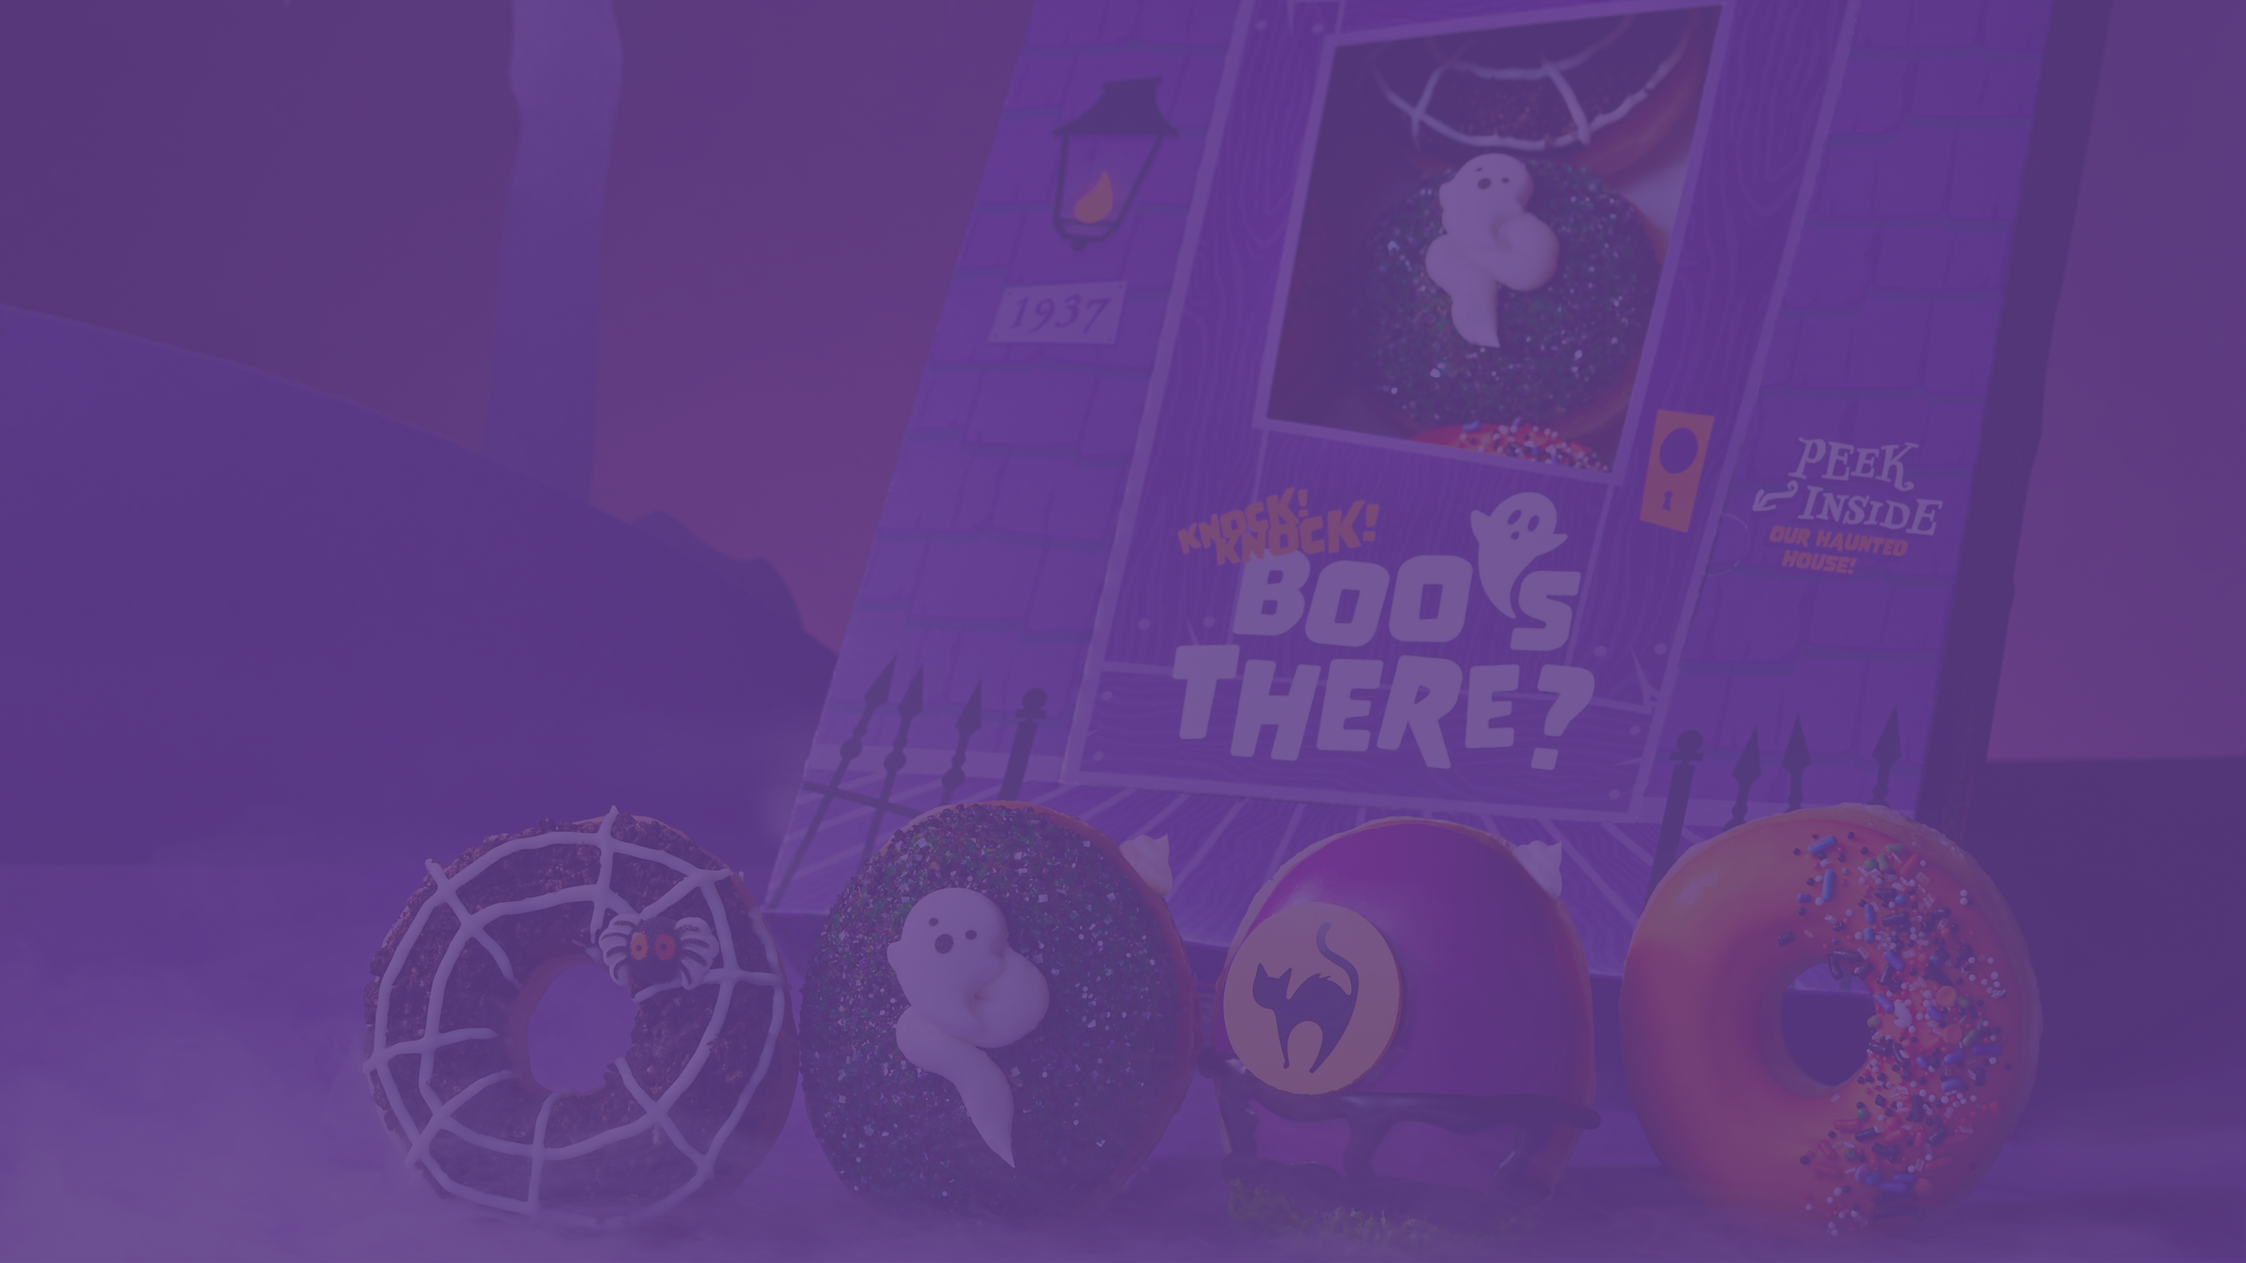
2022: KRISPY 'SKREME' PROMOTION
In 2022, Krispy Kreme transformed again into “Krispy Skreme” for the Halloween season, celebrating with an all-new Haunted House Collection and spook-tacular deals throughout October. Krispy Kreme introduced a line of limited edition doughnuts and a new Freaky Frozen Chiller drink.
Krispy Skreme also brought back “Saturday Scary Sharies.” Every Saturday beginning Oct. 15 through Halloween, Krispy Skreme customers received a $2 Original Glazed dozen when they purchased any dozen, and a special "You've Been Booed!" door hanger to share doughnuts with a friend.
On Halloween Oct. 31, any guest who visited a Krispy Skreme shop dressed in a Halloween costume could receive one FREE doughnut of choice, no purchase necessary.

Slide 10
2023: "SWEET TAX BREAK" DAY PROMOTION
On Tax Day, guests who visited participating Krispy Kreme shops across the U.S. and purchased an Assorted or Original Glazed® dozen at regular price only had to pay the price of sales tax for a second Original Glazed® dozen.

Slide 11
2023: KRISPY KREME ST. PADDY'S DAY PROMOTION
Krispy kreme gave out one free, green-colored version of their glazed doughnuts to its customers for St. Patrick's Day. The chain also released four festive doughnuts in celebration of the holiday. Customers who visited a Krispy Kreme (in-shop or drive-thru) while wearing green received the "O'riginal Glazed."

Slide 12
NATIONAL DONUT DAY PROMOTION
Krispy Kreme is known for giving away free doughnuts for National Doughnut Day every year.
“Our fans look forward to celebrating National Doughnut Day every year with family, friends and co-workers, and they really enjoy getting their favorite doughnut – any doughnut – for free!” “e look forward to a sweet celebration with everyone Friday at Krispy Kreme shops throughout the country.”
DAVE SKENA
GLOBAL CHIEF BRAND OFFICER
KRISPY KREME.

Slide 13
2023: FREE DOUGHNUTS FOR GRADS WITH
KRISPY KREME'S "DOUGH-PLOMA" PROMOTION
To celebrate the class or 2023, Krispy Kreme offered a FREE dozen glazed doughnuts in a special Dough-ploma-wrapped box to any high school or college senior who wore their Class of 2023 swag – from shirts and jackets to graduation cap and gown.

Slide 14
2023: 4TH OF JULY RED, WHITE AND BLUE PROMOTION
In addition to the release of their 'Stars and Stripes' collection of doughnuts, which featured limited edition flavors such as Red Velvet Sparkler and All-American Apple Pie, On On July 4, customers wearing red, white and blue could receive a free Original Glazed doughnut in shop or in the drive thru.

Slide 15
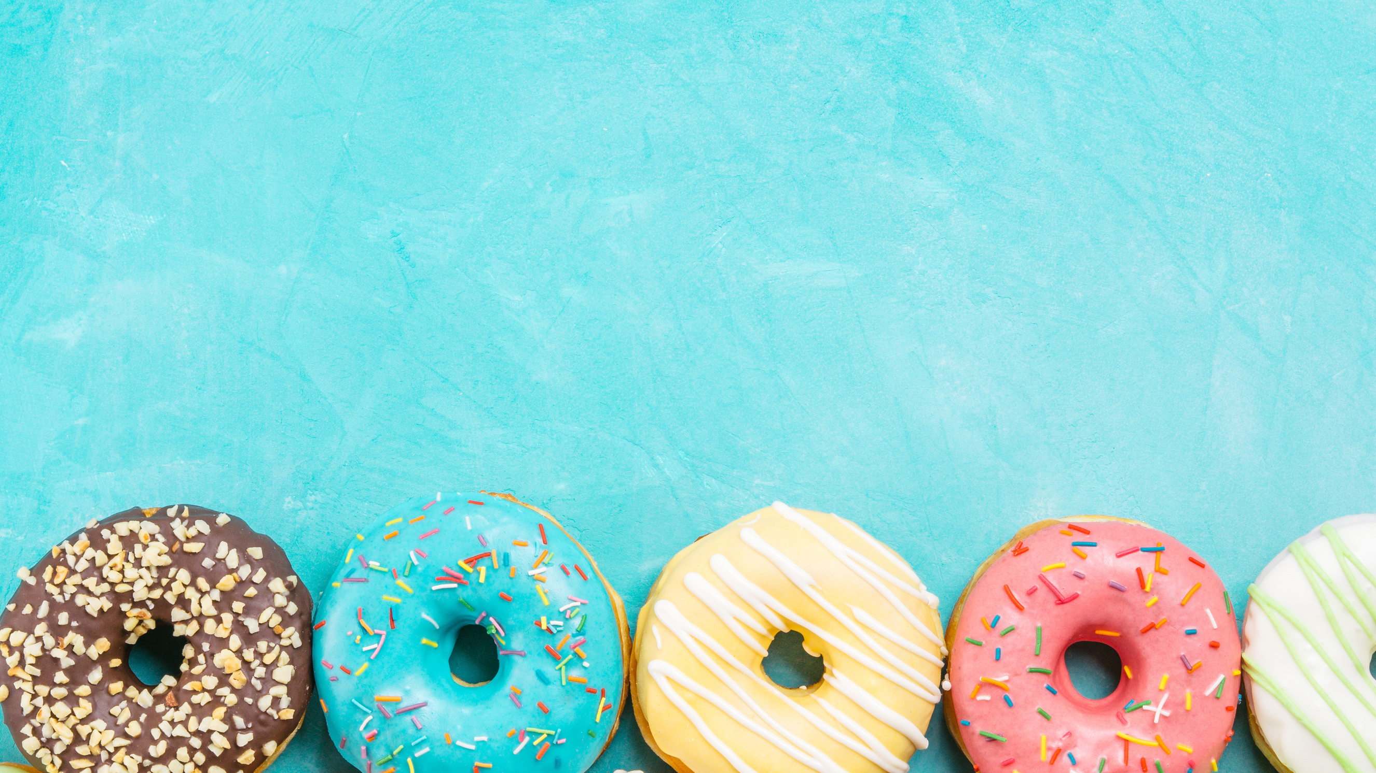
PROMO SUCCESS STORY
KRISPY KREME PROMOTIONS GO ABOVE AND BEYOND
Krispy Kreme also runs successful short-term promotions throughout the year, such as limited edition doughnut flavor releases, sweepstakes and leveraging their social media channels to promote their band and increase consumer engagement and sales.

Slide 16
2022: KRISPY KREME 85TH ANNIVERSARY PROMOTION
To celebrate the company's 85th year in business, select Krispy Kreme stores randomly selected multiple guests to receive a Krispy Kreme 85th birthday card that was worth free Original Glazed doughnuts for a year – one dozen per month.
A total of 8,500 years of free doughnuts were given away. The promotion included an offer for an Original Glazed dozen for just 85 cents with the purchase of any regular price dozen.

Slide 17
2023: APRIL FOOL'S DAY PRANK?
In March, 2023, Krispy Kreme unveiled instructions for an April Fool's Day prank through their TikTok channel and also on their website.
This prank gave instructions on how to turn one of their strawberry jam filled doughnuts into a spicy doughnut prank using chili sauce and a dessert syringe.
Krispy Kreme also announced on their social media channels that, they would be bringing back their Pumpkin Spice Original Glazed Doughnut for a limited time. Commenters were skeptical, thinking it was an April Fool's joke!

Slide 18
2023: KRISPY KREME® EXPANDS ‘C-SWEET’ VIA SEARCH FOR FAN TO SERVE AS BRAND’S FIRST-EVER ‘CHIEF DOUGHNUT DREAMER’
For this promotion, Krispy Kreme fans could “apply” via social media for the chance to be Krispy Kreme’s first-ever "Chief Doughnut Dreamer" and join Krispy Kreme’s Innovation Team at the company’s headquarters in Charlotte, N.C., to develop their future Fan Fav doughnut. Krispy Kreme plans to make the new doughnut flavor available to fans and will also give the Chief Doughnut Dreamer a free year of doughnuts.​

Slide 19
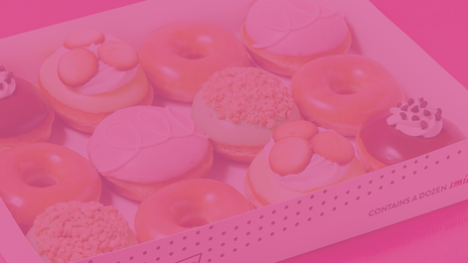
Banana Pudding Doughnut
2018
Key Lime Pie Doughnut
2021
Strawberries & Kreme™ Doughnut
2018
Chocolate Kreme™ Pie Doughnut
2019
"Fan Faves" Back by Demand
In May 2023, Krispy Kreme released four fan-favorite doughnuts in a
limited release doughnut collection

Slide 20
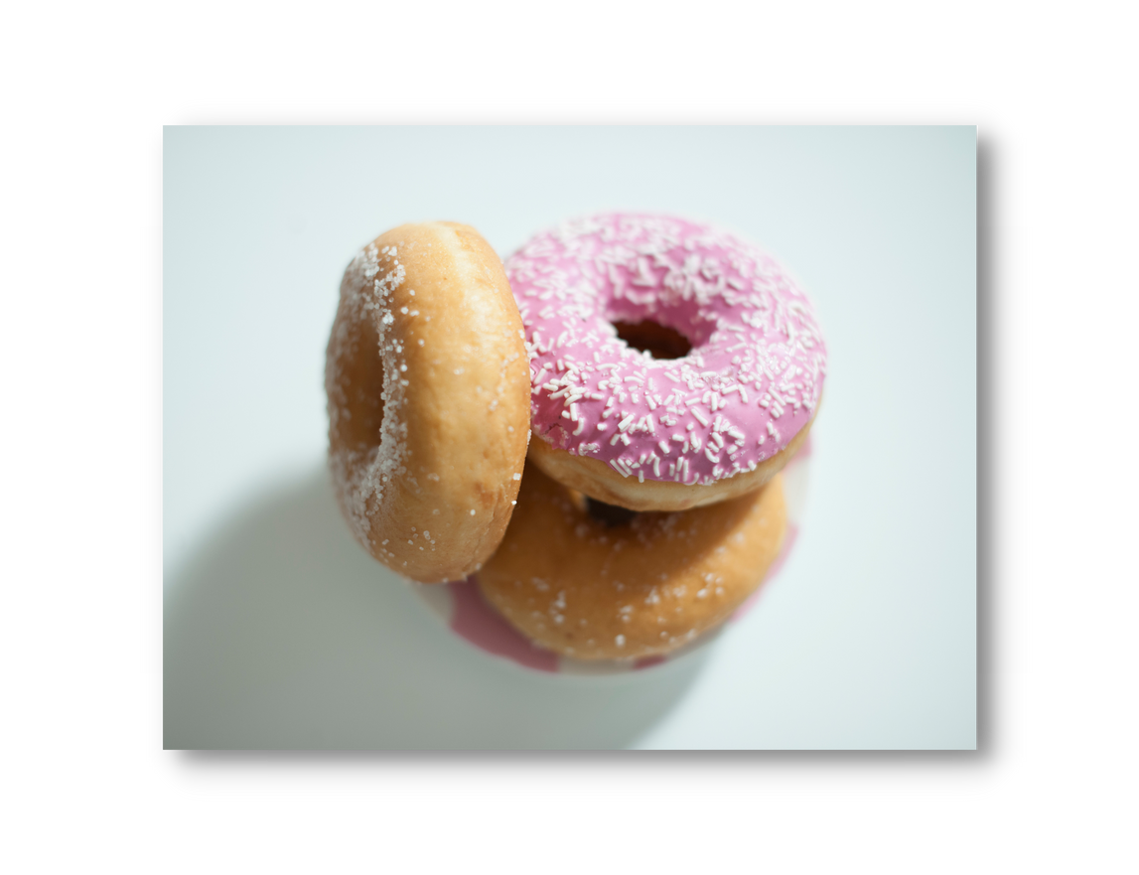
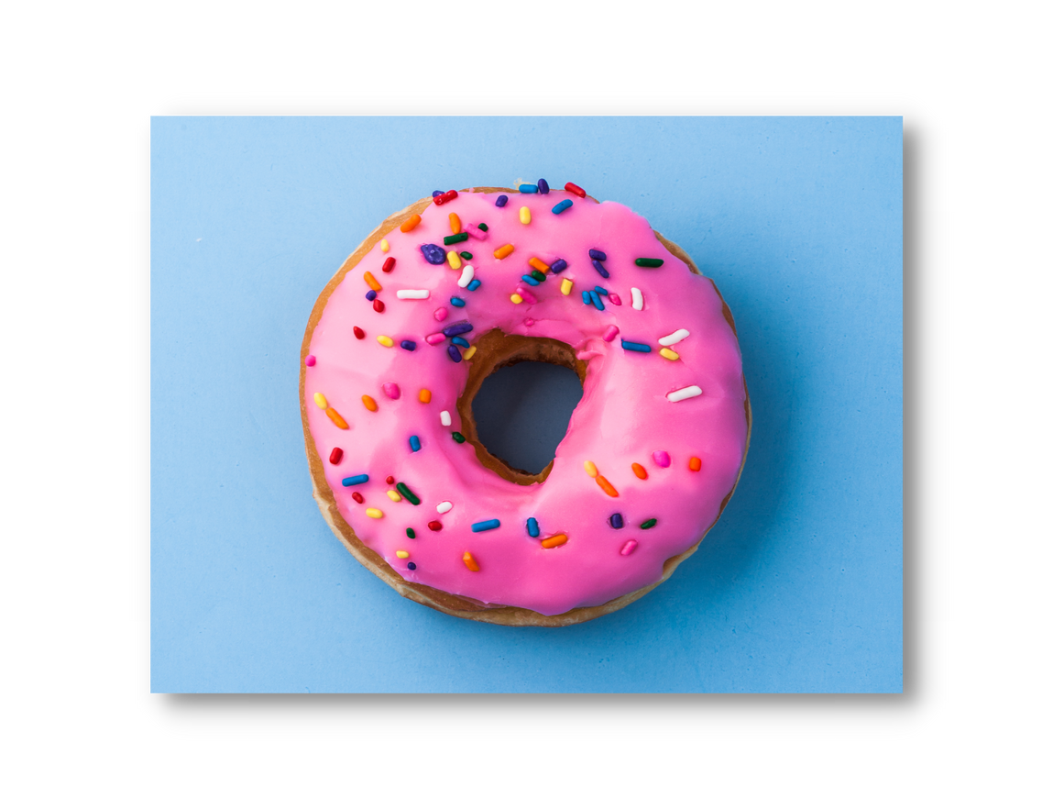
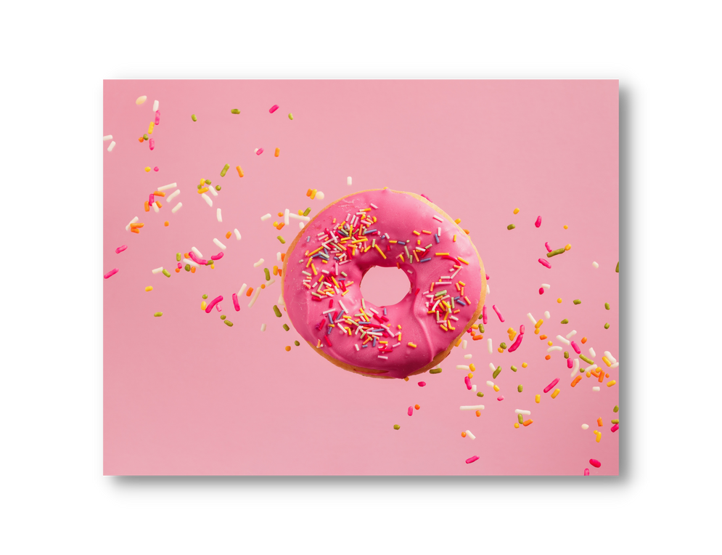
$40 MILLION
Krispy Kreme helped community groups to raise $40 million globally in 2022.
KRISPY
KREME
COMMUNITY FUNDRAISING
83,000
Krispy Kreme supported more than 83,000 fundraising events in the U.S. alone in 2022.
$37 MILLION
Those fundraising events raised more than $37 million

Slide 21
DISCUSSION QUESTIONS
What is promotion?
What are the different forms of promotion?
Why do businesses and brands engage in promotional activities?
How would you describe each of the promotions highlighted in this presentation?
What do you think Krispy Kreme hopes to accomplish by offering free or discounted doughnuts?
Why do you think they are involved with fundraising efforts and how might that represent an example of promotion?
What is sampling?
How might the examples from this story provide an illustration of the concept of sampling?
Why do you think Krispy Kreme offers limited-edition flavored doughnuts?
Why might they bring some of those flavors back?

Slide 22
DISCUSSION QUESTIONS
Consider what you have learned about promotion.
After reviewing the information in the “Sweet Promotion” presentation, you will create your own Krispy Kreme promotion. You will then present your ideas in class.
Working in pairs or small groups, describe your promotion, making sure to identify the following information:
Name of the promotion
Date the promotion will launch
Details of the promotion (BOGO ”Buy one get one”, Free giveaway, Discount, etc.)
Strategy for communicating details of the promotion to consumers (Advertising, social media, etc.)

Slide 23
SOURCES
https://investors.krispykreme.com/news-releases/news-release-details/krispy-kremer-celebrate-class-2023-free-original-glazedr-dozen
https://investors.krispykreme.com/news-releases/news-release-details/krispy-kremer-giving-taxpayers-sweet-tax-break-tax-day-april-18
https://people.com/food/krispy-kreme-is-giving-out-free-green-doughnuts-for-st-patricks-day
https://www.krispykreme.com.au/blog/april-fools-spicy-doughnut
https://www.delish.com/food-news/a33926003/krispy-kreme-labor-day-weekend-deal-2020
https://investors.krispykreme.com/news-releases/news-release-details/krispy-kremer-celebrates-85th-birthday-giving-away-8500-years
https://investors.krispykreme.com/news-releases/news-release-details/krispy-kremer-celebrates-85th-birthday-giving-away-8500-years
https://investors.krispykreme.com/news-releases/news-release-details/krispy-kremer-celebrates-85th-birthday-giving-away-8500-years
https://www.today.com/food/news/krispy-kreme-gas-promo-rcna41903
https://www.krispykreme.com/promos/fanfavs
https://www.bakemag.com/articles/15953-krispy-kreme-responds-to-gas-prices-with-strategic-doughnut-reserve
https://wsvn.com/news/local/ahoy-mateys-talk-or-dress-like-a-pirate-today-and-get-free-doughnuts-at-krispy-kreme/
https://www.marketing-beat.co.uk/2023/01/19/krispy-kreme-sadvert-billboard/

