Slide 1
MARKETING
STUNTS 2023
www.sportscareerconsulting.com - Marketing Insights from SCC

Slide 2
MARKETING
STUNTS 2023
Every year on April Fools’ Day, brands launch creative product innovations and collaborations online and through social media channels. We call this practice a publicity or marketing "stunt."
In this presentation, we will review several examples. See if you can guess if the product launch is an actual product or brand collaboration or if it is just an April Fools' Day marketing prank.
www.sportscareerconsulting.com - Marketing Insights from SCC

Slide 3
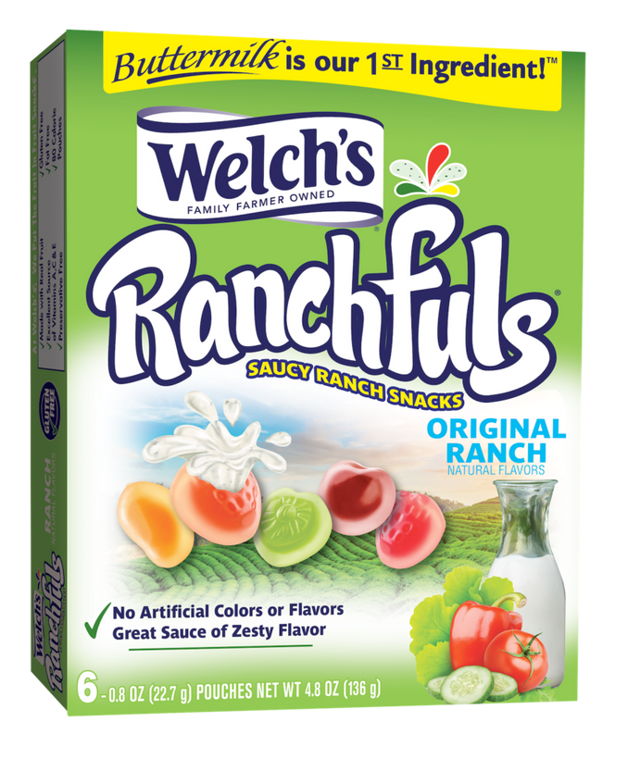
Welch's
"Ranchfuls"
Snacks
MARKETING
STUNTS 2023
Welch's introduced a new flavor of their popular Fruit Snacks product via the brand's Facebook page with the post: "Get ready to experience the ultimate sauce-filled snack! Made with REAL Buttermilk and veggies and no artificial colors or flavors, every bite is bursting with zesty flavor."
www.sportscareerconsulting.com - Marketing Insights from SCC

Slide 4
APRIL FOOLS!
www.sportscareerconsulting.com - Marketing Insights from SCC

Slide 5
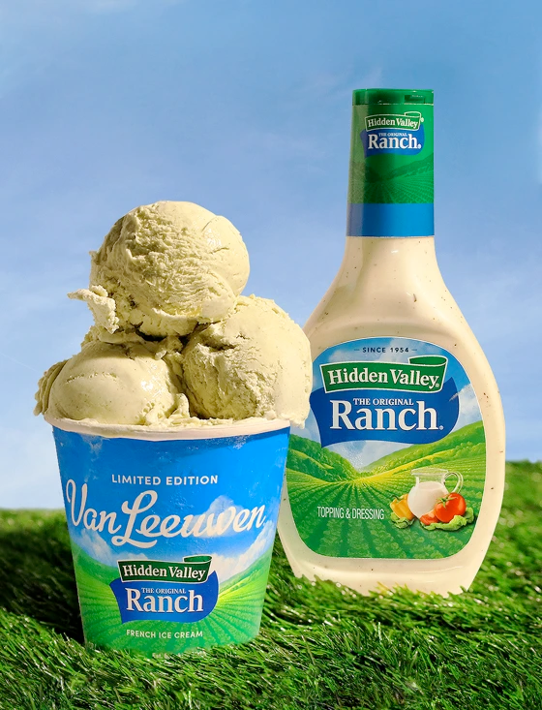
MARKETING
STUNTS 2023
Ranch-Flavored
Ice Cream
Created in honor of National Ranch Day on March 10, popular ice cream company Van Leeuwen collaborated with the top-selling ranch brand in the country, Hidden Valley Ranch to create a limited edition ranch-flavored ice cream.
www.sportscareerconsulting.com - Marketing Insights from SCC

Slide 6
REAL PRODUCT!
www.sportscareerconsulting.com - Marketing Insights from SCC

Slide 7
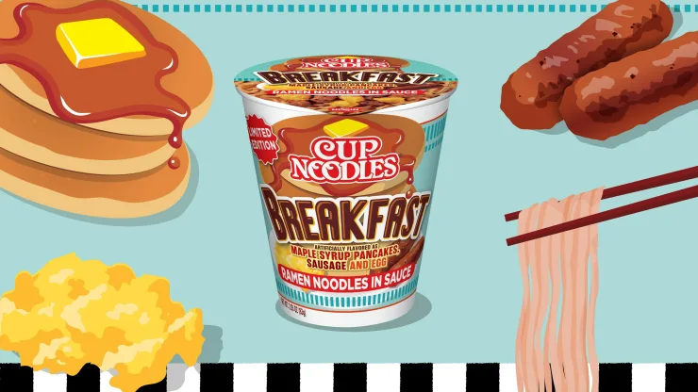
MARKETING
STUNTS 2023
Ramen Noodles for Breakfast
Cup Noodles recently launched a breakfast product, blending ramen noodles with breakfast flavors of pancakes, maple syrup, sausage, and eggs in the brand's iconic noodle cup.
www.sportscareerconsulting.com - Marketing Insights from SCC

Slide 8
REAL PRODUCT!
www.sportscareerconsulting.com - Marketing Insights from SCC

Slide 9
MARKETING
STUNTS 2023
Suburu's
Forager Granola
Subaru created a branded granola snack. The automaker says “At Subaru, we’re committed to being More Than a Car Company, and now, we are literally More Than a Car Company, because we’re making granola. We know Subaru drivers have a reputation for being ‘crunchy,’ and now we have a snack that is as crunchy – or perhaps crunchier – than they are.”
www.sportscareerconsulting.com - Marketing Insights from SCC

Slide 10
APRIL FOOLS!
www.sportscareerconsulting.com - Marketing Insights from SCC

Slide 11
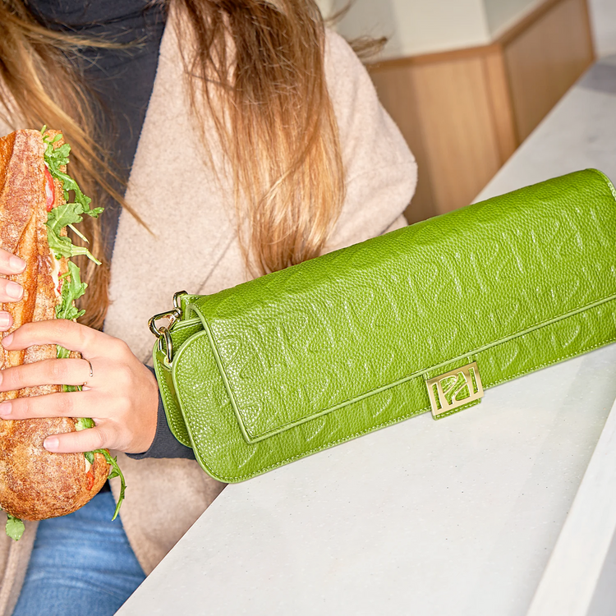
MARKETING
STUNTS 2023
Panera's BAGuette Purse
To promote a new product, Panera created a stylish purse accessory. As described by the brand, "At 12” long, the BAGuette is the perfect size to carry one of our new Toasted Baguette sandwiches."
www.sportscareerconsulting.com - Marketing Insights from SCC

Slide 12
REAL PRODUCT!
www.sportscareerconsulting.com - Marketing Insights from SCC

Slide 13
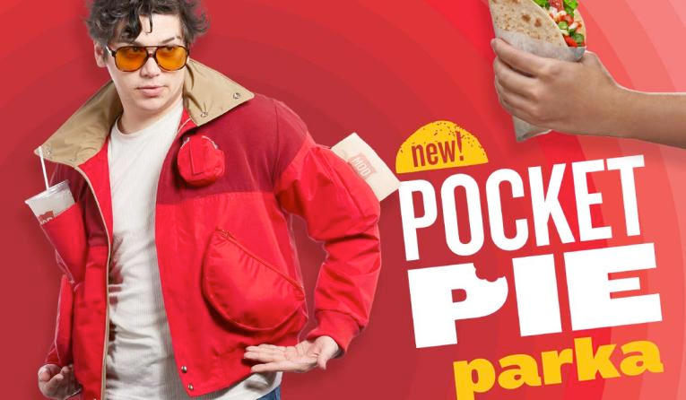
MOD Pizza "Pocket Pie" Parka
MARKETING
STUNTS 2023
MOD Pizza created a parka jacket with pockets lined in a way that customers can carry its new "pocket pie" menu item. The parka also has another pocket to holster a beverage.
www.sportscareerconsulting.com - Marketing Insights from SCC

Slide 14
APRIL FOOLS!
www.sportscareerconsulting.com - Marketing Insights from SCC

Slide 15
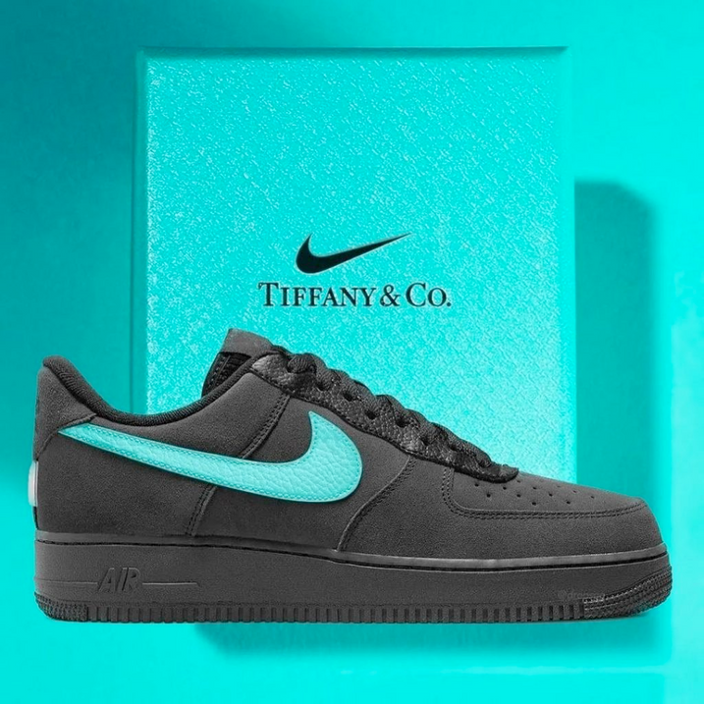
Nike and Tiffany & Co. Sneaker
Collaboration
MARKETING
STUNTS 2023
In an interesting brand collaboration, Nike teamed up with luxury brand Tiffany & Co. to create a limited edition "Nike/Tiffany Air Force 1" sneaker.
www.sportscareerconsulting.com - Marketing Insights from SCC

Slide 16
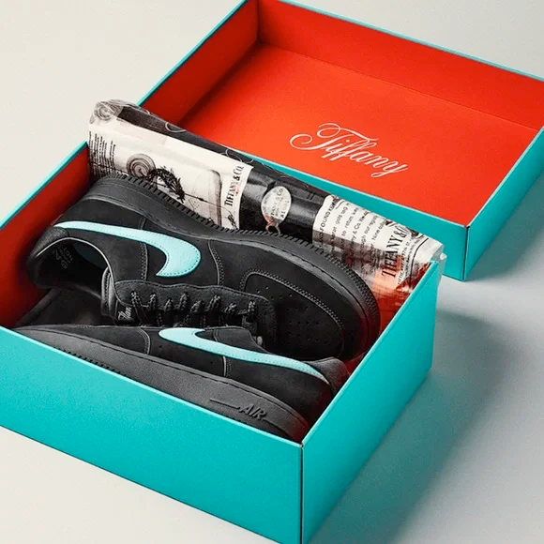
REAL PRODUCT!
www.sportscareerconsulting.com - Marketing Insights from SCC

Slide 17
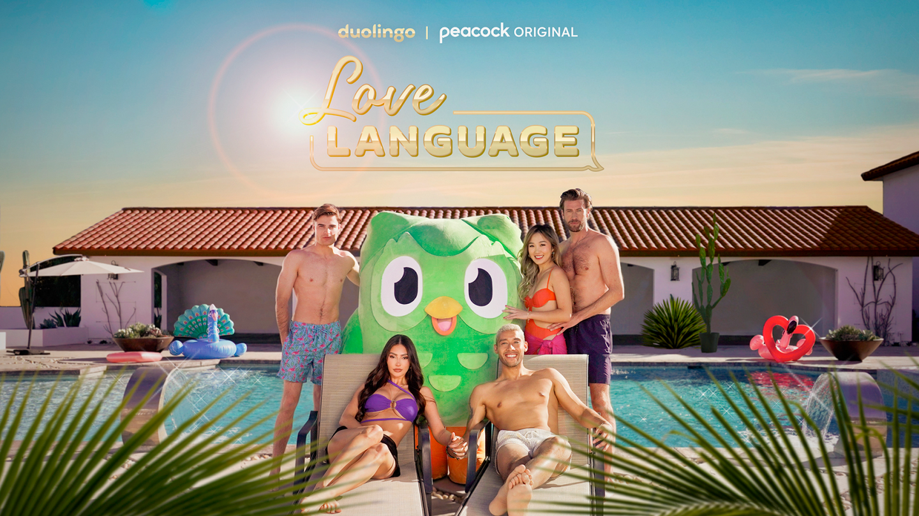
Peacock & DuoLingo Launch Dating Show
MARKETING
STUNTS 2023
Peacock Plus enlisted reality star Francesca Farago to star in its new reality dating show, "Love Language", in which none of the cast members speak the same language. They partnered with language-learning brand Duolingo to launch the show.
www.sportscareerconsulting.com - Marketing Insights from SCC

Slide 18
APRIL FOOLS!
www.sportscareerconsulting.com - Marketing Insights from SCC

Slide 19
MARKETING
STUNTS 2023
UPS Introduces
an Energy Drink
The UPS Store unveiled “Unstoppable in a Can,” an energy drink that gives consumers the energy to conquer their five-year business plan to promote its services to aspiring entrepreneurs.
www.sportscareerconsulting.com - Marketing Insights from SCC

Slide 20
APRIL FOOL'S!
www.sportscareerconsulting.com - Marketing Insights from SCC

Slide 21
MARKETING
STUNTS DISCUSSION QUESTIONS
www.sportscareerconsulting.com - Marketing Insights from SCC

Slide 22
MARKETING
STUNTS 2022
1) What is a "stunt" from a marketing perspective?
2) What is a collaboration?
3) Why do brands collaborate?
4) What is publicity?
5) Why do you think brands engage in "stunts" as a marketing strategy?
6) Do you think there is any risk associated with this strategy? Why or why not?
www.sportscareerconsulting.com - Marketing Insights from SCC

Slide 23
SOURCES:
facebook.com/WelchsFruitSnacks
media.subaru.com/pressrelease/2032/1/subaru-america-launches-all-new-2023-subaru-forager
axios.com/2023/04/01/april-fools-pranks-ramen-breakfast-walmart
today.com/food/trends/hidden-valley-ranch-ice-cream-van-leeuwen-review-rcna74423
panerabaguettebag.com
tiffany.com/stories/tiffany-and-nike-air-force
peacocktv.com/stream-tv/love-language
qsrmagazine.com/news/mod-pizza-rolls-out-limited-edition-pocket-pie-parka
inc.com/theupsstore/why-business-owners-are-buzzing-and-laughing-about-this-brands-april-fools-joke.html
MARKETING
STUNTS 2023
www.sportscareerconsulting.com - Marketing Insights from SCC

