Slide 1
BRANDS THAT
VALENTINE’S

Slide 2
PROMOTION
Promotion is any form of communication used to inform, persuade, or remind people about a company’s products or services.
Promotion plays a significant role in creating and maintaining the levels of commitment and emotional involvement consumers have with the brand.

Slide 3
PACKAGING
In marketing, packaging refers to the process of designing and producing the container for a product. The container could be anything from a candy bar wrapper to the packaging surrounding a new Android device.
How important is packaging as it relates to marketing? Some industry professionals actually consider packaging as a fifth “P” in an expanded variation of the marketing mix.

Slide 4
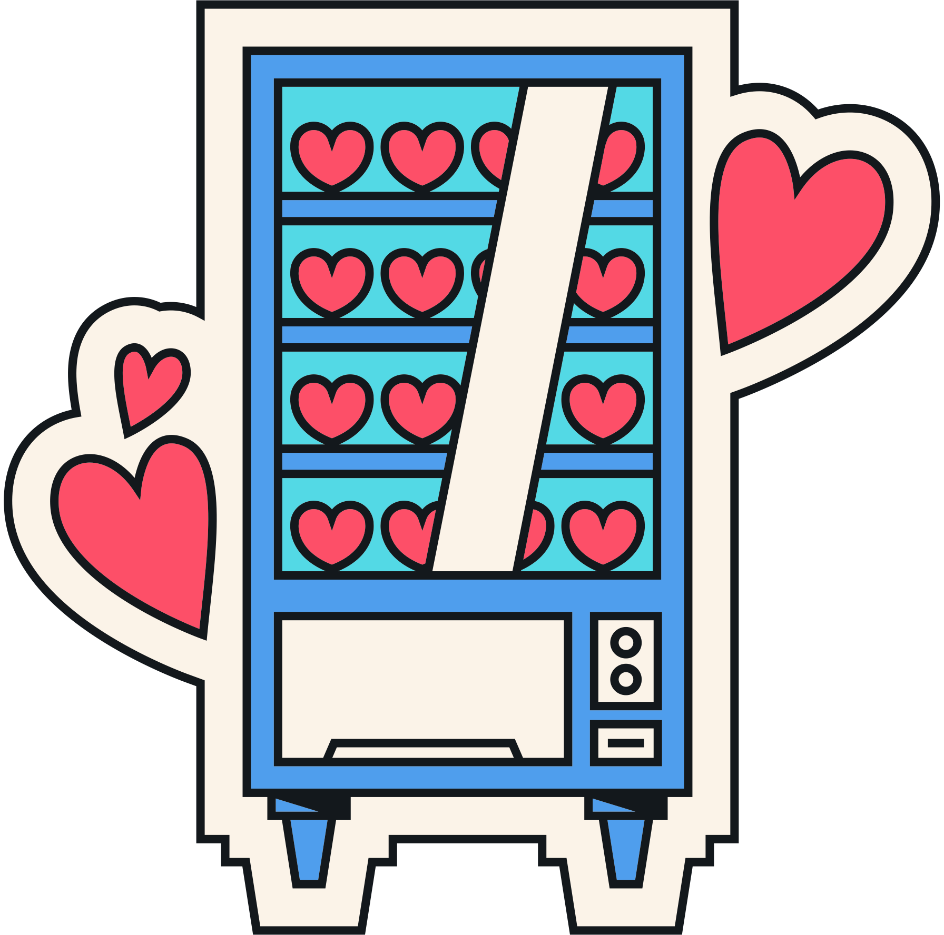
Packaging & Promotion
HOW DO BUSINESSES AND BRANDS DEVELOP PACKAGING & PROMOTION STRATEGIES TO HELP GRAB CONSUMER ATTENTION? LET'S TAKE A LOOK AT SOME OF THIS YEAR'S NOTABLE VALENTINE'S DAY BRAND PACKAGING AND PROMOTIONS STRATEGIES.

Slide 5
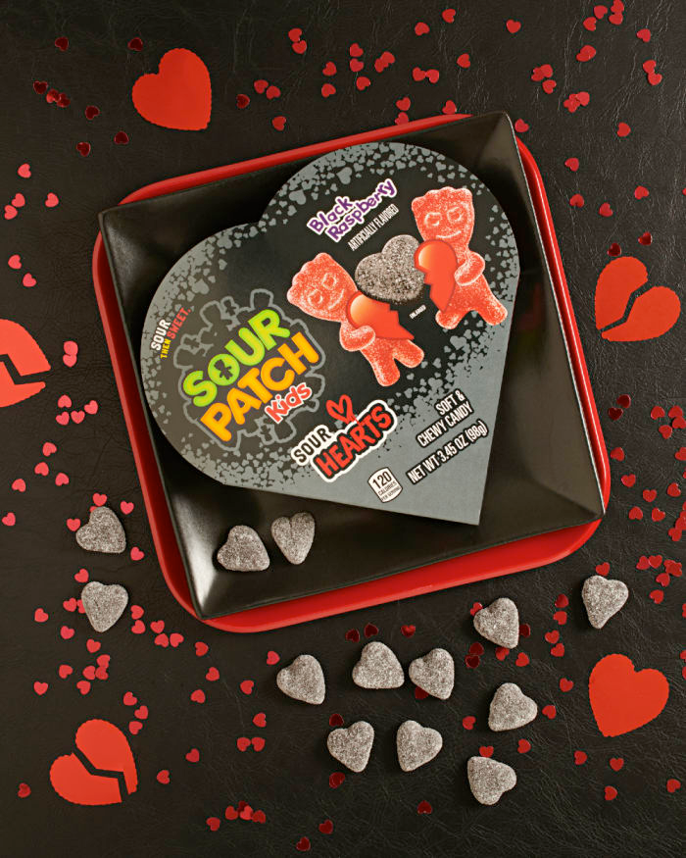
SOUR PATCH KIDS
In February, Sour Patch kids will appeal to those consumers who don't like Valentine's Day with the introduction of "Sour Hearts", a black raspberry limited edition flavor packaged in a black Valentine's Day heart-shaped box.
Marketing Insights from SCC

Slide 6
SOUR PATCH KIDS
In honor of its new, limited-edition product, Sour Patch Kids is throwing the ultimate anti-Valentine's Day celebration: the Sour Hearts Social Club. The one-of-a-kind dinner experience gathers singles and friends the day before Valentine's Day, February 13th, at The Allis at Soho House in Chicago.
Marketing Insights from SCC

Slide 7
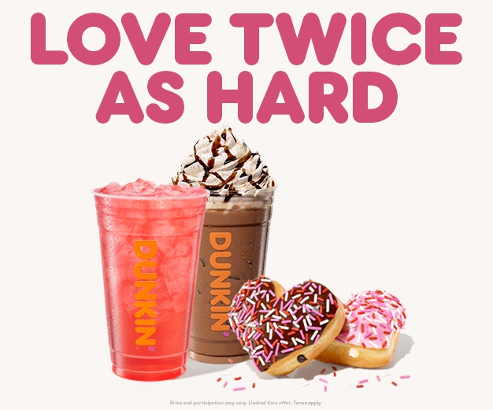
DUNKIN’
With a lineup of special menu items available only in the month of February, Dunkin' will be offering fan-favorite drinks and unique donut flavors in the shape of a heart.
Marketing Insights from SCC

Slide 8
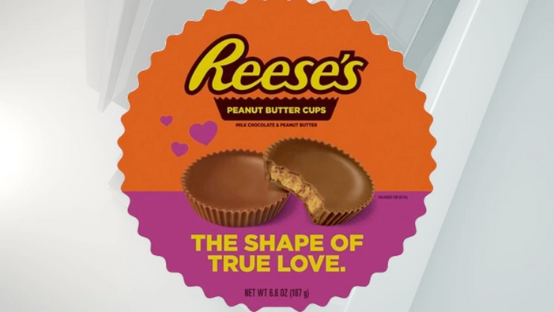
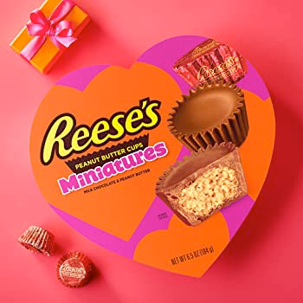
REESE’S
Each year for Valentine's Day, Reese's offers its popular Peanut Butter Cups in the shape of hearts.
This year, the brand introduced Valentine's Day-themed packaging, including this year featuring the phrase "The Shape of True Love” and heart-shaped peanut butter cup gift boxes.
Marketing Insights from SCC

Slide 9
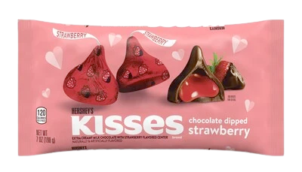
HERSHEY
For Valentine’s Day this year, Hershey is introducing a new flavor with a Valentine’s Day-themed spin on its iconic Hershey Kisses candy with the launch of a Chocolate Dipped Strawberry flavor.
Marketing Insights from SCC

Slide 10
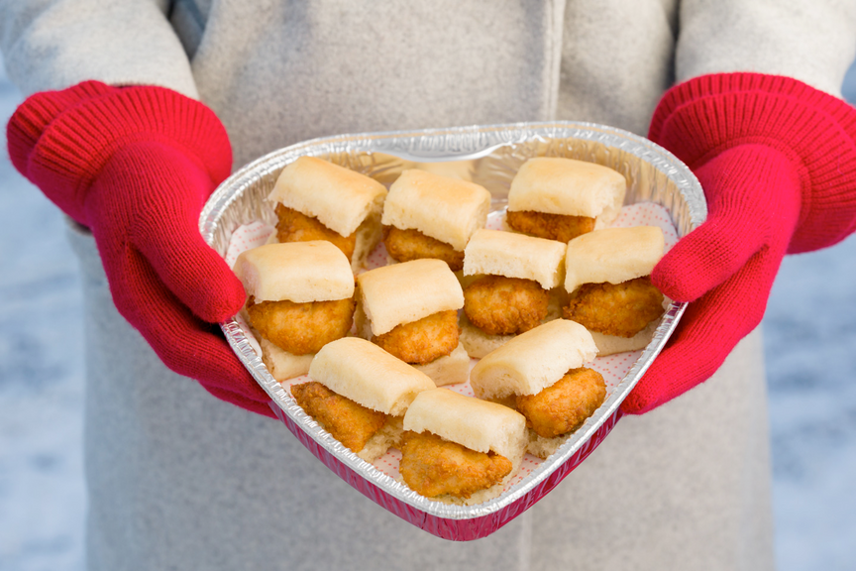
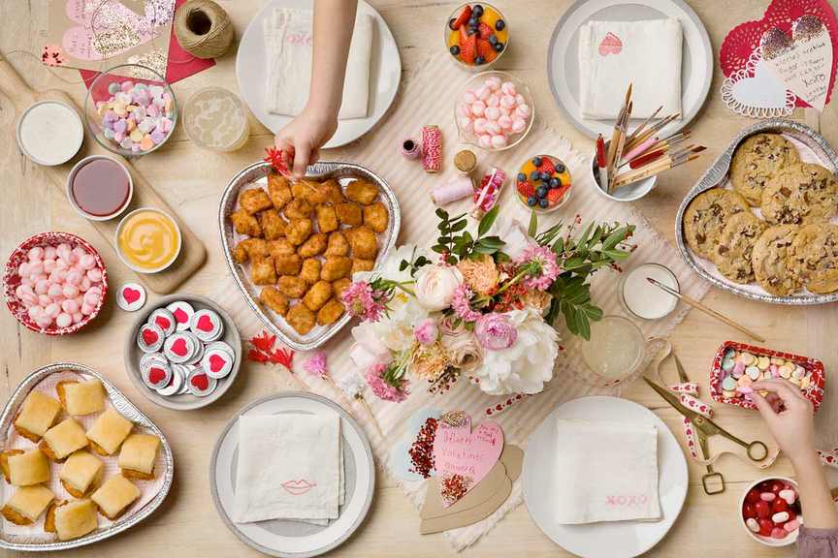
CHICK-FIL-A
Chick-Fil-A’s “Heart Trays” will be available for a limited time, filled with select menu items, such as 30-count Chick-fil-A® Nuggets, 10-count Chick-n-Minis®, 6-count Chocolate Chunk Cookies or 12 Chocolate Fudge Brownie halves.
Marketing Insights from SCC

Slide 11
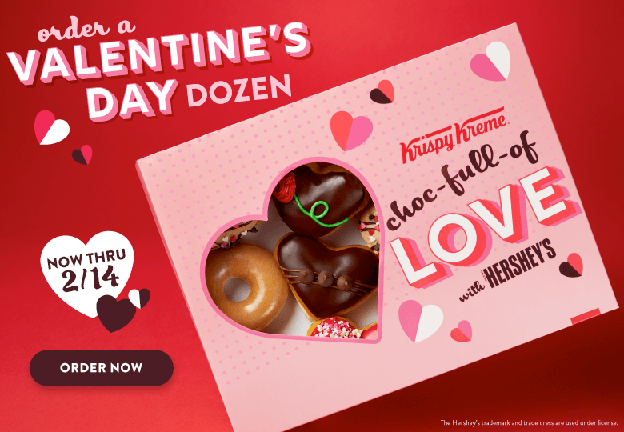
KRISPY KREME
Krispy Kreme's 2023 brand collaboration with Hershey's are packaged in a delightful custom red and pink “Choc-Full-of-Love” box with a heart-shaped cutout showcasing the chocolate sweet treats inside.
Marketing Insights from SCC

Slide 12
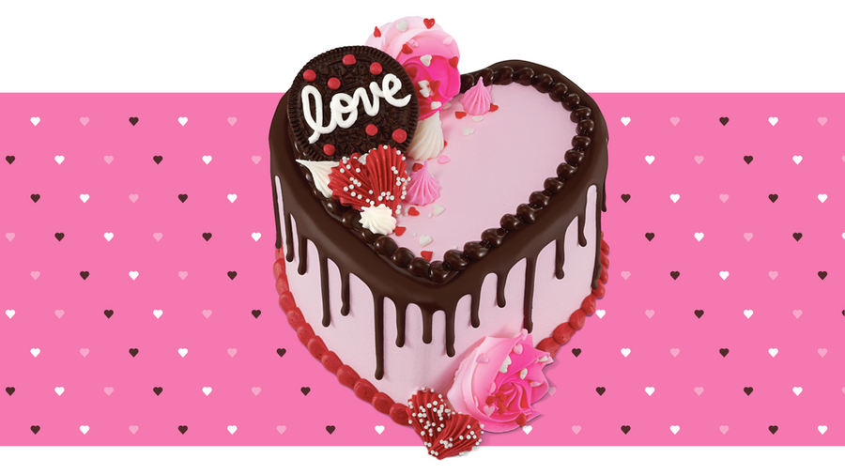
BASKIN ROBBINS
In 2023, Baskin Robbins is bringing back a fan-favorite Flavor of the Month worth melting for, Love Potion #31, along with a sweet new surprise, the Crazy for You Cake.
Marketing Insights from SCC

Slide 13
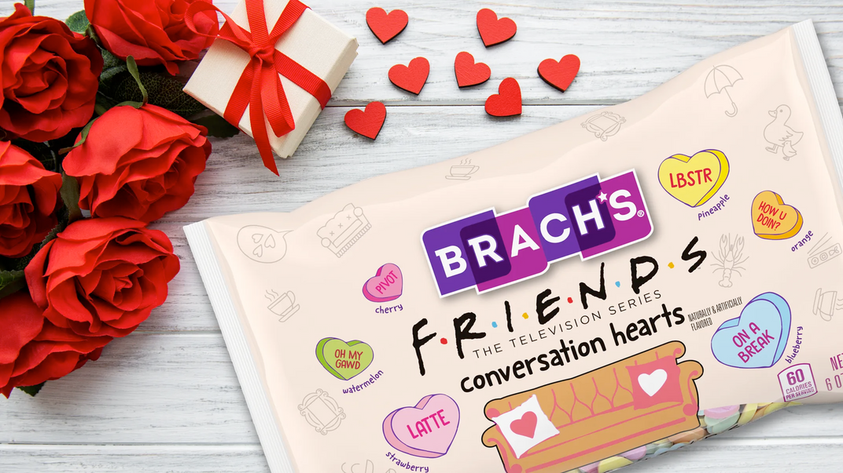
BRACH’S
This year, Brach’s is introducing limited-edition Conversation Hearts inspired by the enduring sitcom “Friends.” The hearts will feature 26 quotes and references from the show, including “UR My LBSTR,” “Moo point” and “On a Break.” The flavors will include watermelon, strawberry, blueberry, pineapple, cherry and orange.
Marketing Insights from SCC

Slide 14
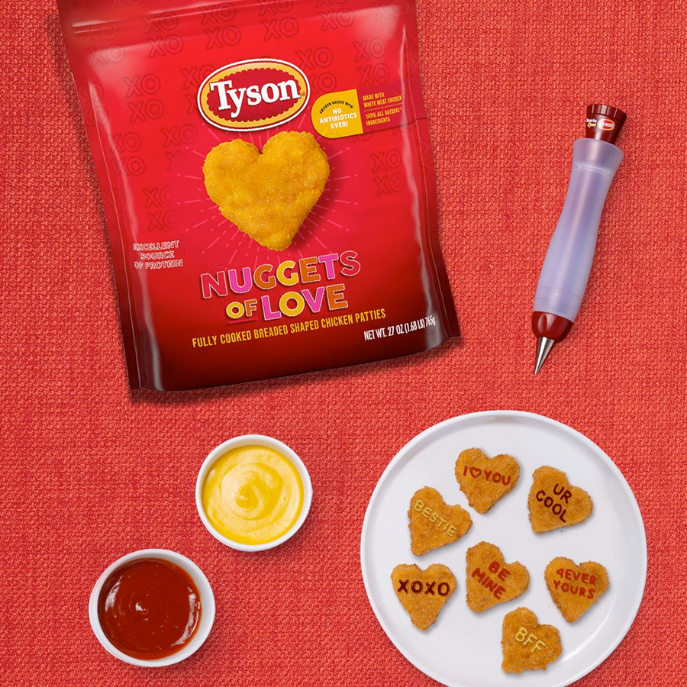
TYSON
Just in time for Valentine's Day, in Tyson brought back their "Nuggets of Love" heart-shaped chicken nuggets which were a very popular item last year.
Marketing Insights from SCC

Slide 15
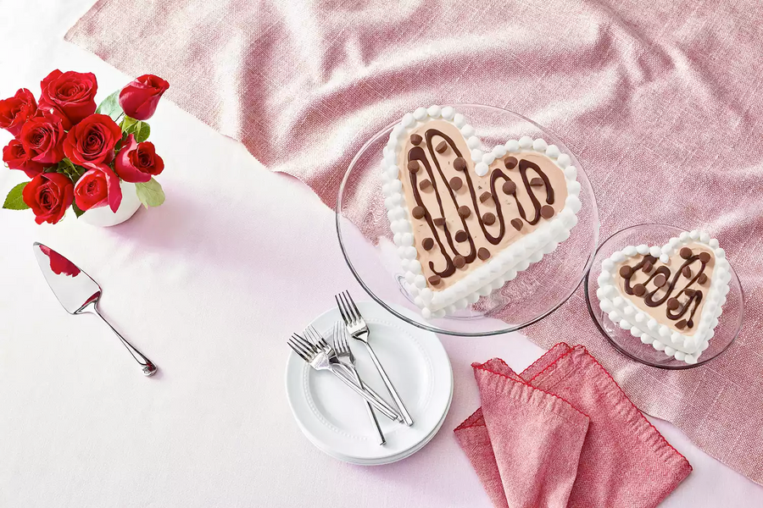
DQ
DQ dropped two new menu items for Valentine's Day this year, including a new Blizzard, inspired by the holiday, and a triple truffle Blizzard cupid cake shaped in the form of a heart.
Marketing Insights from SCC

Slide 16
DISCUSSION QUESTIONS
1) WHAT DO THE BRANDS FEATURED IN THIS PRESENTATION HAVE IN COMMON?
2) WHAT IS PROMOTION?
3) WHAT IS PACKAGING AS IT RELATES TO MARKETING?
4) HAVE YOU SEEN ANY OTHER EXAMPLES OF VALENTINE'S DAY PACKAGING OR PROMOTIONS?
5) WHAT IS CROSS PROMOTION?
6) WHAT IS ONE EXAMPLE OF CROSS PROMOTION FROM THIS PRESENTATION?

Slide 17
DISCUSSION QUESTIONS
7) WHAT OTHER BUSINESSES OR BRANDS MIGHT BENEFIT FROM VALENTINE'S DAY PACKAGING OR PROMOTION?
8) WHY MIGHT RESTAURANTS AND/OR HOSPITALITY & TRAVEL BRANDS BE INTERESTED IN MARKETING AROUND VALENTINE'S DAY?
9) WHY DO YOU THINK SOME BRANDS ARE TAKING AN ANTI-VALENTINE'S DAY MARKETING APPROACH?
10) IN YOUR OPINION, IS THAT A RISKY STRATEGY? WHY OR WHY NOT?

Slide 18
STUDENT ACTIVITY
The next slide features a list of several brands. Select one and create a Valentines-themed promotion or special packaging. Consider all the examples that you just reviewed in this presentation and apply some of those concepts to your promotion or packaging.
Be prepared to present your ideas in class.

Slide 19
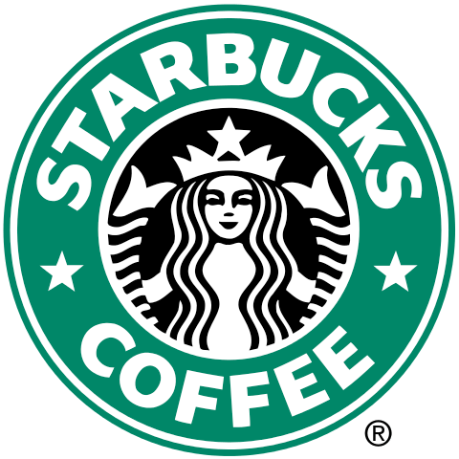
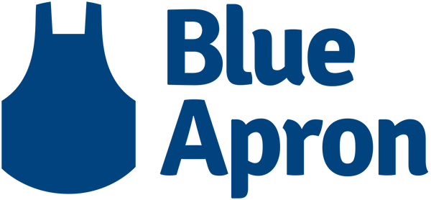
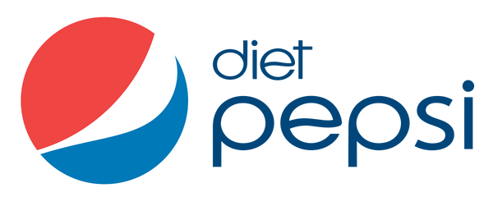
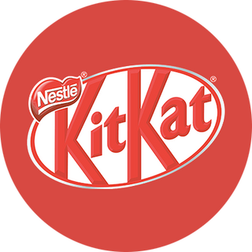
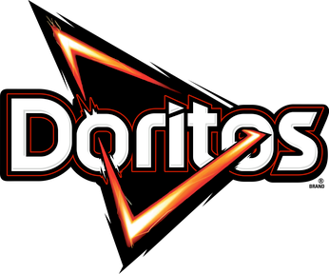
STUDENT ACTIVITY

Slide 20
SOURCES
www.fooddive.com/news/sour-patch-kids-sours-hearts-haagen-dazs-butter-cookie-cones-nutella-b-ready-biscuits/641950
www.prnewswire.com/news-releases/sour-patch-kids-puts-sweet-twist-on-valentines-day-with-new-sour-hearts-black-raspberry-candy-and-exclusive-dinner-experience-301735768.html
news.dunkindonuts.com/news/valentines-day-2023
www.abc27.com/hershey/hershey-to-release-new-candies-for-valentines-day-easter
www.chick-fil-a.com/stories/inside-chick-fil-a/this-valentines-day-chicken-is-the-new-chocolate
www.investors.krispykreme.com/news-releases/news-release-details/krispy-kremer-new-valentines-heart-shaped-doughnuts-are-choc
www.parade.com/food/baskin-robbins-valentines-day-menu-love-potion-ice-cream-scoop-2023
hwww.brand-innovators.com/news/brands-show-the-love-for-valentines-day

