Slide 1
By the numbers
The Academy Awards

Slide 2
5
The 2022 Academy Awards will mark just the 5th time in history that the show was postponed.

Slide 3
2
This is the 2nd year in a row that the event has been postponed as a result of COVID-19.

Slide 4
3
Last year marked the third year in a row that the Academy Awards did not feature a host. Wanda Sykes, Regina Hall, and Amy Schumer will host the 2022 Oscars in an attempt to give ratings a boost.

Slide 5
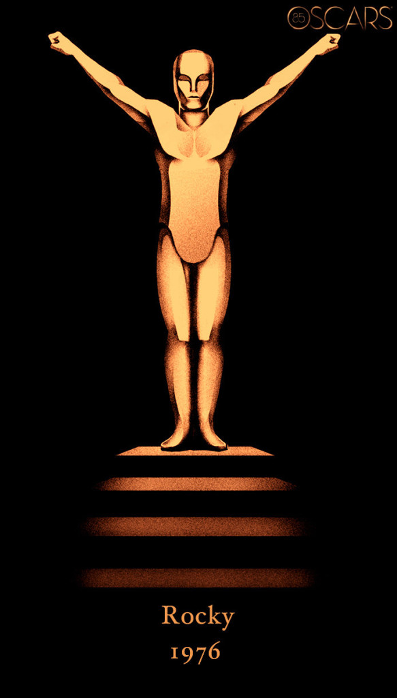
$75 million
ABC has televised every Oscars telecast since 1976, the network has a $75 million-a-year contract with the Motion Pictures Academy to air the awards show through 2028.

Slide 6
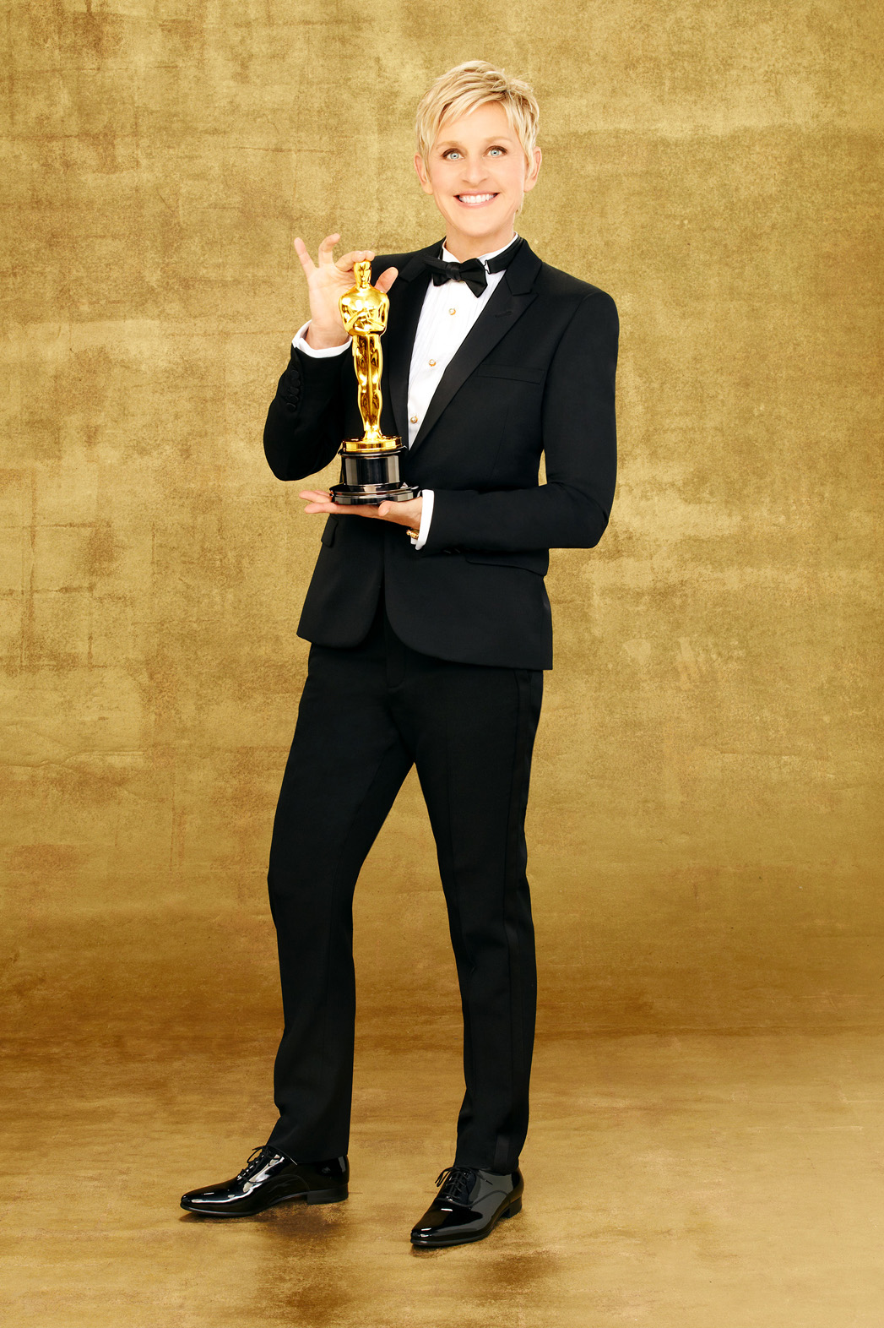
43,000,000
In 2014, 43 million people tuned in to watch the broadcast of the Academy Awards show, hosted by Ellen DeGeneres

Slide 7
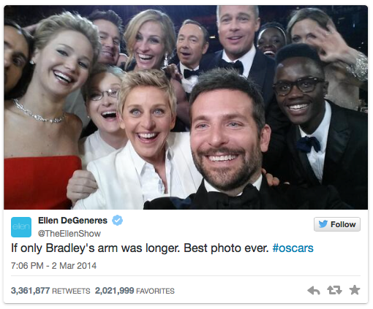
$1 billion
That year, Ellen’s “impromptu” selfie (and subsequent tweet) provided a value of between $800 million and $1 billion in exposure for Samsung (the pic was taken on a Samsung Galaxy device and tweeted during the broadcast)

Slide 8
23,600,000
In 2019, the Oscars telecast recorded its lowest rated broadcast all-time when 26.6 million viewers tuned in for the 90th anniversary of the Academy Awards…until 2020 when just 36.6 million people watched the show (a 20% drop in viewership from the previous year)

Slide 9
10,400,000
Just 10.4 million people tuned in to find out which film took home the best picture prize last year, a nearly 56% drop from the 23.6 million viewers that turned on their TVs for the program in 2020.

Slide 10
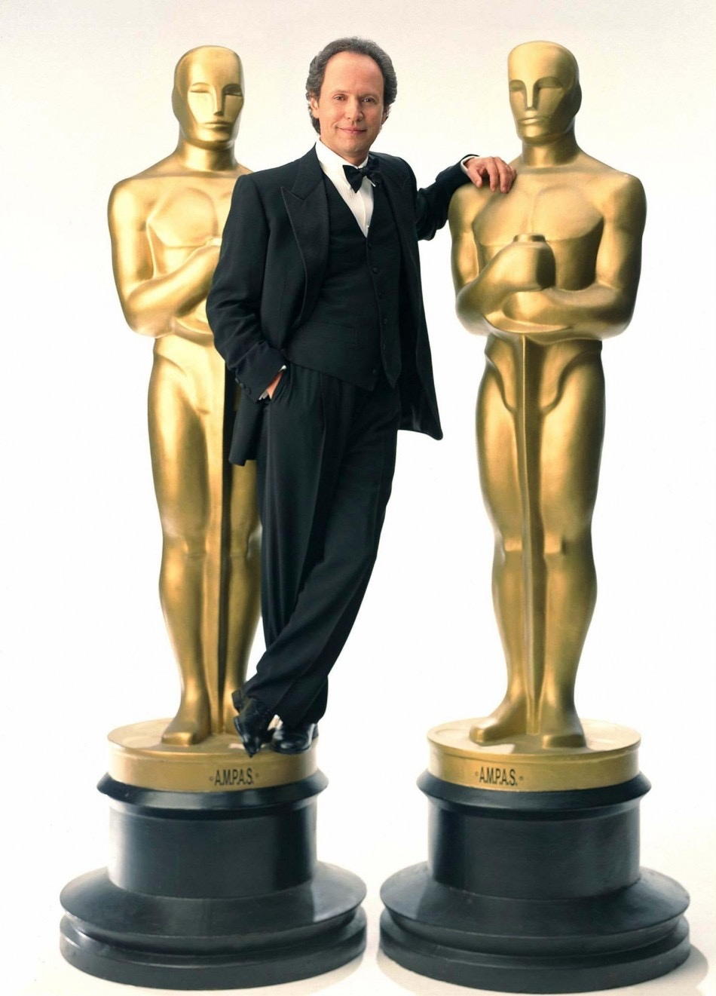
55,000,000
The most watched Oscars telecast was in 1998 which drew 55 million viewers.
That year Titanic won for Best Picture and Billy Crystal was the evening’s host.

Slide 11
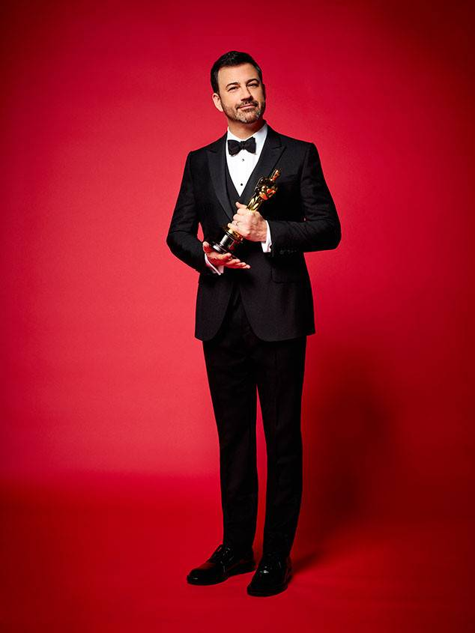
$15,000
Late night host Jimmy Kimmel was the last host of the Oscars. He earned a fee of $15,000 for the job, according to US Magazine.

Slide 12
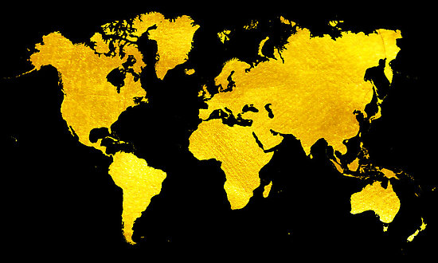
225
It is estimated that viewers will tune in from more than 225 different countries to watch this year's Oscars

Slide 13
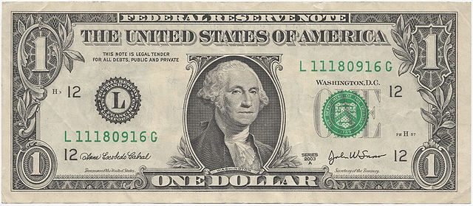
$1.00
Oscar winners are not allowed to sell their statue to anyone other than back to the Academy… And what does the Academy charge to buy the award? One dollar.

Slide 14
$900
The current estimated value of the 24-karat gold-plated Oscar statuette is around $900.

Slide 15
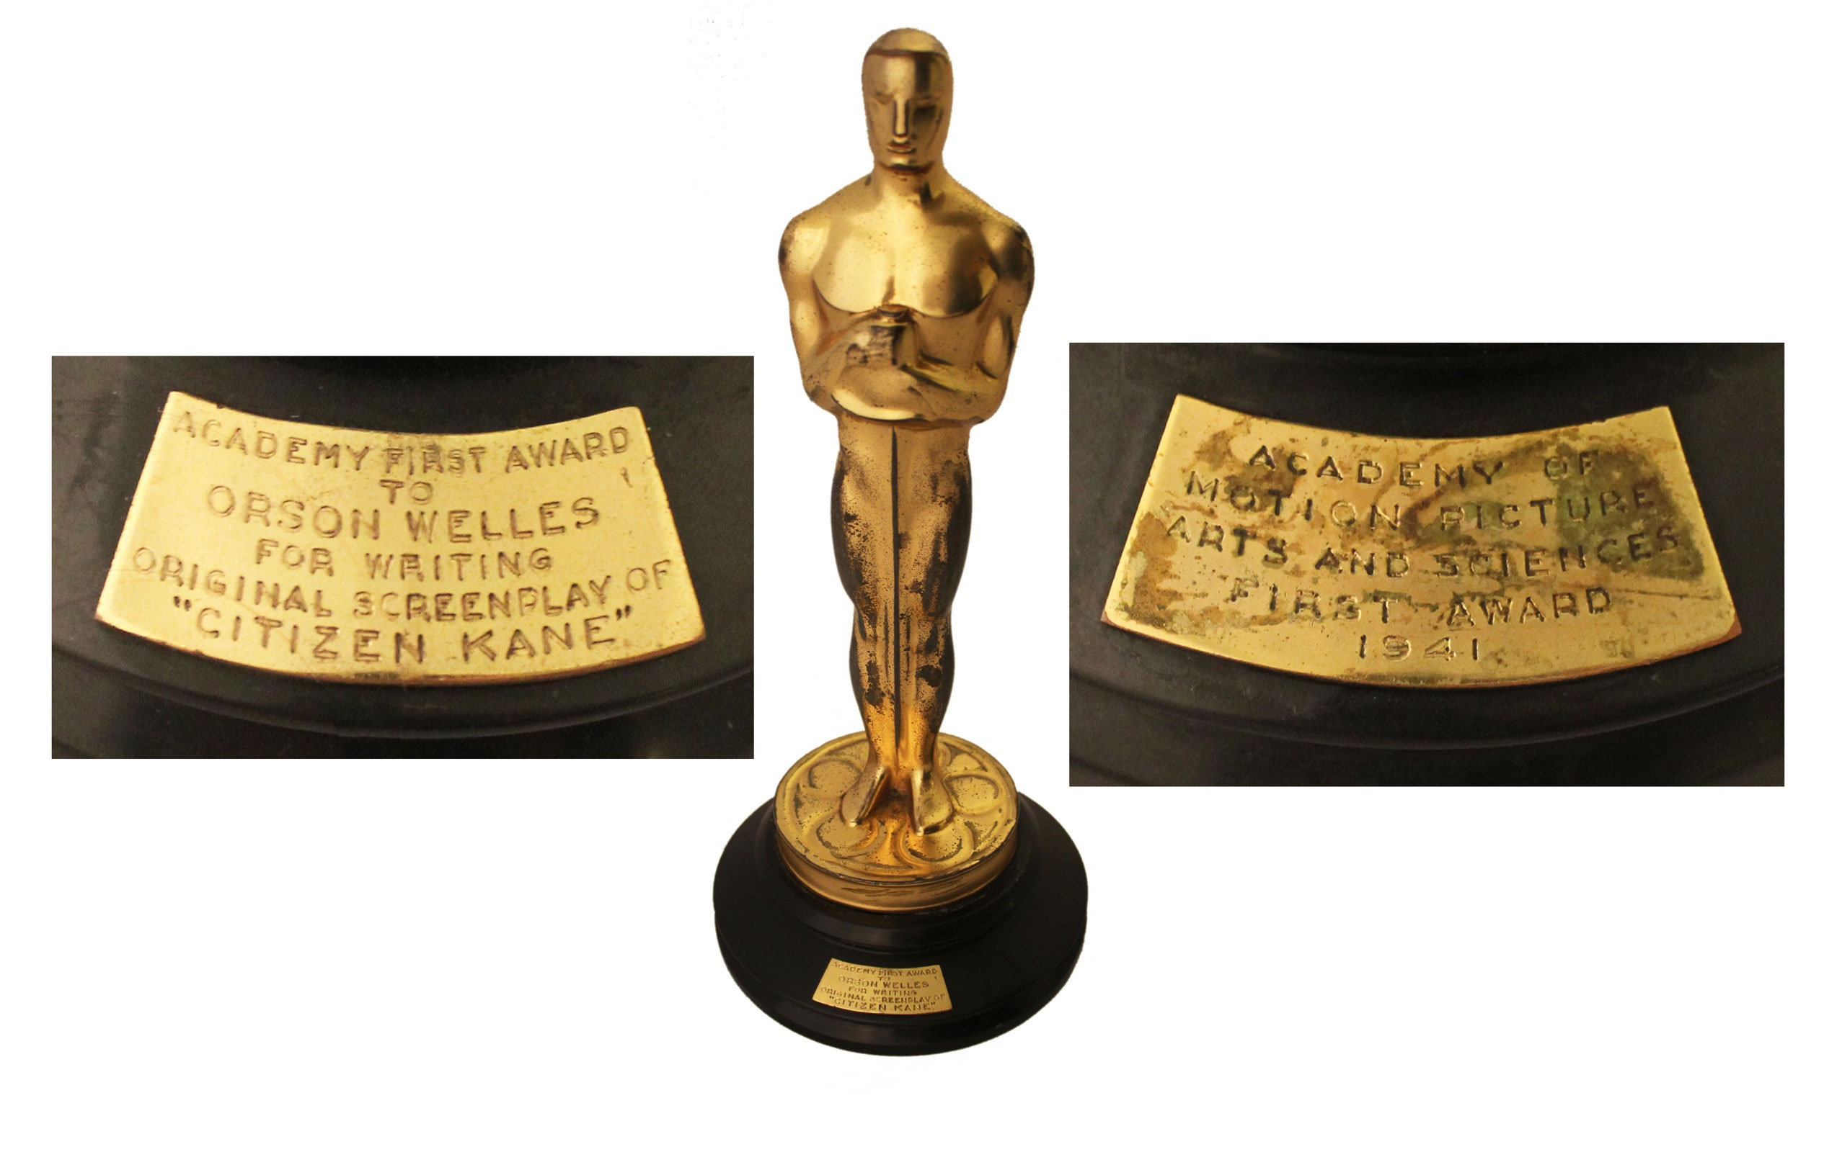
$861,542
In 1941, Orson Welles's won an Oscar for "Citizen Kane" (Best Original Screenplay). His heirs would later sell the statue at an auction for $861,542 after winning a lawsuit granting them permission to sell it.

Slide 16
$100,000
The Oscar nominee “swag” bags given away in 2015 contained a record $232,000 worth of gifts, continuing the trend of overly extravagant gifts for celebrity attendees.
This year’s estimates suggest the giveaways are worth more than $100,000, including extra virgin olive oil infused with edible gold flakes and a plot of land in Scotland. Also included is an Orca-themed pool float from PETA in protest of Sea World.

Slide 17
$115.3 million
In 2021, the Oscars nabbed around $115.3 million in advertising revenue, according to Kantar, a tracker of ad spending. That was a 10.7% drop from the nearly $129.2 million ABC generated in ad sales from the Academy Awards broadcast the previous year.

Slide 18
$2.2 million
According to Variety, ABC is charging between $1.7 million and $2.2 million per 30-second advertising spot in its broadcast of the 94th annual Academy Awards. That’s down from the $2.8 million they reportedly charged four years ago.

Slide 19
0
Despite the recent trend of declining ratings and high price tag, ABC has reportedly sold out of advertising inventory for this year’s show.

Slide 20
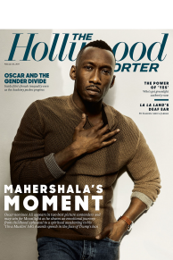
$72,000
Advertising isn’t limited to television. The cost for a one-page ad in the Hollywood Reporter during Oscar season comes in at $72,000.

Slide 21
$9 million
On average, a film will see a $9 million average increase in box office sales for winning an Oscar for Best Picture

Slide 22
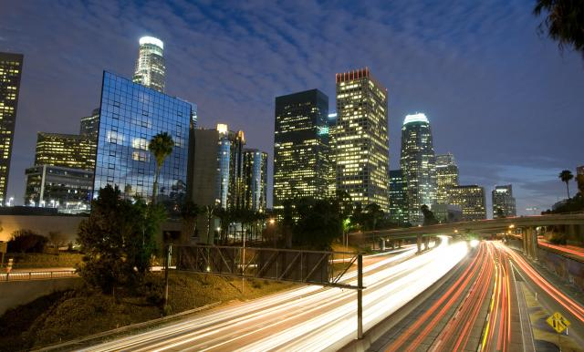
$43 million
The total cost of production for this year’s Academy Awards? It will cost a whopping $42.9 million to host the show ceremony in 2022.

Slide 23
32%
Last year, 32% of the Oscar nominees were women, the highest percentage in the history of the Academy Awards

Slide 24
28.3%
Based on data from TheWrap, 65 of the 229 individual nominees from 2022's crop of nominated films are women, or 28.3%, the lowest number in three years.

Slide 25
$10-20 million
According to Variety, Oscar campaign budgets for films seeking nominations in multiple categories can run from $10 to $20 million

Slide 26
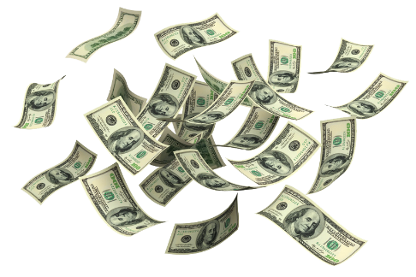
$130 million
According to reports, the greater Los Angeles area’s economy receives a $130 million boost annually from hosting the Academy Awards

Slide 27
questions for class
discussion
The Academy Awards

Slide 28
1) Why do advertisers spend so much advertising during the academy awards
2) Why do you think the academy refuses to allow winners to sell their statue?
3) How do you think social media influences the way marketers approach award shows like the oscars?
discussion questions

Slide 29
4) What kind of economic impact can winning an academy award have on a particular film?
5) What kind of economic impact can winning an academy award have on the career for individual winners (producers, directors, screenwriters, actors, actresses etc.)?
6) how do you think the idea of viewers throwing oscars parties might influence marketers of particular brands?
discussion questions

Slide 30
7) How do major events like the Oscars impact the economy of the host city (los angeles in the case of the academy awards)? 8) do you think brands will approach advertising during the 2022 academy awards in the same way they might have pre-pandemic? Why or why not?
discussion questions

