Slide 1
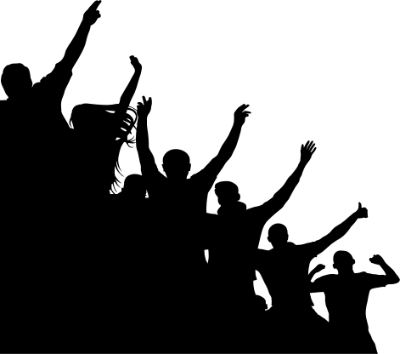
Game Day
Traditions

Slide 2
Game attractiveness refers to the customer’s perception of the event. It is a situational factor that varies from game to game or event to event. Game attractiveness can be influenced by a variety of factors.

Slide 3
GAME ATTRACTIVENESS
Game attractiveness is a situational factor that varies from game to game and week to week. There are a number of variables that impact game attractiveness, one of which is the existence of
traditions.

Slide 4
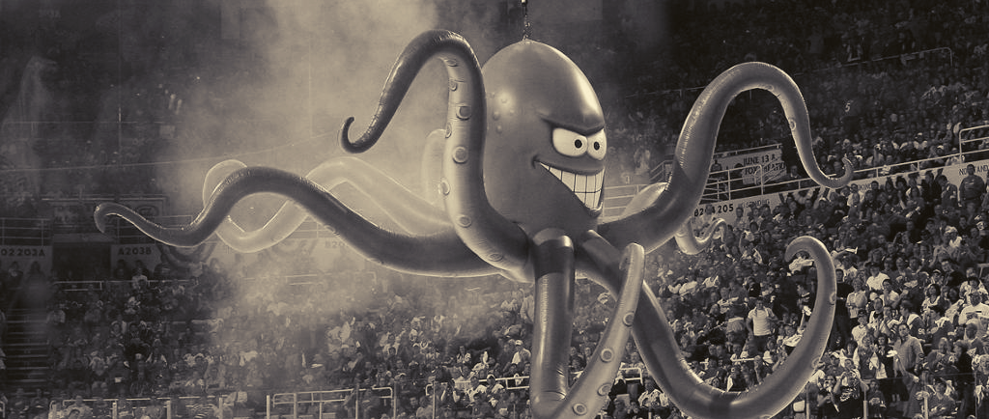
DETROIT RED WINGS
"Legend of the Octopus"
www.sportscareerconsulting.com

Slide 5
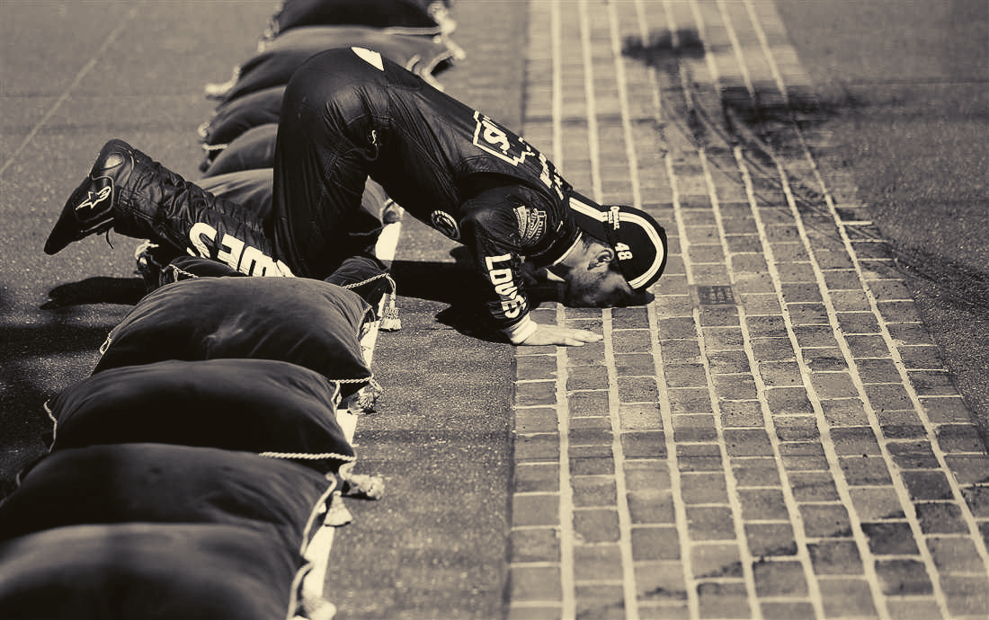
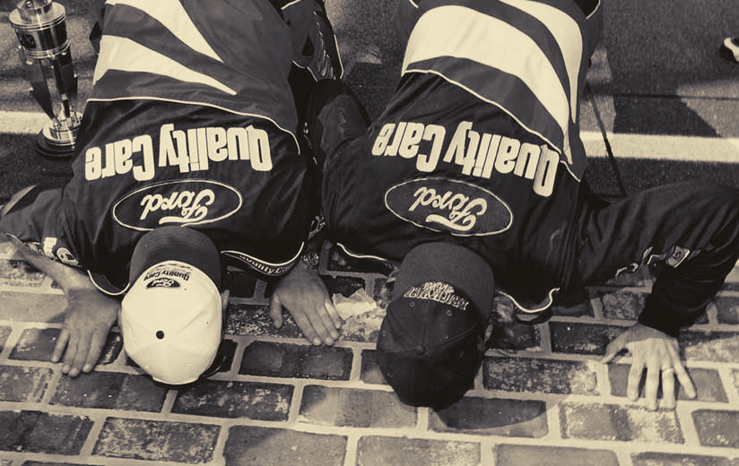
INDIANAPOLIS MOTOR SPEEDWAY
”KISSING THE BRICKS"
www.sportscareerconsulting.com

Slide 6
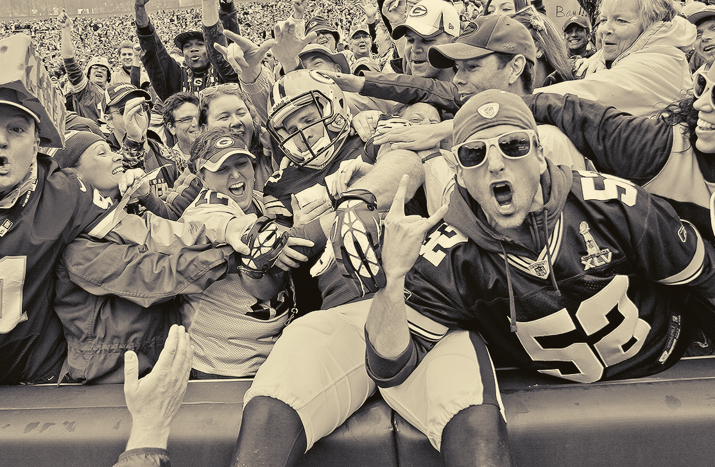
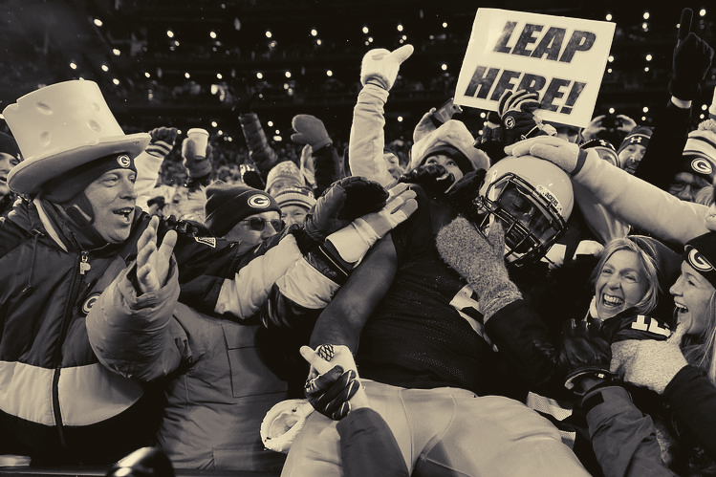
GREEN BAY PACKERS
"LAMBEAU LEAP"
www.sportscareerconsulting.com

Slide 7
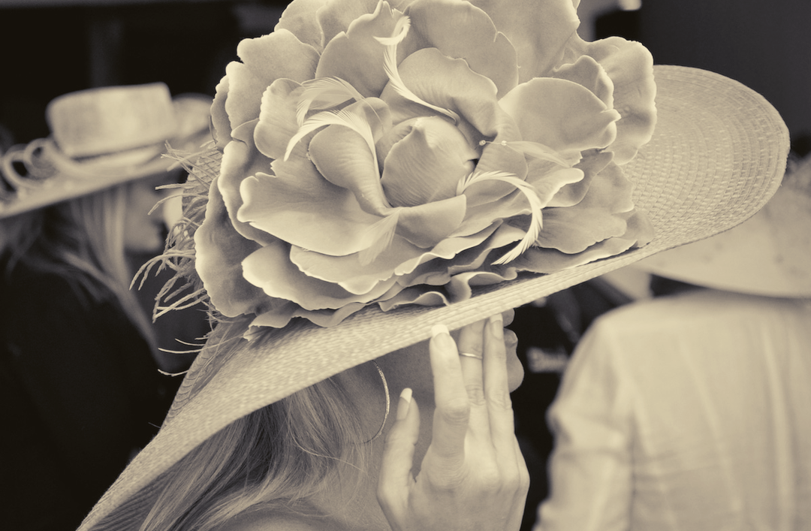
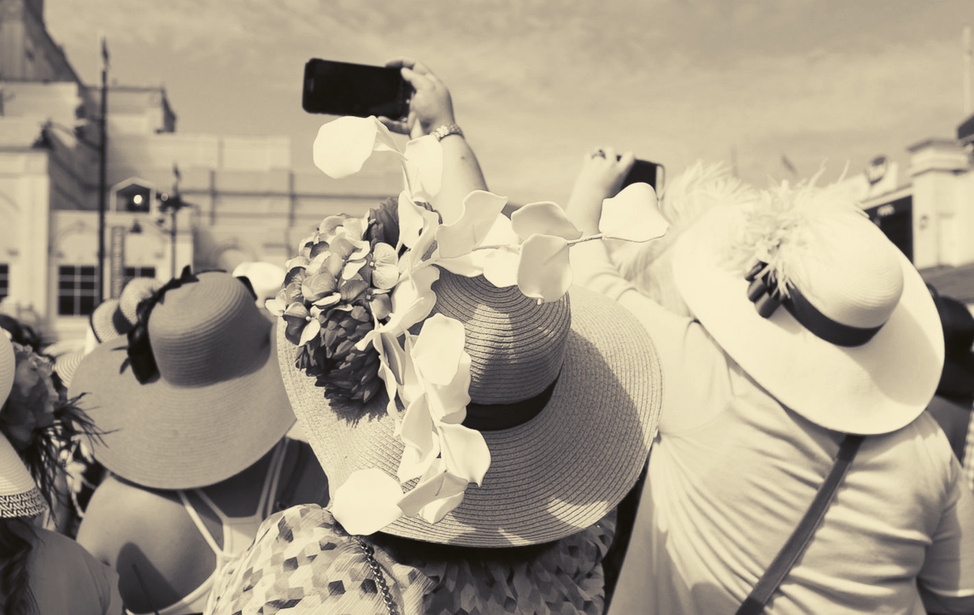
KENTUCKY DERBY HATS
www.sportscareerconsulting.com

Slide 8
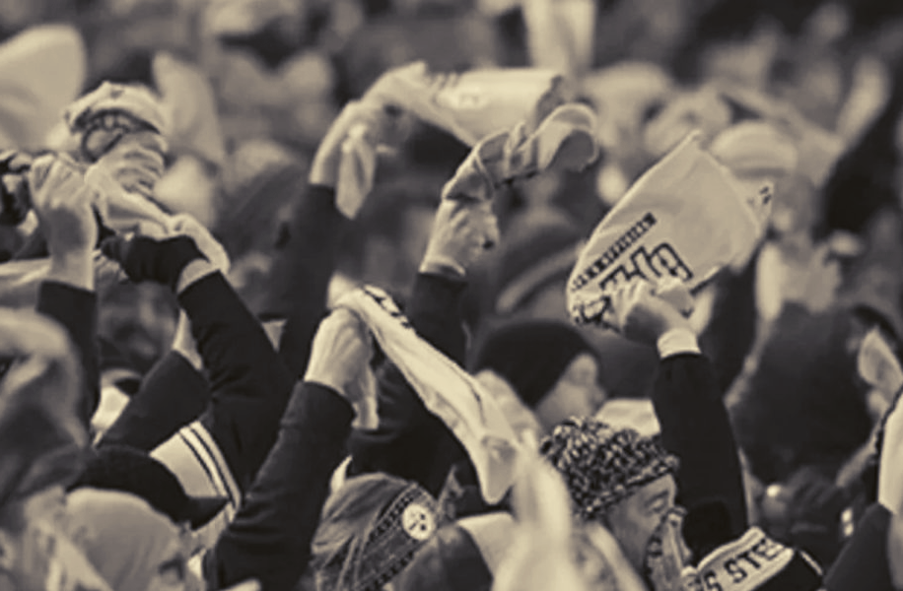
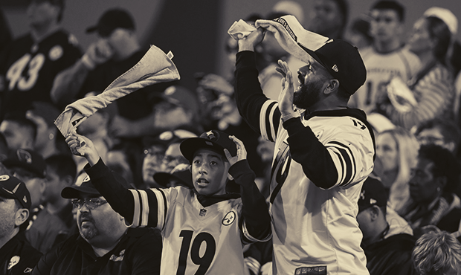
PITTSBURGH STEELERS
"TERRIBLE TOWELS"
www.sportscareerconsulting.com

Slide 9
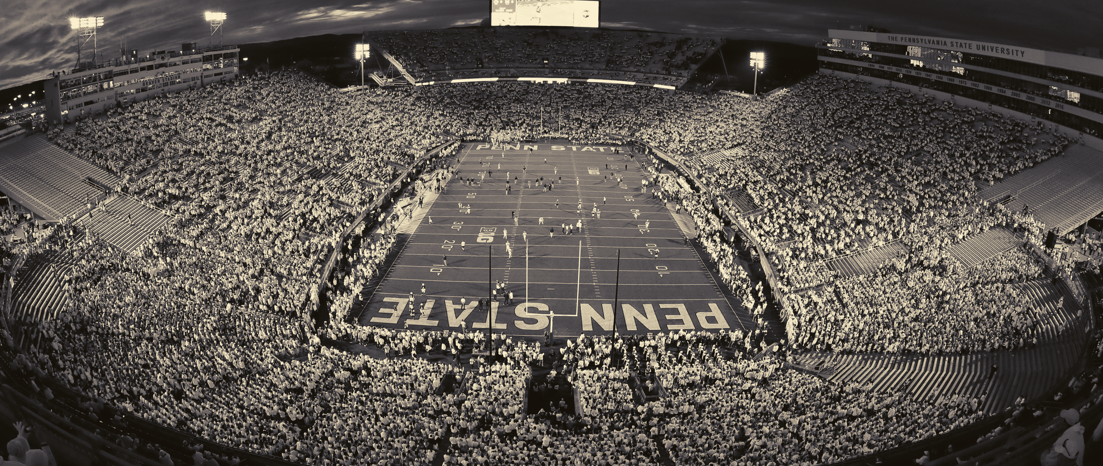
PENN STATE FOOTBALL
"WHITE OUT"
www.sportscareerconsulting.com

Slide 10
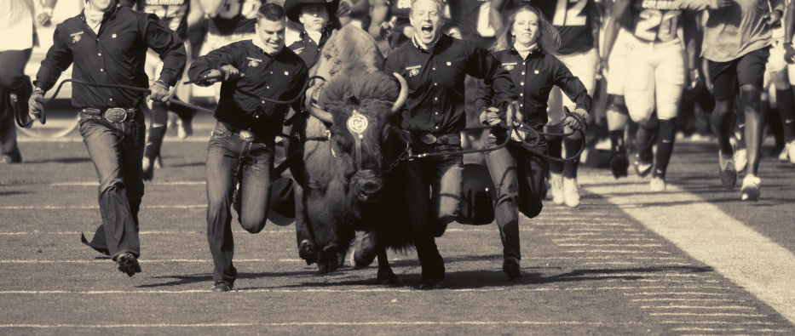
COLORADO UNIVERSITY FOOTBALL
"RALPHIE'S RUN"
www.sportscareerconsulting.com

Slide 11
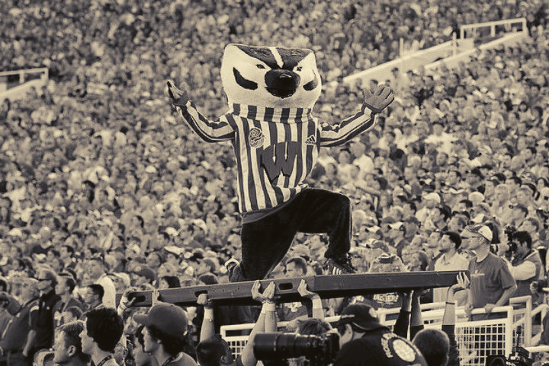
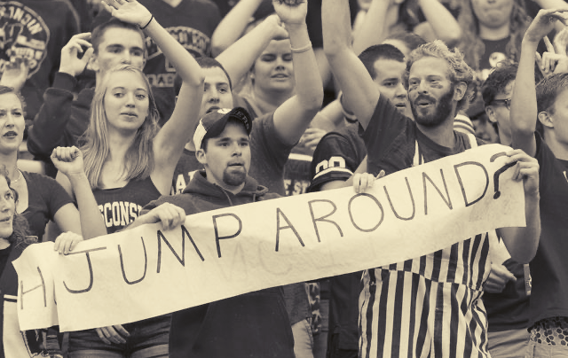
UNIVERSITY OF WISCONSIN FOOTBALL
"JUMP AROUND"
www.sportscareerconsulting.com

Slide 12
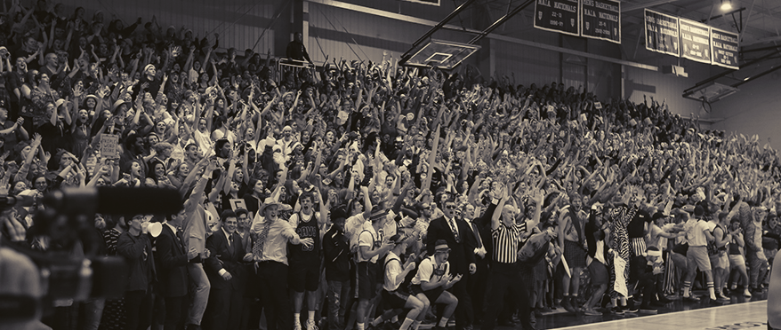
Taylor University Basketball
"SILENT NIGHT GAME"
www.sportscareerconsulting.com

Slide 13
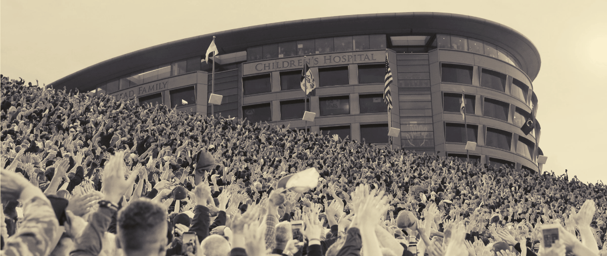
UNIVERSITY OF IOWA FOOTBALL
"HAWKEYE WAVE"
www.sportscareerconsulting.com

Slide 14
Discussion
Questions

Slide 15
GAME DAY TRADITIONS
1) What are game day traditions?
2) How do you think game day traditions impact game attractiveness?
3) How many of the traditions from this presentation are you familiar with?

Slide 16
GAME DAY TRADITIONS
4) Can you think of any other traditions in sports or entertainment not discussed in this presentation or in your textbook?
5) Does your school have any game day traditions?
6) Could you create a new game tradition for a sporting event at your school? How might that impact the fan experience?

